Slide 1
WP4: Exploiting CCI products in MIP experiments
Dirk Notz
Max Planck Institute for Meteorology

Slide 2
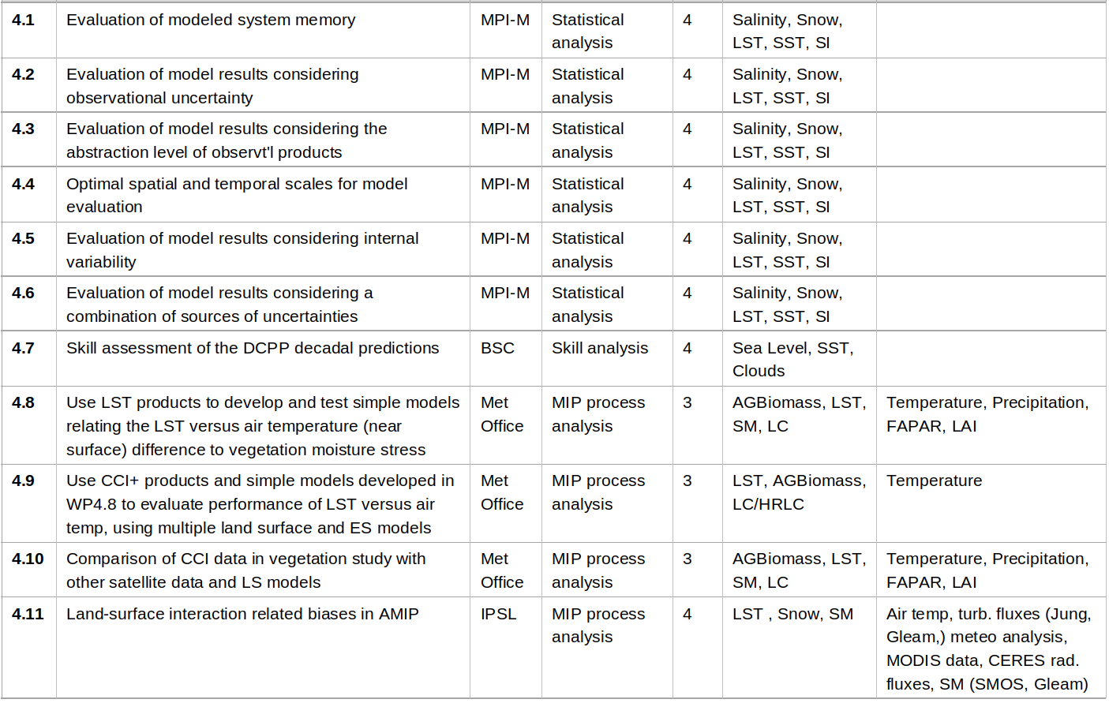
WP4: Exploiting CCI products in MIP experiments

Slide 3
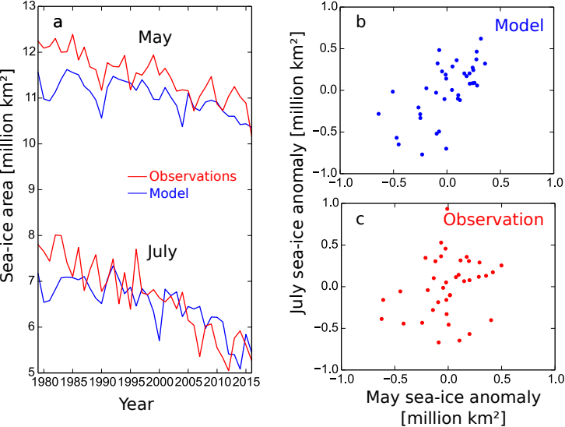
WP4.1 Evaluation of modeled system memory
The issue:
Model simulations are often primarily evaluated regarding their mean state and/or their long-term trend. However, for a reasonable description of reality also the memory of the system must be modeled realistically.
Notz, 2017

Slide 4
WP4.1 Evaluation of modeled system memory
MPI-M work within WP4.1 (4PM)
Examine approaches to estimate memory from simulations and observations
Test approach for limited amount of CCI data
Communicate approach to ESMVal-Tool developers
Notz, 2017

Slide 5
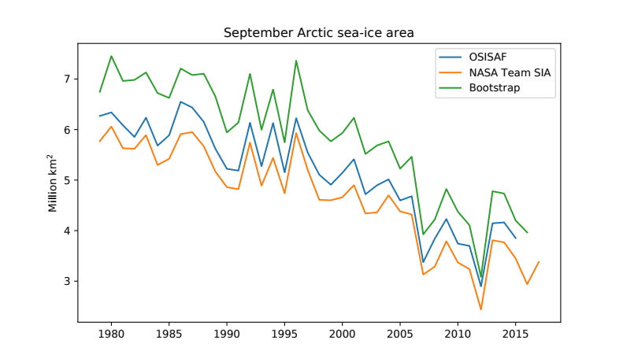
WP4.2 Evaluation of model results considering observational uncertainty
The issue:
Observational uncertainty is often underestimated and neglected in model-evaluation studies. Among others, this hinders robust projection of the future evolution of the climate system.

Slide 6
WP4.2 Evaluation of model results considering observational uncertainty
MPI-M work within WP4.2 (4 PM)
Develop and communicate best practices to report uncertainties of CCI products
Examine methods to consider observational uncertainties in climate research for limited set of CCI variables
Communicate results to ESMVal-Tool developers

Slide 7
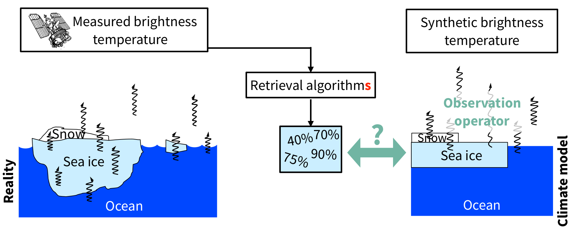
WP4.3 Evaluation of model results considering the abstraction level of observational products
The issue:
Satellite algorithms often have to deal with an incomplete knowledge of important physical properties of the observable, causing substantial observational uncertainty.
Clara Burgard, MPI-M

Slide 8
WP4.3 Evaluation of model results considering the abstraction level of observational products
MPI-M work within WP4.3 (4 PM)
Examine approaches to simulate lower-level observables for limited subset of CCIs
Develop decision tree to identify ideal level of abstraction for model evaluation and model initialisation
Clara Burgard, MPI-M

Slide 9
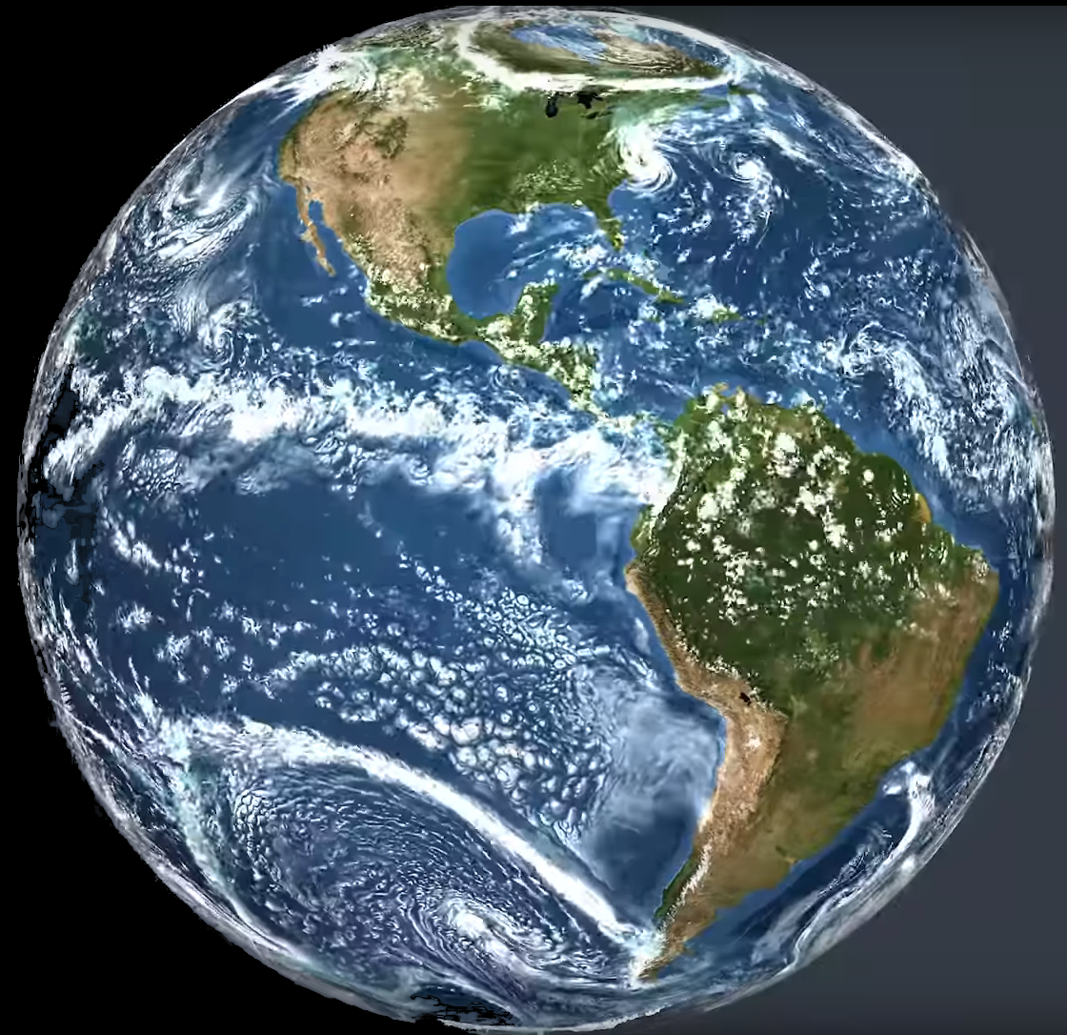
WP4.4 Optimal spatial and temporal scales for model evaluation
The issue:
Observational products and climate models provide information on various time scales and length scales. Observational uncertainty decreases for longer averaging periods and larger spatial scales.
ICON-ESM (MPI for Meteorlogy)

Slide 10
WP4.4 Optimal spatial and temporal scales for model evaluation
MPI-M work within WP4.4 (4 PM)
Establish method to scale uncertainties for temporal and spatial averaging
Examine change in observational uncertainty as a function of averaging period and length scale for limited subset of CCIs
Develop decision tree for best scale to use for a particular purpose
ICON-ESM (MPI for Meteorlogy)

Slide 11
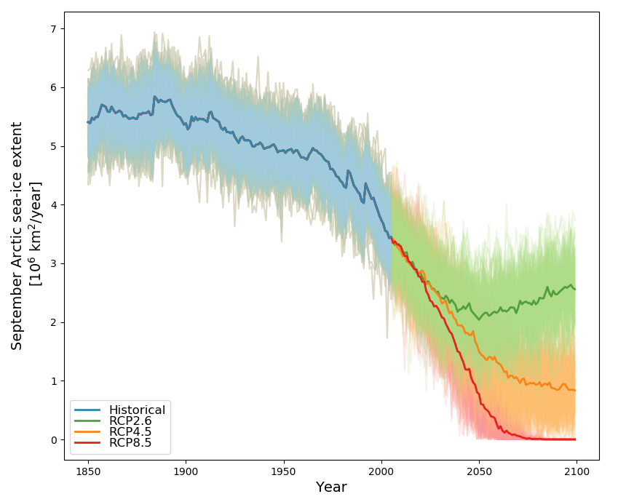
WP4.5 Evaluation of model results considering internal variability
The issue:
Because of internal variability, model simulations cannot be expected to perfectly agree with observations. Taking this into account during model evaluation is further complicated becayse we don‘t know the true internal variability of the system.
Notz, 2017

Slide 12
WP4.5 Evaluation of model results considering internal variability
MPI-M work within WP4.5 (4 PM)
Use a limited subset of CCIs to examine the impact of internal variability on model evaluation
Establish best practices to consider internal variability in model-evaluation studies
Communicate the results to ESMVal-Tool developers
Notz, 2017

Slide 13
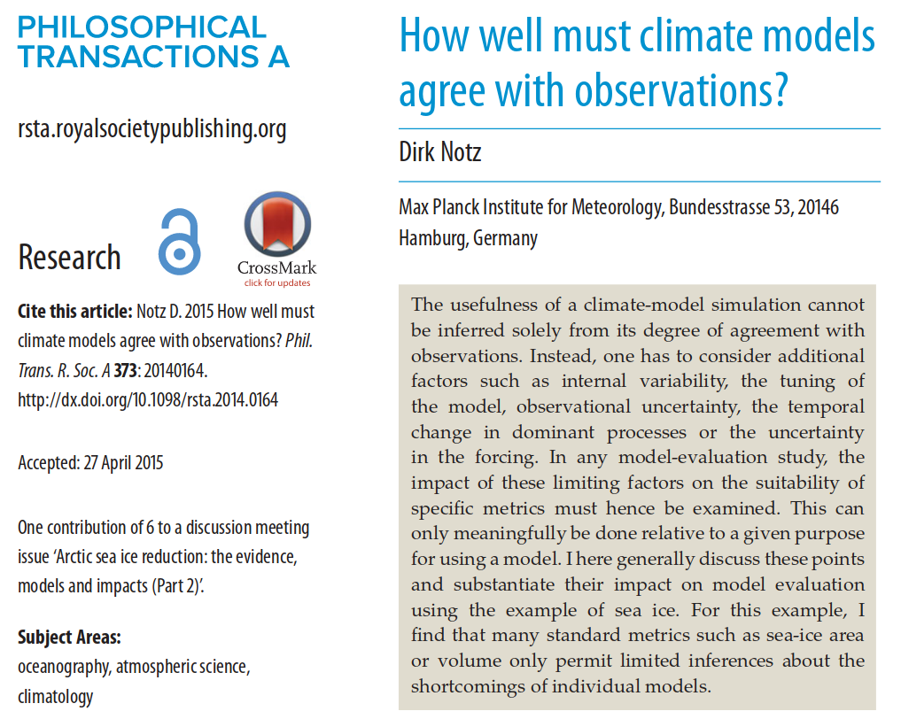
WP4.6 Evaluation of model results considering a combination of sources of uncertainties
MPI-M work within WP4.6 (4 PM)
Examine best practices to evaluate model simulations in the light of the combined impact of these uncertainties
Test these approaches on a limited number of CCIs
Communicate results to ESMVal-Tool developers

Slide 14
WP4.6 Evaluation of model results considering a combination of sources of uncertainties
The Issue:
In most cases, the agreement of a model simulation with an observational record is impacted by the combined uncertainty resulting from internal variability, difference in spatial and temporal scales and observational uncertainty.

