Slide 1
WP5.6: Extension of the CMF Database
A. Benedetti & R. Dragani (ECMWF)

Slide 2
Long-term consistency: a key requirement for climate reanalyses
Inconsistent datasets (➔ typically mutually biased) are problematic to assimilate;
DA schemes assume data are unbiased ➔ we solve a different problem
They make the assimilation inefficient, and the results inaccurate

Slide 3
The Climate Monitoring Facility (CMF)
The CMF was originally conceived as a user-friendly monitoring tool that could provide a first glance into an observed dataset long-term consistency by confronting it with modelled equivalent as step 0 in reanalysis preparation.
Today, the tool is available on-line and can be used to evaluate the CCI ECVs’ climate quality, and promote the CCI data usage.
The evaluation is purely of a qualitative nature (i.e. to identify clearly wrong data values, unrealistic jumps, data gaps, etc…).
The tool is based on a user-friendly web-interface built on a pre-computed database (the so-called CMF Db) that includes an excess of 100 different model fields.
The interface is hosted by C3S (http://apps.ecmwf.int/climate-monitoring/) to increase its visibility and usage

Slide 4
The CMF web-interface:
Selection panel
Plot area
http://apps.ecmwf.int/climate-monitoring/

Slide 5
CMF capability
Data:
Representation of mean quantities and other statistics.
Representation of observation uncertainties (time series of errors)
Plotting (time series of monthly mean area averaged quantities):
Actions, e.g. pan & zoom, reset the plot area.
Multiple selection from a pull-down menu.
Hover cursor to report data values.
Axis control.
Documentation:
General information (e.g. how to use CMF, data disclaimer, Db content, user guide)
Metadata information (e.g. data units, source, version, … , and events - CHARMe)

Slide 6
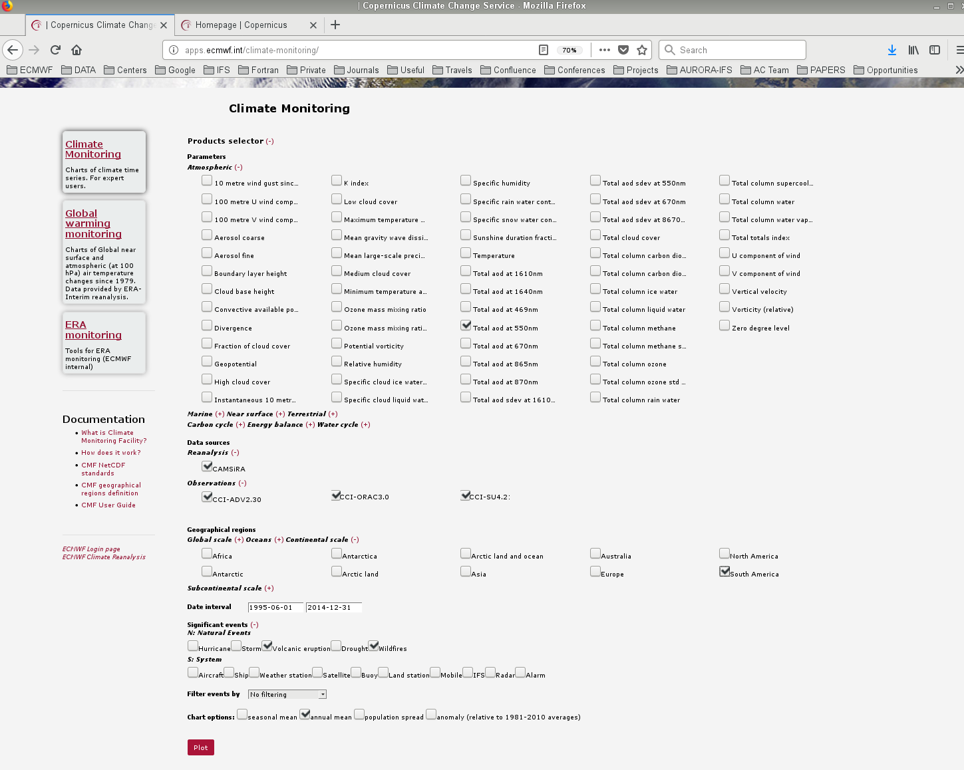
An example using CCI data

Slide 7
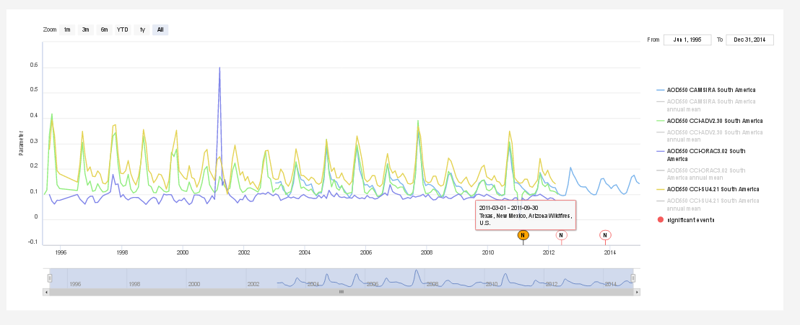
Result of the CMF query:
Users can select or deselect lines by clicking on the legend name

Slide 8
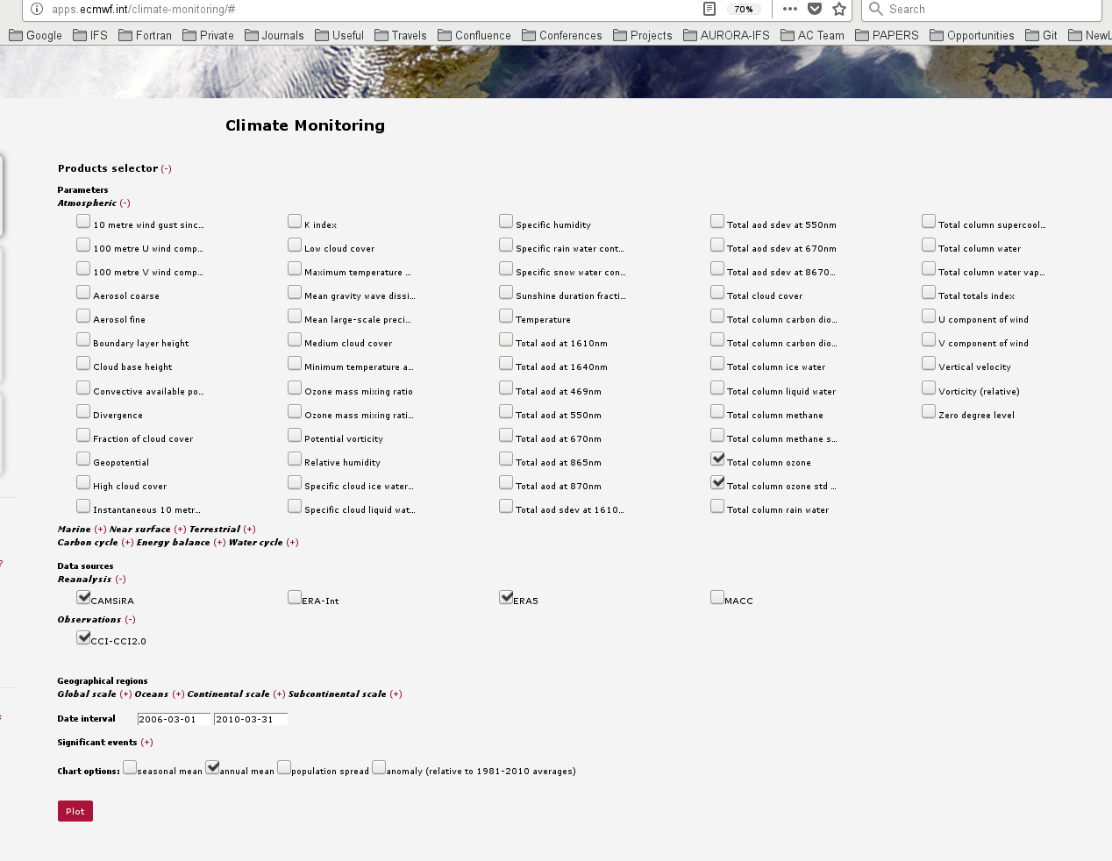
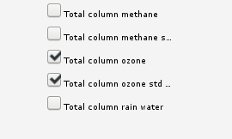
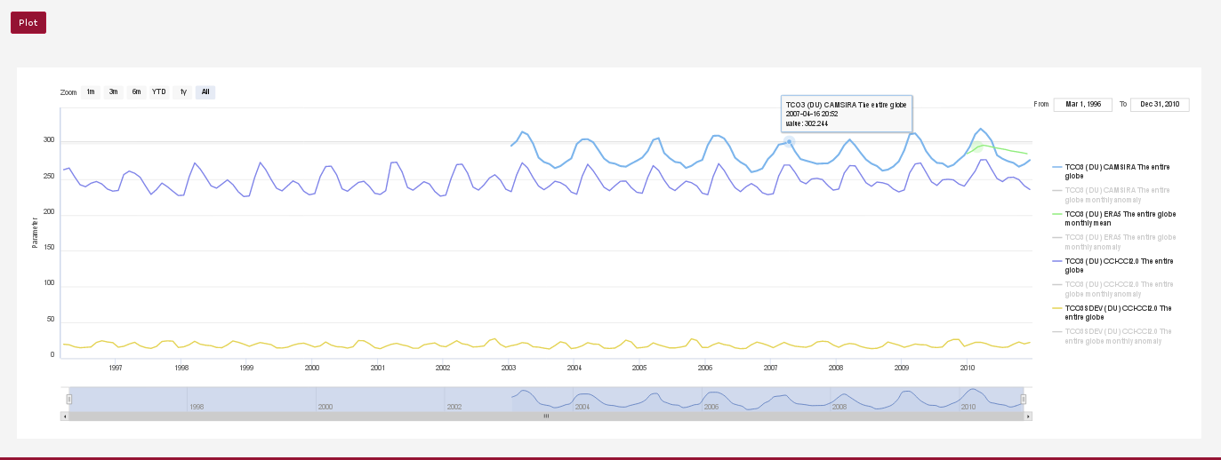
Observation uncertainty in the CMF
Parameter selection

Slide 9
The proposed work
The aim within CCI+ CMUG P1 is to enhance the CMF Db with suitable CCI+ products and corresponding reanalysis products and made these additional fields publicly available to CCI, C3S and wider scientific community (4PM).
The interface is at http://apps.ecmwf.int/climate-monitoring/
Feedbacks to: rossana.dragani@ecmwf.int

