Slide 1
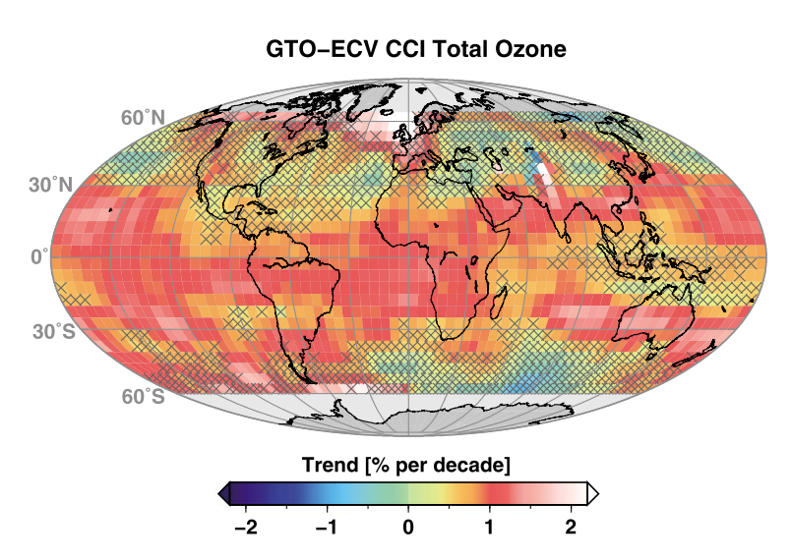








Ozone_cci & Ozone_cci(+) plans
8th CCI CMUG meeting, Exeter, UK, 29-31 October 2018
M. van Weele, KNMI
on behalf of the Ozone_cci(+) consortium

Slide 2
CRG and ozone user needs
Provision of different, consistent data sets derived from individual model studies
  Climate Models (e.g. CMIP6 activity).
  Chemistry-Climate Models (e.g. CCMI).
  Chemical Transport Models.
Use of data products
  In reanalyses (CAMS, ERA5) and for evaluation purposes (assessment of uncertainties),
  as boundary (initial) conditions for climate model simulations,
  in scientific projects (e.g., the EC StratoClim project; project in the EC “Aerosols and Climate” cluster), and
  for outreach and dissemination.
Address inter-consistency between ECV data products in broader way:
  confrontation of multiple ECV parameters to the output of the models operated by the Ozone_cci CRG;
  study possible interlinks between ozone and other ECVs connected by chemical, radiative or dynamical effects.

Slide 3
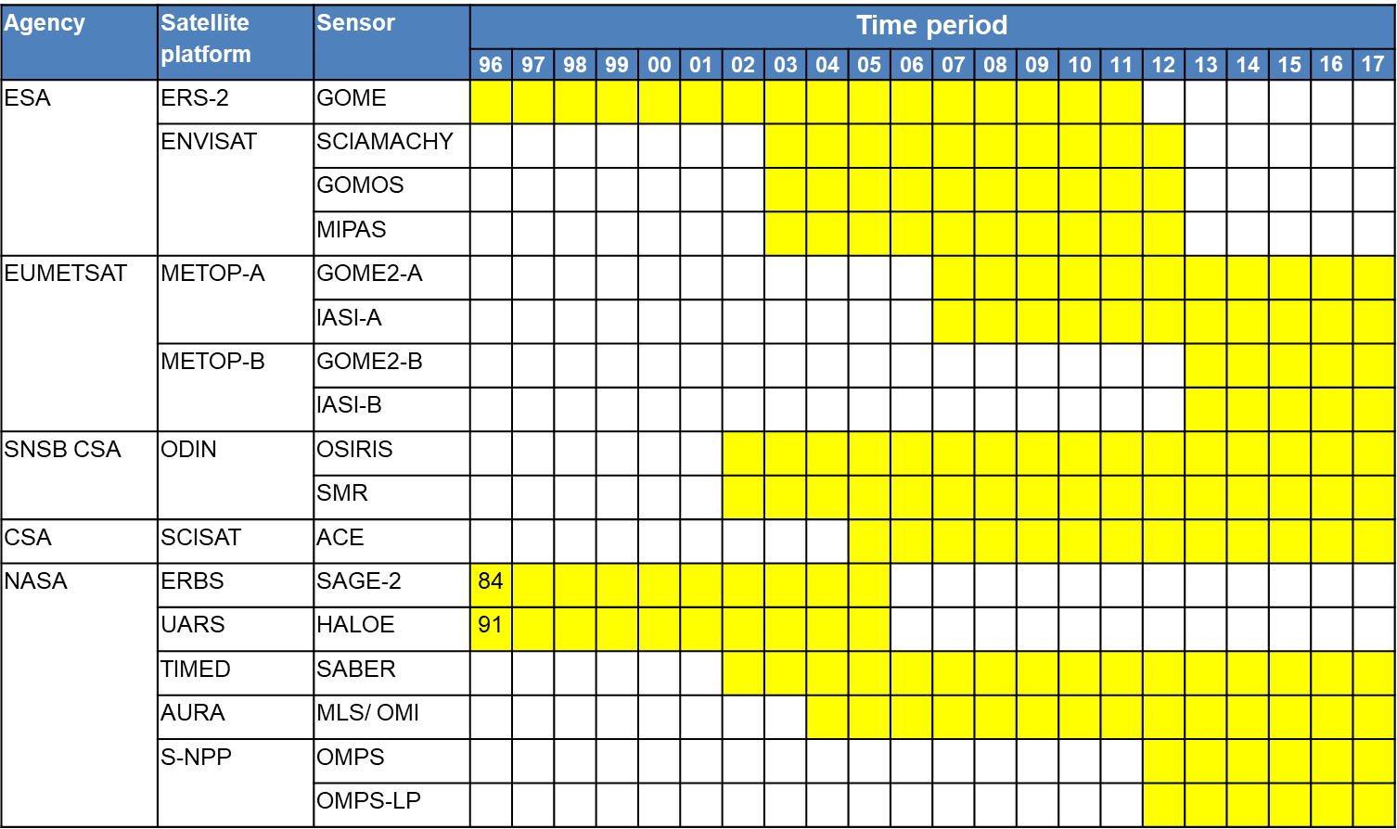
Ozone platforms and sensors
Exploited during CCI Phase-II

Slide 4
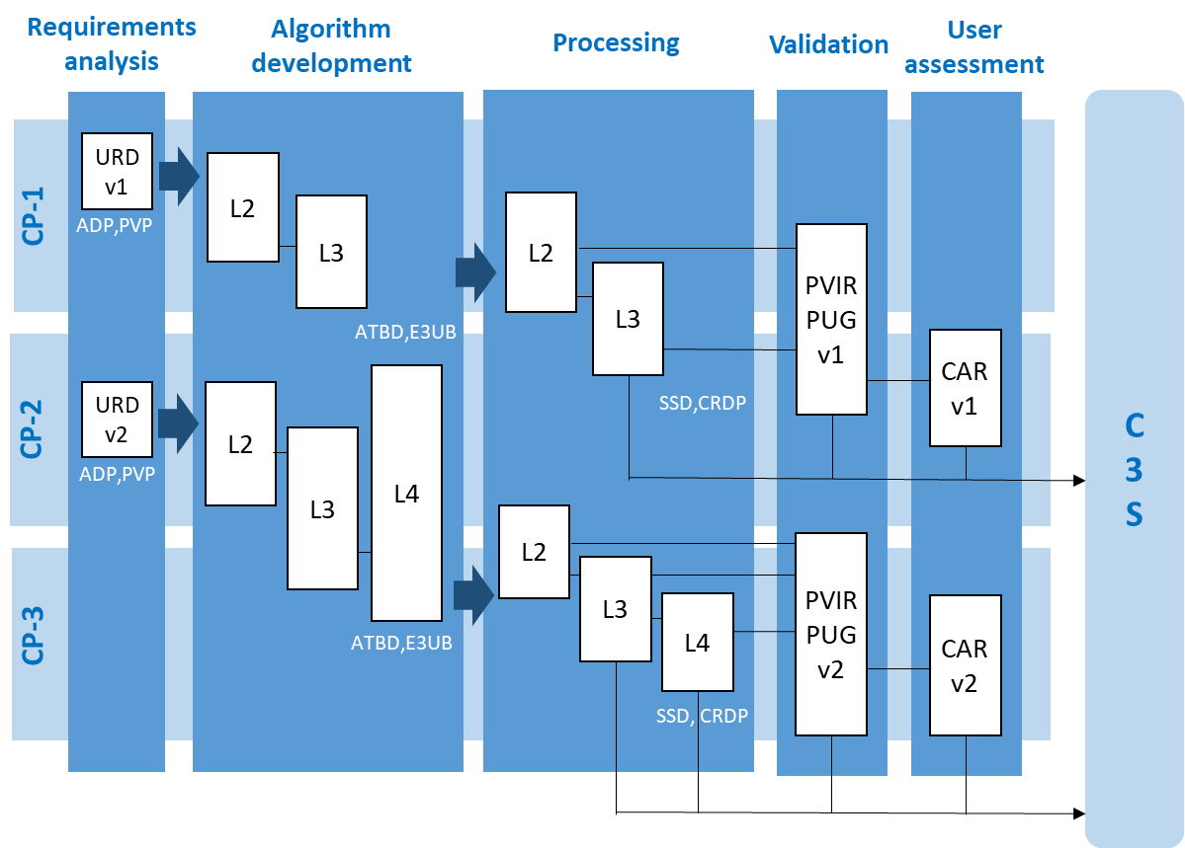
CCI+ at a glance (under ESA review)
Two full cycles of development, processing, validation, user assessment
Synchronisation with C3S planning (reprocessing)

Slide 5
Example of achievement
Included in WMO/UNEP Ozone Assessment 2018
Sofieva et al., ACP, 2017

Slide 6
Feedback CMUG session
Phase I and II
Generated data sets have been used in important papers and e.g. the WMO UNEP ozone assessment 2018
Interaction with CMUG (mostly ECMWF) has been sought and will again be sought on requirements and (newly) provided data records (e.g. S5P)
Cross ECV:
Ozone assimilation is being coupled with aerosol assimilation in CMUG
Stratospheric ozone is a factor for the atmospheric circulation, its changes potentially affecting many ECVs on seasonal to decadal timescales, predominantly in the SH

Slide 7
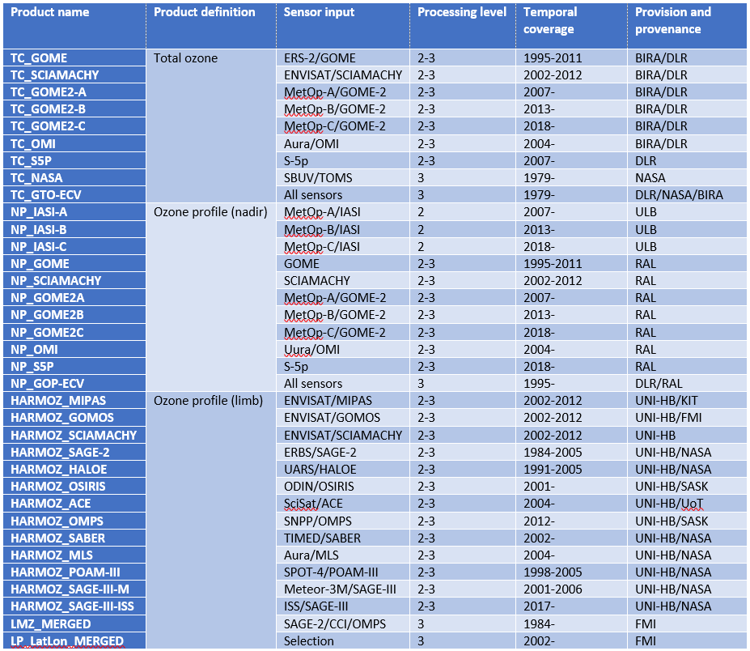
Planned ozone CRDP (CCI+)
Main planned additions (w.r.t. CCI phase-II):
Sentinel-5P
MetOp-C GOME-2 and IASI
SAGE-III on Meteor-3M
SAGE-III on ISS
Merging of GTO-ECV with NASA SBUV/TOMS
Inclusion and tentative extension of Multi-Sensor Reanalysis (MSR) back to 1960
Creation of GOP-ECV (ozone profile merged CDR)

Slide 8
Approach to product development
Make a significant impact on C3S ozone CDRs and services
Progress to matching ozone requirements (GCOS, CMUG, URD)
Gap Analysis
  Input on key gaps requested to users (CRG) and CCI ozone data providers
  Aligned with the C3S Target Requirements and Gap Assessment Report
  5 generic gap types: Gaps in spatiotemporal coverage, in the processing algorithms, in the uncertainty estimates, in the fitness-for-purpose of the CDR and (scientific) knowledge gaps
  Remedies, provided by the data providers and reviewed by CRG, with Impact assessment, estimated effort, required expertise, and risk register

Slide 9
Approach to product development
Key requirements identified as drivers for new product specification and development in CCI+
  Extension of existing CDRs forward in time → inclusion of new sensors (Sentinel-5P, Metop-C, S-NPP, SAGE-III, Altius..)
  Extension of existing CDRs backward in time → merging of CCI Phase-2 data sets with historical NASA; use of ground-based data as input in L4 products
  Create European merged ozone profile CDR (nadir)
  Improve accuracy of ozone profile products in LT and UTLS
  Improve uncertainty characterization (incl. their validation)

Slide 10
Improved characterization of uncertainties
Improved validation approaches
  Better coverage of high altitudes through inclusion of reference ground-based microwave sensors
  Tentative use of trajectories to improve L3 product validation
  Assessment of product relevance for trend studies
Verification of ex-ante uncertainties
  Ground-satellite differences and their statistics will be confronted with the combined ex-ante measurement uncertainties
  Separation between random and systematic effects
  Assessment of co-location mismatch / sampling errors
  Use of Observing System Simulators to perform full uncertainty budget closure

Slide 11
Next meetings
ESA ATMOS 2018 (26-29 Nov 2018)
CCI co-location meeting (Spring 2019)
ESA Living Planet Symposium (13-17 May 2019)

