Slide 1
DROUGHT MONITORING
Suhyb Salama, Rogier van der Velde, University of Twente

Slide 2
Content
In the first part of the lecture you will be introduced to the main physical processes of water and energy cycles and how they interrelate to each others and to drought events.
In the second part we will focus on agriculture drought, introducing thereby soil moisture quantification, processes and monitoring techniques.
The last part of the lecture will deal with remote sensing of the water cycle and how it is used to monitor agriculture drought.

Slide 3
Learning outcomes
Understand the main physical processes of water and energy cycles and how they interrelate to each others and to drought events.
Understand soil moisture quantification, processes and monitoring techniques.
Visualise soil moisture
Prepare you to use climate data records of soil moisture to monitor agriculture drought.

Slide 4
What is drought?
Meteorological drought
A shortage of water caused by evapotranspiration exceeding rainfall over a prolonged period of time

Slide 5
What is drought?
Meteorological drought
A shortage of water as a result of more Evapotranspiration than Rainfall over a prolonged period of time
Agricultural drought:
A severe shortage of available (soil) water causing damage to crops (and nature)

Slide 6
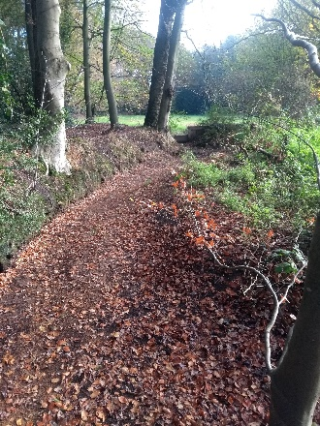
What is drought?
Meteorological drought
A shortage of water as a result of more Evapotranspiration than Rainfall over a prolonged period of time
Agricultural drought:
A severe shortage of (soil) water causing damage to agricultural crop (and nature)
Hydrological drought:
A shortage of water in catchments leading to a depletion of groundwater tables a reduction in streamflow

Slide 7
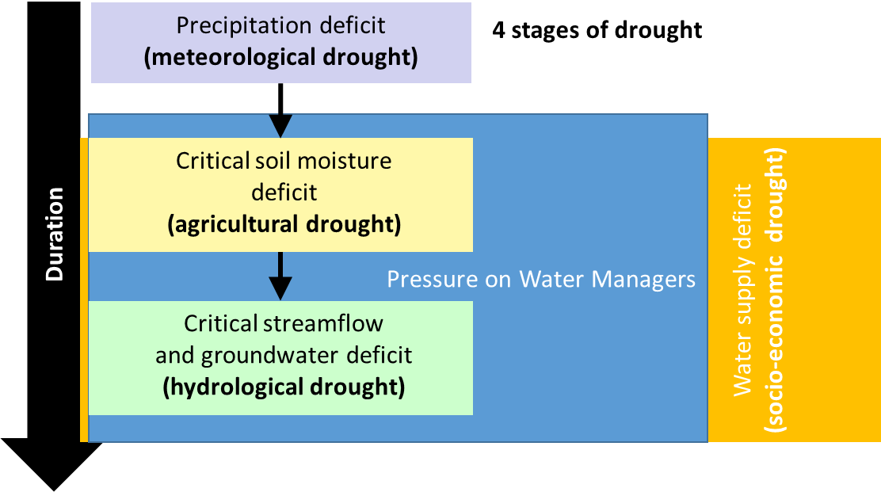
What is Drought?
Drought may be defined as the lack of water of a certain location in a certain period compared to a climatic average
Adapted from Wilhite & Glantz, 1985

Slide 8
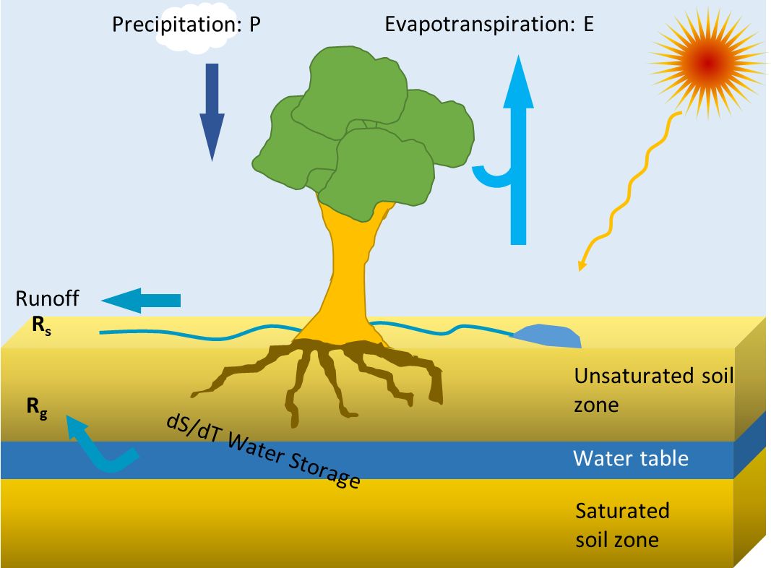
Earth’s Water Balance
𝑑𝑆/𝑑𝑡=𝑃−𝐸−𝑅_𝑠−𝑅_𝑔
The change in water storage = Precipitation – Evapotranspiration – Runoff

Slide 9
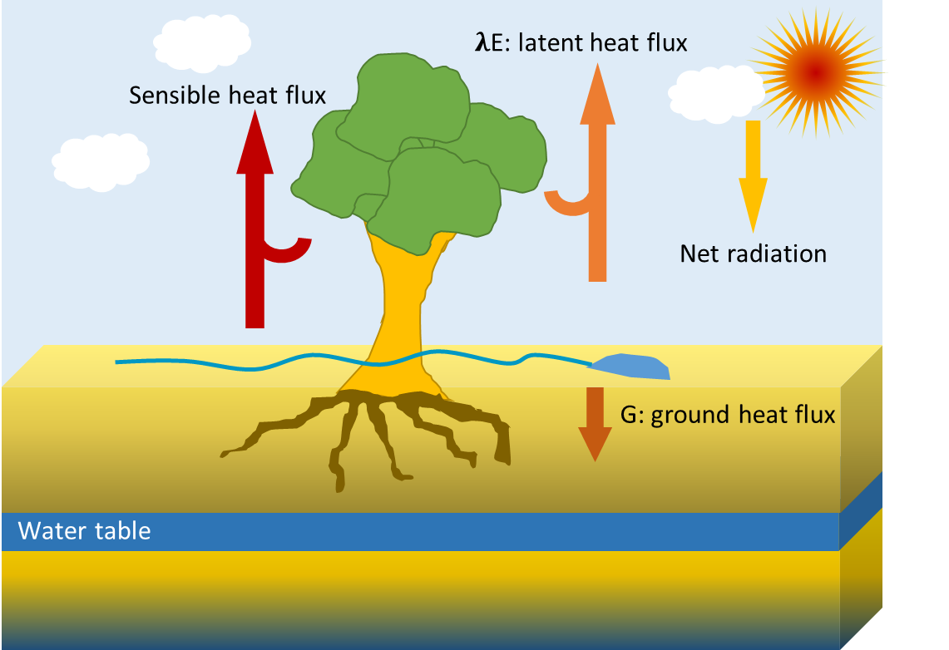
Earth’s Energy Balance
change of energy in Soil-Vegetation-Atmosphere system
The change in energy = Net radiation – Latent heat – Sensible heat – Ground heat fluxes
$$C\frac{dT}{dt}=R_{n}−λE−SH−G$$
Units: energy basis

Slide 10
Coupling Water to Energy Balances
$$\frac{dS}{dt}=P−E−R_{s}−R_{g}$$
$$C\frac{dT}{dt}=R_{n}−λE−SH−G$$
They are linked through the evapotranspiration term, where 𝜆 is the latent heat of vaporisation, where $λ$ is the latent heat of vaporisation ≈ 2.5 106 J kg-1 ≈ 0.7 kWh at 20 oC.

Slide 11
Water & Energy Balance in the Wet Limit

Slide 12
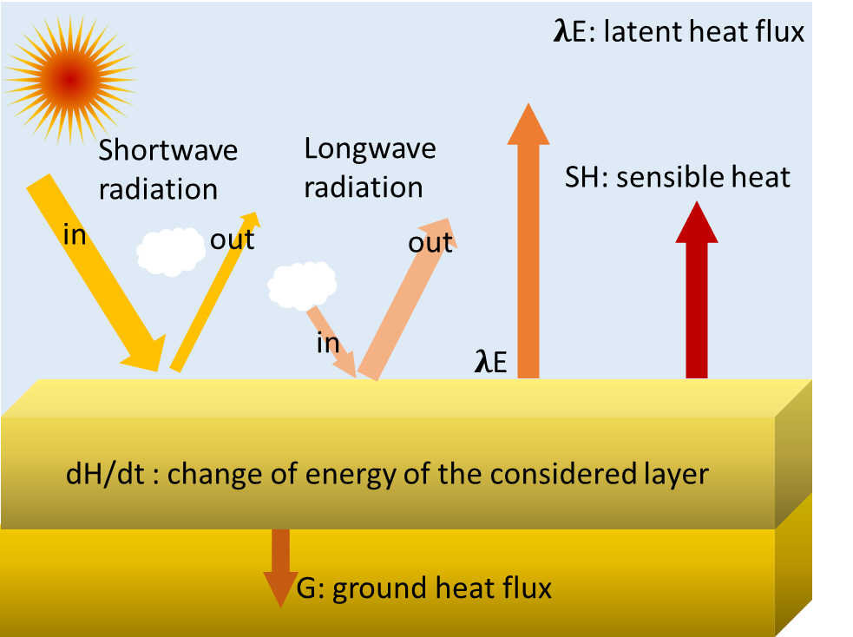
Earth’s Energy Balance
Where
In the energy limited case:
Evapotranspiration is regarded to be ‘potential’ under the prevailing weather conditions, and is often calculated with a ‘combination’ method as the sum of a radiation and a vapor deficit term.
$$C\frac{dT}{dt}=R_{n}−λE−SH−G$$
$$R_{n}=SW_{in}−SW_{out}+LW_{in}−LW_{out}$$

Slide 13
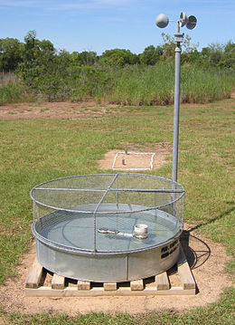
Evapotranspiration under energy limiting conditions
Penman (1948) for well-watered short grass,
$$λE=\frac{s}{s+γ}\left(\left(R_{n}−G\right)+f\left(u\right)\left(e_{s}−e_{s}\right)\right)$$
https://nl.wikipedia.org/wiki/Evaporatie

Slide 14
Evapotranspiration under energy limiting conditions
Penman (1948) for well-watered short grass,
Priestley & Taylor (1972),
$$λE=\frac{s}{s+γ}\left(\left(R_{n}−G\right)+f\left(u\right)\left(e_{s}−e_{s}\right)\right)$$
$$λE=α\frac{s}{s+γ}\left(R_{n}−G\right)$$
with α ≈ 1.2 – 1.3
https://nl.wikipedia.org/wiki/Evaporatie

Slide 15
Evapotranspiration under energy limiting conditions
Penman (1948) for well-watered short grass,
Priestley & Taylor (1972),
Makkink (1957),
$$λE=\frac{s}{s+γ}\left(\left(R_{n}−G\right)+f\left(u\right)\left(e_{s}−e_{s}\right)\right)$$
$$λE=α\frac{s}{s+γ}\left(R_{n}−G\right)$$
with α ≈ 1.2 – 1.3
https://nl.wikipedia.org/wiki/Evaporatie
$$λE=C\frac{s}{s+γ}{SW}_{in}$$
with C = 0.65 and recognising that
$$R_{n}≈{0.5 SW}_{in}$$

Slide 16
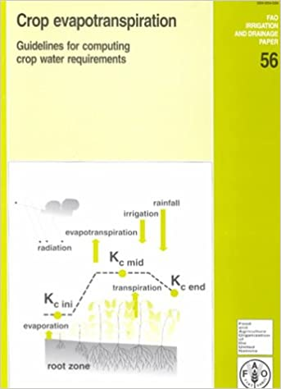
Evapotranspiration under energy limiting conditions
Combination methods, such as Penman, Priestley & Taylor, Makkink, all provide the potential daily evapotranspiration of a well-watered short grass surface (reference surface, Eref).
The crop evapotranspiration is calculated by multiplication a factor dependent on the crop type and the crop growth stage, known as the FAO: crop factor approach.
More information can be found here http://www.fao.org/3/x0490e/x0490e00.htm

Slide 17
Water & Energy Balance in the Wet Limit

Slide 18
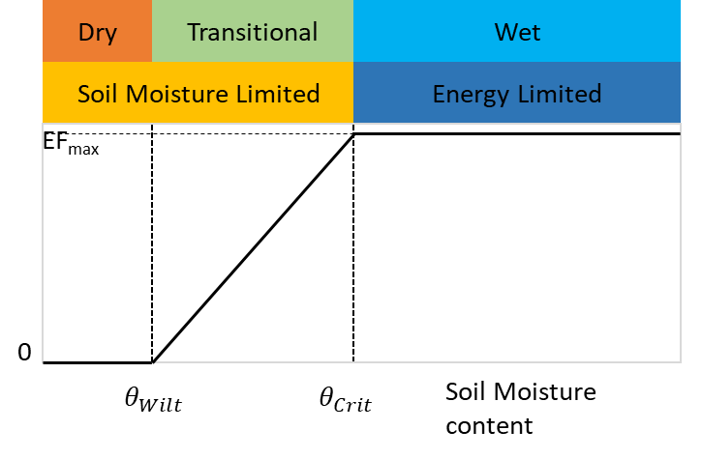
Soil Moisture Regimes
Three climate/soil moisture regimes can be defined, related to the impact of soil moisture on evapotranspiration variability.
Wet (𝜃>𝜃_𝐶𝑟𝑖𝑡) and dry (𝜃<𝜃_𝑊𝑖𝑙𝑡) climate regimes, where soil moisture does not impact evapotranspiration variability.
Transitional climate regime (𝜃_𝑊𝑖𝑙𝑡≤𝜃≤𝜃_𝐶𝑟𝑖𝑡), where soil moisture strongly constrains evapotranspiration variability.
Notes:
Two main evapotranspiration regimes, characterized with the evaporative fraction (𝐸𝐹=𝜆𝐸/𝑅_𝑛) can be defined: a soil moisture-limited and an energy limited evapotranspiration regime.
In the energy-limited evapotranspiration regime, corresponding to values of soil moisture lying above a given critical soil moisture value 𝜃_𝑐𝑟𝑖𝑡, evaporative fraction is independent of the soil moisture content.
Below 𝜃_𝑐𝑟𝑖𝑡, soil moisture content provides a first-order constraint on evapotranspiration (soil moisture limited evapotranspiration regime)
The other important threshold is the wilting point 𝜃_𝑊𝑖𝑙𝑡 under which no evapotranspiration takes place anymore

Slide 19
Soil Matrix
The soil matrix constitutes of:
Solid material
Air
Water
Water resides in the soil matrix as a film around the soil particles.
Water in the soil are subject to two forces :
Soil matrix
Gravity
The size distribution and type of solid material determines the water holding capacity of the soil matrix

Slide 20
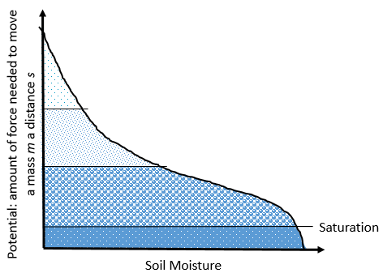
Soil water retention curve
Physically the retention curve describes how strong water is bound to the soil matrix. In other words, the retention curve characterizes capacity of the soil to hold water within its matrix.
1- Air entry: air starts entering the soil matrix.
1
All pores filled with water

Slide 21
Soil water retention curve
Physically the retention curve describes how strong water is bound to the soil matrix. In other words, the retention curve characterizes capacity of the soil to hold water within its matrix.
1- Air entry: air starts entering the soil matrix.
Field capacity: water in the soil is in equilibrium with gravity.
2
Large pores empty
1
All pores filled with water

Slide 22
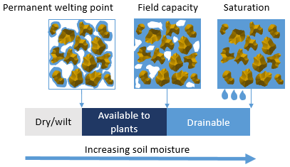
Soil water retention curve
Physically the retention curve describes how strong water is bound to the soil matrix. In other words, the retention curve characterizes capacity of the soil to hold water within its matrix.
Bund water
1- Air entry: air starts entering the soil matrix.
Field capacity: water in the soil is in equilibrium with gravity.
Wilting point: plant roots cannot take up water.
3
Small pores empty
2
Large pores empty
1
All pores filled with water

Slide 23
Drought Monitoring
More than half of the terrestrial earth is susceptible to drought each year. The onset and impact of droughts is highly variable over space and time and usually occur over large areas.
Because drought is a recurring phenomenon and common for all climate zones, it is difficult to predict and monitor drought using conventional approaches over large areas.
Drought early warning and monitoring are usually carried out using drought indicators that are functions of: rainfall, vegetation conditions, soil moisture, groundwater and evapotranspiration.
The success of drought preparedness and mitigation depends, to a large extent, upon timely information about drought onset, progress and areal extent.

Slide 24
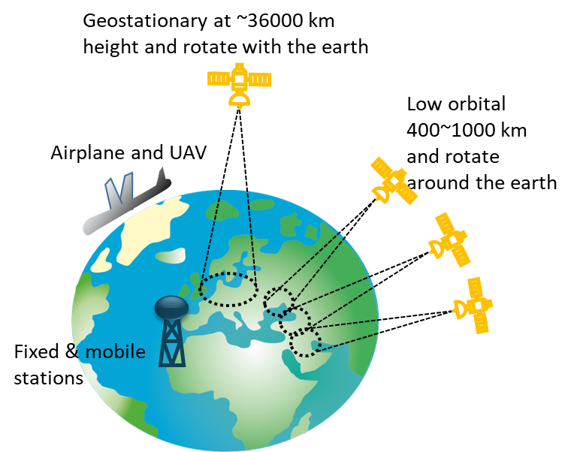
What is Remote Sensing?
Satellite remote sensing enables continuous drought monitoring over a variety of spatial and temporal scales that can help to generate timely information on drought onset, progress, and areal extent.
Remote sensors collect information on the target without physical touch i.e. from a distance, on any platform:
hand held, mobile (phone) and/or fixed station
UAV and aircraft
Satellites: orbital or geostationary.

Slide 25
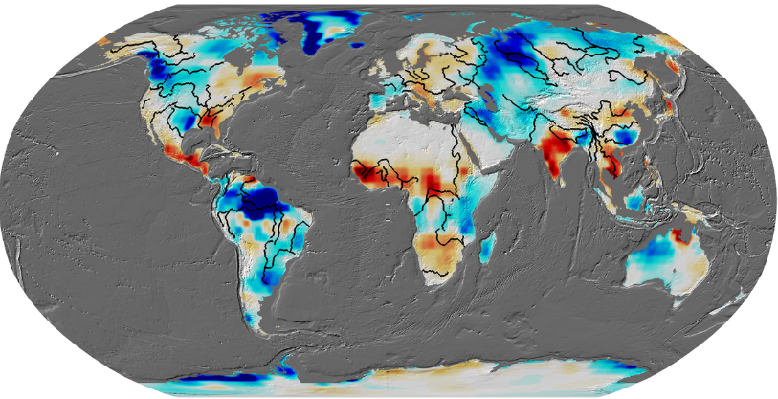
How it Measures?
Radiation- based: detecting the energy that is reflected from the Earth surface.
Gravity-based: detecting gravity variations of the Earth.
Monthly Mass Grid from GRACE
Source: https://grace.jpl.nasa.gov/data/

Slide 26
Types

Slide 27
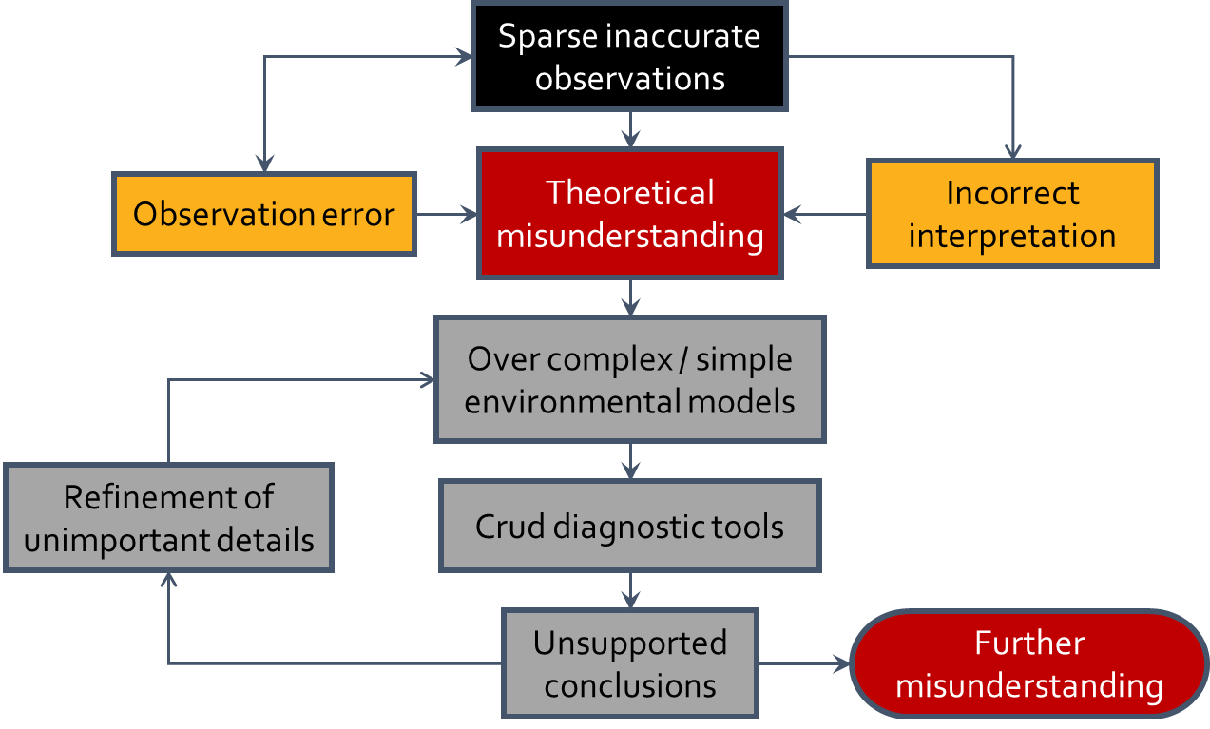
Why Remote Sensing?

Slide 28
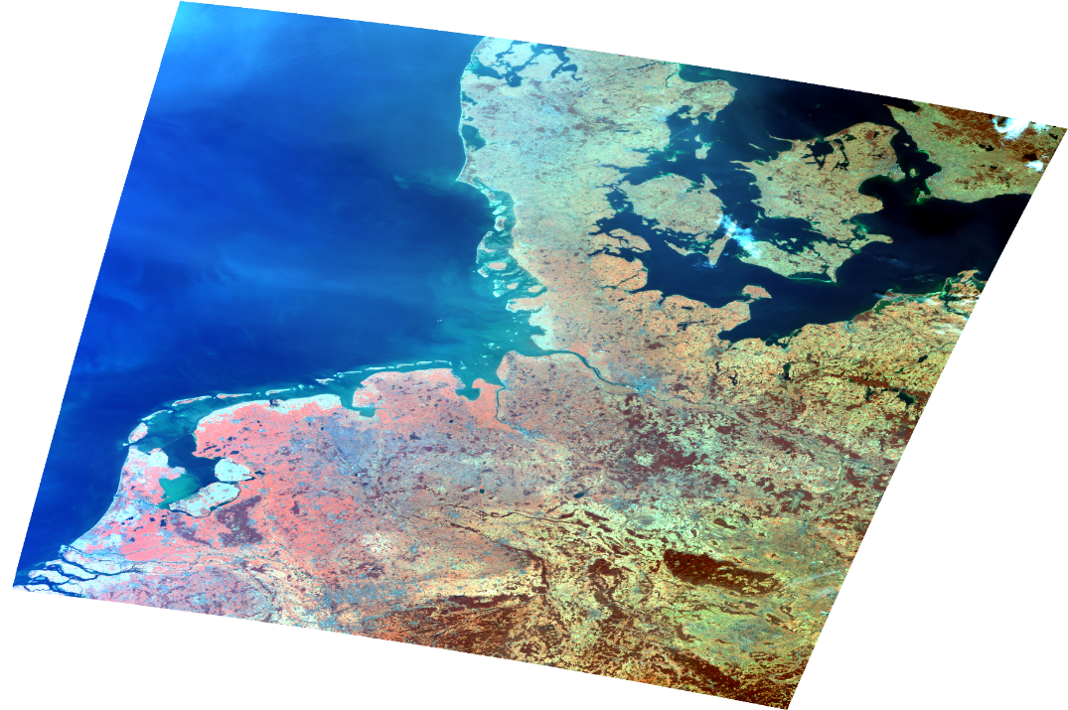
Why Remote Sensing?
Remote sensing technology (in particular Earth observation) provides dense data at unprecedented spatial and temporal resolutions solving :
Data sparsity
Error through the possibility of filtering quality data
Synoptic coverage
All components of water and energy cycles can be estimated from remote sensing data!
ESA Sentinel 3 OLCI

Slide 29
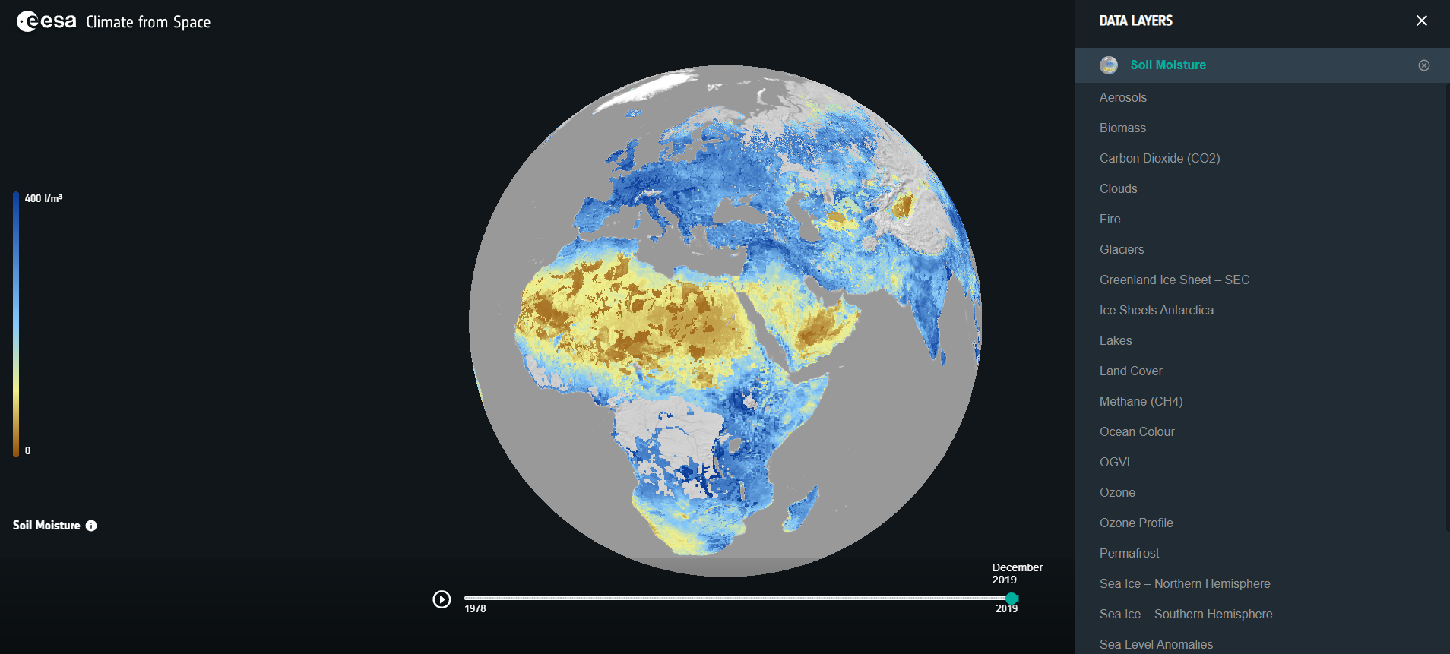
Exploring satellite products of soil moisture
Go to: https://cfs.climate.esa.int/
Click on the tab data layers and choose Soil Moisture

Slide 30
Drought monitoring: indicator & indices
World Meteorological Organization (2016): Handbook of Drought Indicators and Indices.
A total 50 indices & indicators are recognised:
23 meteorological
4 soil moisture
8 hydrological
10 remote sensing
5 composite or modelled
https://www.droughtmanagement.info/find/guidelines-tools/handbook-drought-indicators-and-indices/

Slide 31
Conclusion
Drought is the problem of a long term exceedance of the demand of water in comparison to its supply.
Rainfall and Evapotranspiration represent important parts of the supply and demand aspects of water from meteorological, agricultural and hydrological perspectives.
Soil moisture and its availability are important indicators determining the severity drought stress.
Various drought monitoring initiatives are ongoing and its products are readily available.

Slide 32
Further reading
World Meteorological Organization (WMO) and Global Water Partnership (GWP), 2016: Handbook of Drought Indicators and Indices (M. Svoboda and B.A. Fuchs). Integrated Drought Management Programme (IDMP), Integrated Drought Management Tools and Guidelines Series 2. Geneva. https://www.drought.gov/drought/sites/drought.gov.drought/files/GWP_Handbook_of_Drought_Indicators_and_Indices_2016.pdf
Guttman, N. B., 1999: Accepting the Standardized Precipitation Index: A calculation algorithm. J. Amer. Water Resour. Assoc.., 35(2), 311-322, https://drought.unl.edu/archive/Documents/NDMC/Workshops/136/Ref/SPI_Guttman.pdf.
Seneviratne, S.I., Corti, T., Davin, E.L., Hirschi, M., Jaeger, E.B., Lehner, I., Orlowsky, B., Teuling, A.J., 2010: Investigating soil moisture–climate interactions in a changing climate. Earth-Science Reviews 99 (2010) 125–161. https://www.sciencedirect.com/science/article/pii/S0012825210000139.
Wilhite, D.A., and Glantz, M.H., 1985: Understanding the drought phenomenon: The role definitions, Water International, 10(3), 111-120, doi: 10.1080/02508068508686328. https://www.researchgate.net/publication/240371212_Understanding_the_Drought_Phenomenon_The_Role_of_Definitions

Slide 33
Reading assignment
From the references in the Further readings slide,
1. Write an analytical summary on remote sensing and soil moisture indices and discuss how can we establish a remotes sensing index that solely uses soil moisture, and
2. Present your summary in an assay with no more than 2000 words.

Slide 34
References
Makkink, G.F., 1957: Tersting the Penman formula, by means of lysimeters, Journal of the Institution of Water Engineers, 11, 277-288.
Penman, H.L., 1948: Natural evaporation from open water, bare soil and grass, Proceeding of the Royal Society: Series A, 193, 120-145.
Priestley, C.H.B., and Taylor, R.J., 1972: On the assessment of the surfaces heat flux and evaporation using large scale parameter, Monthly Weather Review, 100, 81-92.

Slide 35
Additional explanation
Water content and redistribution are a function of soil pore space and pore-size distribution, which are governed by texture and structure.
Soil with large total water holding capacity (largest pore space ) does not describe how much water is available to plants, or how freely water drains in soil.
These processes are governed by potential energy. Water is stored and redistributed within soil in response to differences in potential energy.
Potential energy is the amount of force needed to move a mass m a distance s: ΔΨ=−𝐹/𝑚 ΔS , amount of work per mass.

Slide 36
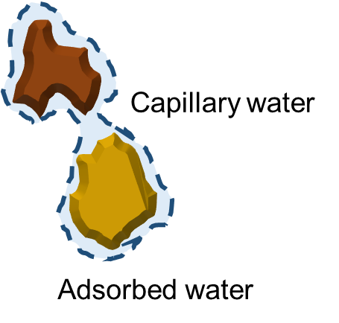
Water Soil Dynamics
Forces acting on soil water (in the vadose zone) are:
Capillary forces
Adsorptive forces (adhesion of water to solid soil surfaces)
Gravitational forces
Drag or shear forces (at soil surface-water interface)

Slide 37
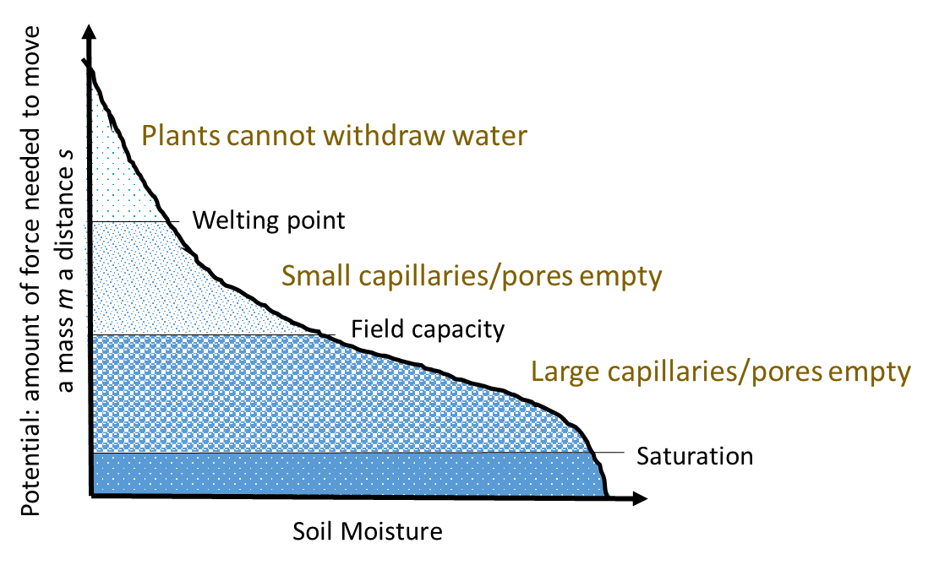
Retention Curve
Physically the retention curve describe how strong water is bound to the soil matrix. In other words the retention curve characterises capacity of the soil to hold water within its matrix.

Slide 38
ESA COMMUNICATION
corporatebranding@esa.int

