Slide 1

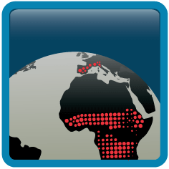


Summary Terrestrial ECV’s
Alexander Loew, Silvia Kloster
Max-Planck-Institute for Meteorology

Slide 3

Loew et al., 2013

Slide 4

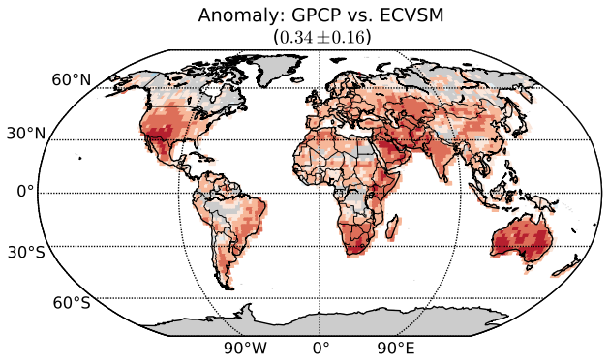

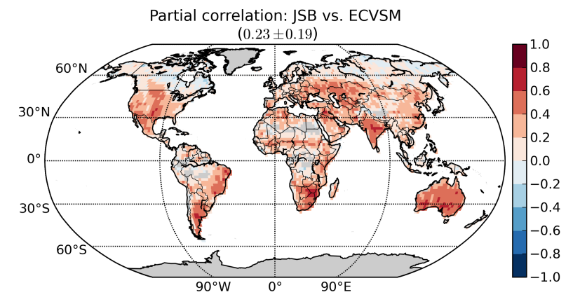
CCI - SM as a good proxy for soil moisture & rainfall dynamics
Soil moisture vs.
precipitation anomalies
„ECV_SM a good proxy for precipitation anomalies“
MPI-ESM soil moisture
vs. ECV_SM¹
„ECV_SM good proxy for global SM dynamics“
¹precipitation impact removed
Loew et al., 2013
Notes:
CCI sm partial correlation: Figure shows the correlation of model and ECV_SM soil moisture anomalies AFTER having removed a joint forcing of precipitation ➔ even, when effect of precipitation is removed, ECV_SM and JSBACH simulations compare well in large parts of the globe. Regions with lower agreement are
A) dense forested areas / snow influenced areas → CCI not sensitive
B) some other areas, where one can try to learn from the differences for the model
2) Anomalies were calculated on monthly timescale by removing mean seasonality

Slide 5
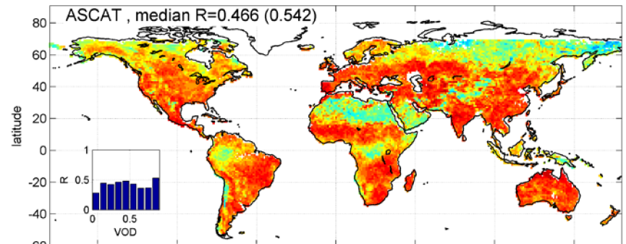
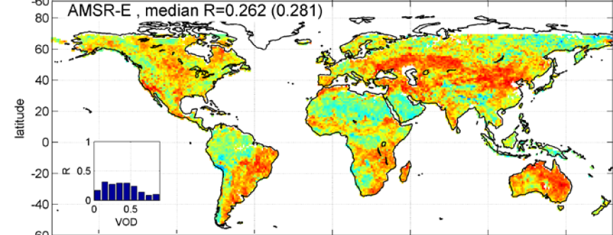
Soil moisture as a raingauge
Correlation between 5-day precipitation estimates from soil moisture and GPCC reference precipitation
Brocca et al., 2014, JGR

Slide 6
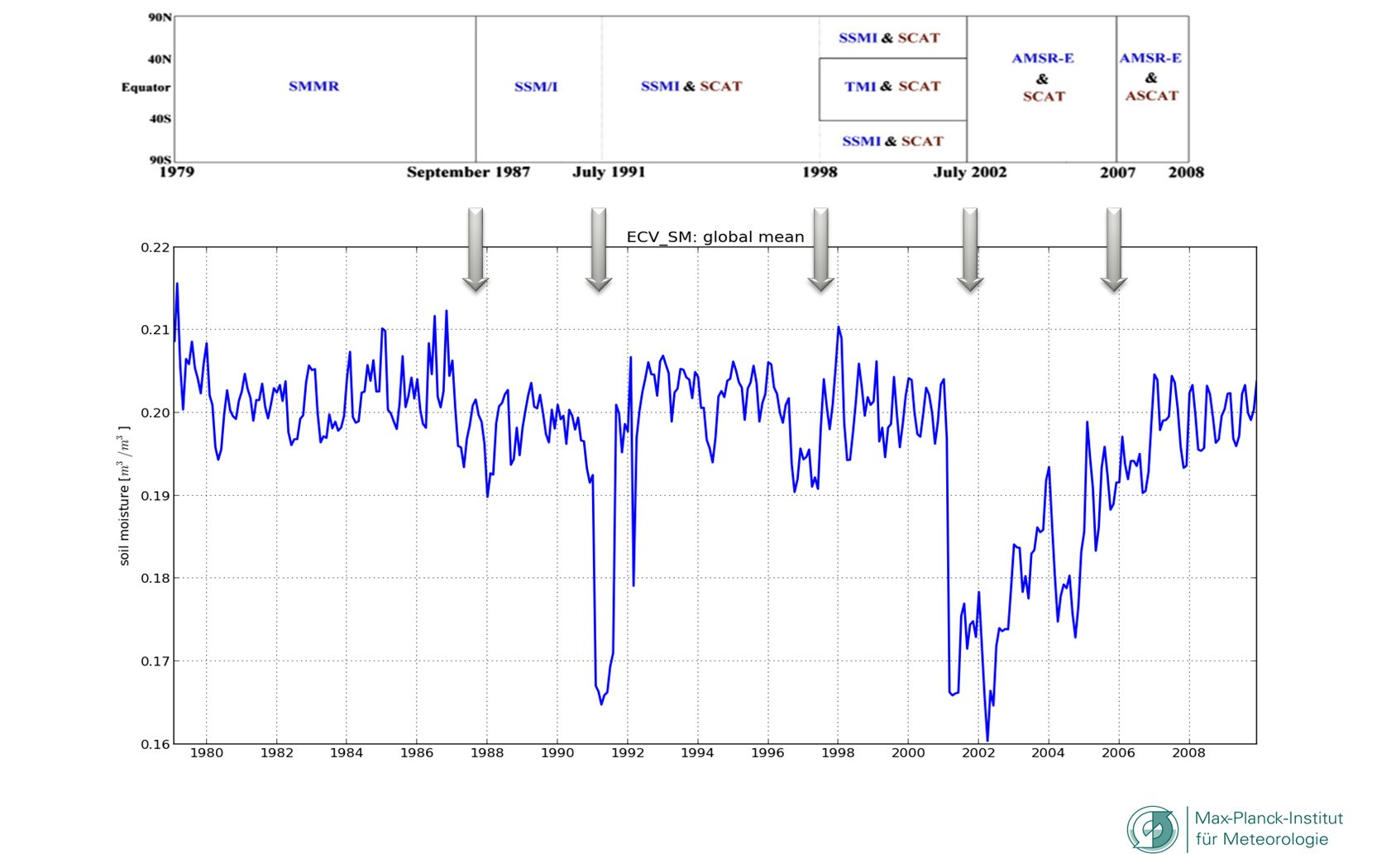
S O L V E D !
Effect of sampling bias on global mean soil moisture fields
Communication to modellers matters!

Slide 7
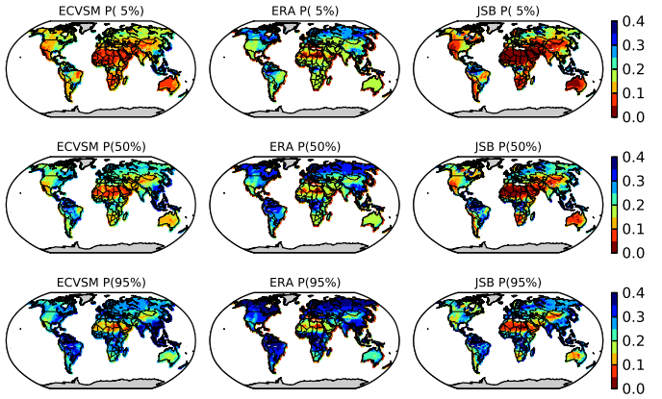
Suitability for SM dynamics?
Is CCI SM suitable to evaluate the general soil moisture dynamics of an ESM?

Slide 9
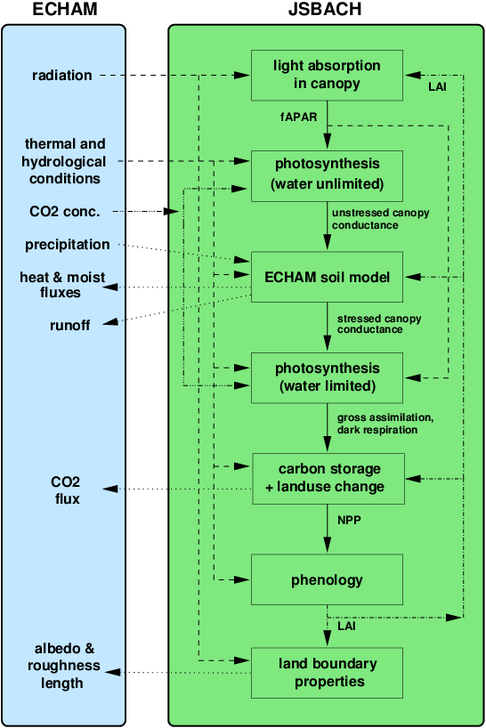
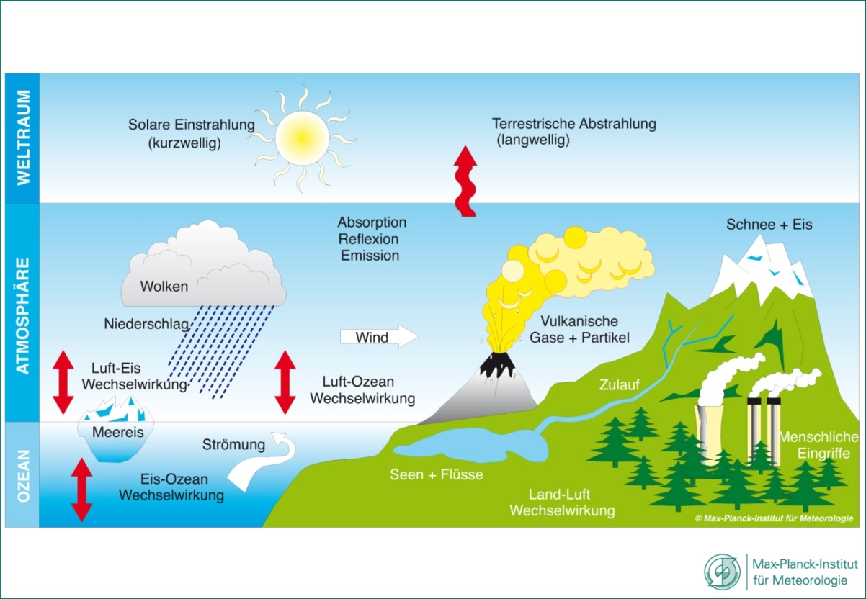
MPI-ESM:JSBACH

Slide 10
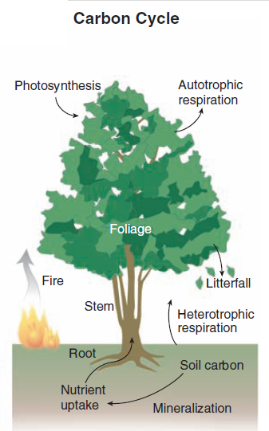
From Burned area to fire emissions
3
* Combustion Completeness
CO,
NO2
HCHO
…
Burned area
[m²/year]
Fuel Load
[gC/m²]
Carbon Emissions [gC/(m²year)]
*Mortality
Vegetation model
Carbon Emissions
JSBACH FIRE
Algorithm
BA satellites
A&B,
SPITFIRE
ESA CCI FIRE
(GFED)
1
(Arora and Boer, 2005)
(Thonicke et al 2001)
JSBACH
Carbon Emissions
GFEDv3
Fract. Burned Tree
2
CCI LC
(GFED)
(Bonnan et al., 2001)
(van der Werf et al, 2010)

Slide 11
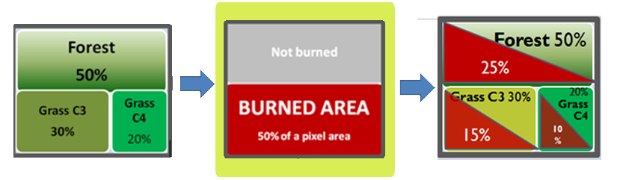
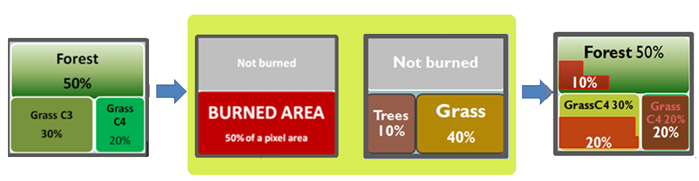
Integration Pathway: Burned Area in JSBACH
A
Equal distribution of burned fraction
grid cell burned
grid cell
GFED
1.87°
“Simple approach”
1.87°
B
Observed fraction of burned trees versus burned grass
grid cell burned
grid cell
GFED
1.87°
1.87°
Notes:
How to implement burned area into JSBACH
Without any information what vegetation burned the burned area is equally distributed among the available PFT within a grid box
GFED (and so will CCI fire) provides in addition the information on how much of the observed burned area can be attributed to tree and grass burning. This can be accounted for in the model and typically leads to more grass burning in the model compared to the simple approach (A)

Slide 12
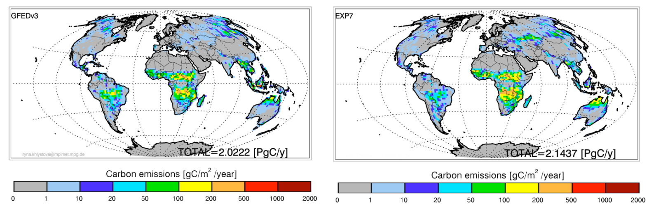
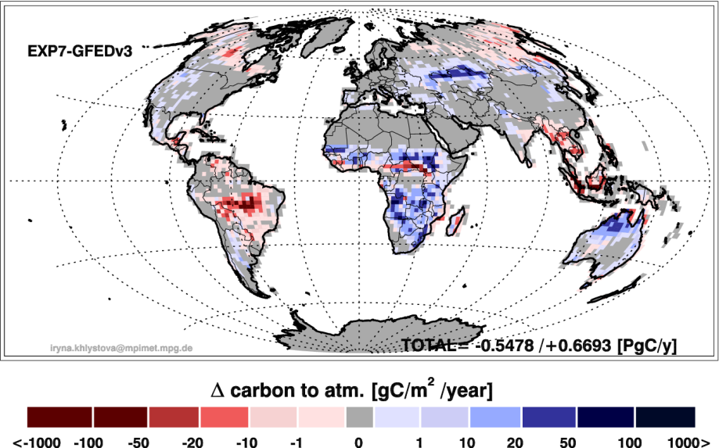
Results: Carbon emissions
Carbon Emissions GFEDv3
Carbon Emissions JSBACH Fire
GFED
EXP4
2.02 PgC/y
2.14 PgC/y
Difference Carbon Emissions JSBACH Fire minus GFEDv3
JSBACH - GFED
Notes:
Results:
Using approach B in JSBACH and compare this to carbon emissions reported in GFED that are based on the same burned area dataset (but use a different vegetation model, see also slide 1). The global emissions are very similar. Regionally, JSBACH leads to higher carbon emissions over Africa and lower emissions in South America and over Indonesia.

Slide 13
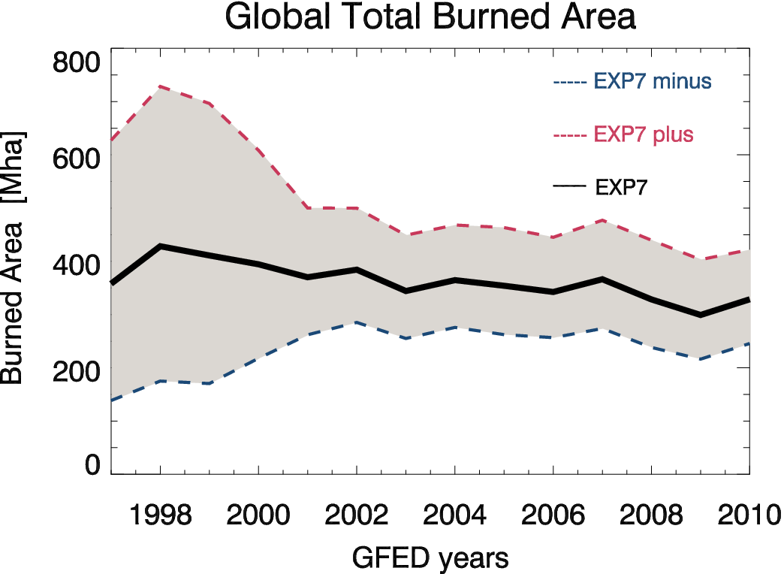
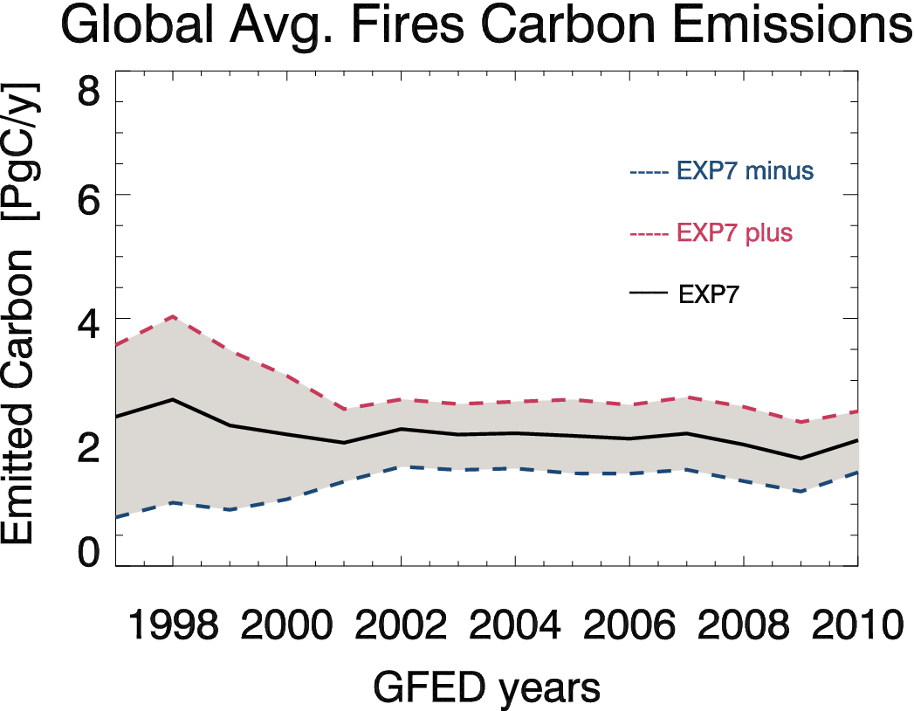
Using the GFED BA Uncertainty
+ Unc
EXP4
- Unc
+ Unc
EXP4
The relation between the uncertainty in the Burned Area and calculated Carbon Emissions is non-linear.
- Unc
Notes:
The MODIS burned area as reported in GFED comes with uncertainty estimates. When we include these in the model the burned area estimates can be translated into resulting uncertainties in the fire carbon emissions. Overall, we find regionally a highly non linear relationship between burned area and carbon emission uncertainty. Globally, the uncertainty is in relative terms lower for fire carbon emissions.

Slide 14
Global multiyear records consistent with landcover are a prerequesite for this kind of analysis

Slide 16
Questions
How does an integration of ESA CCI LC data affect the energy and water fluxes at global scales?
Does the integration of ESA CCI LC data improve the skill of MPI-ESM in simulating present day climate?
Is the usage of ESA CCI LC data superior compared to precursor data? Added value of CCI?

Slide 17
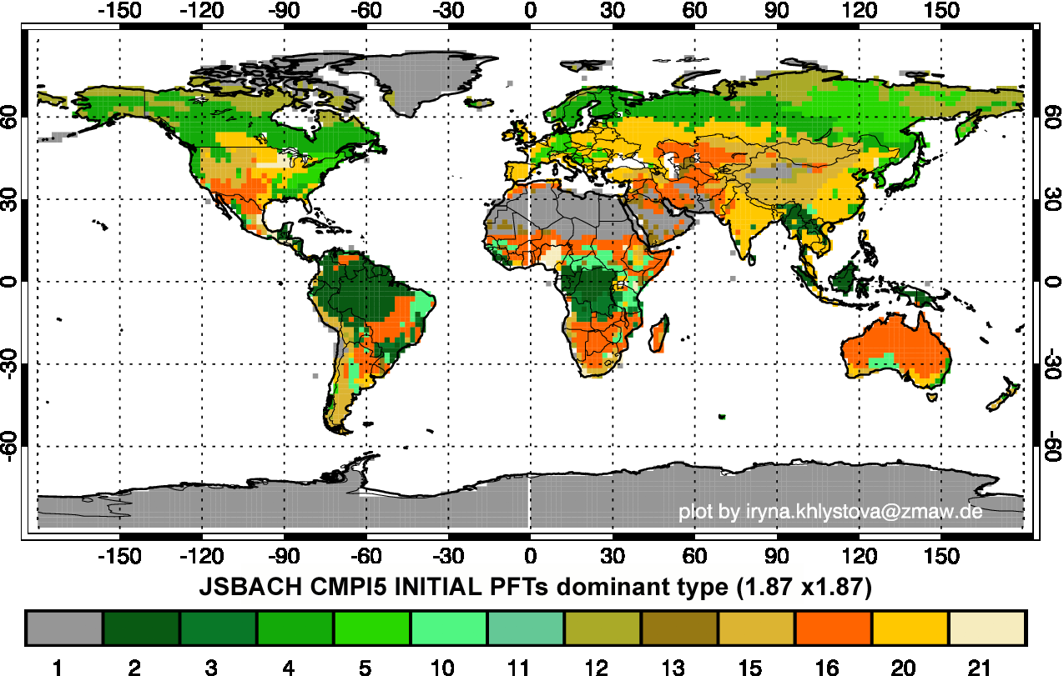
PFT distribution (JSBACH)

Slide 18
Input
Landcover data
Forcing data
Source | Period
CTRL | -
Globcover | 2005
CCI LC v1.2 (Nov) | 2000
 | 2005
 | 2010
Name | online/offline
CRU/NCEP | offline
WATCH | offline
MPI-ESM | online

Slide 19
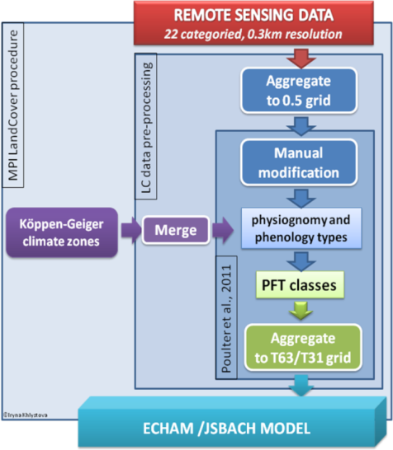
Protocol agreed with CRG of CCI LC

Slide 20
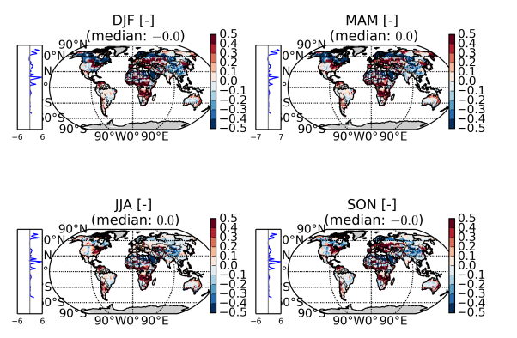
Effect on model prognostic variables
Change in LC = change in prognostic variables

Slide 21
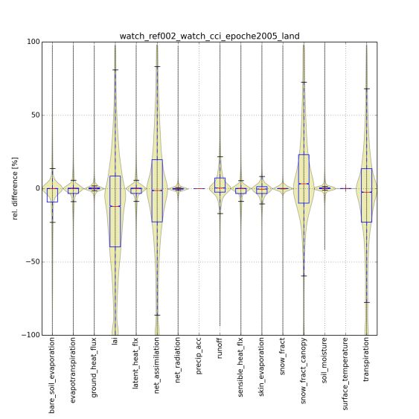
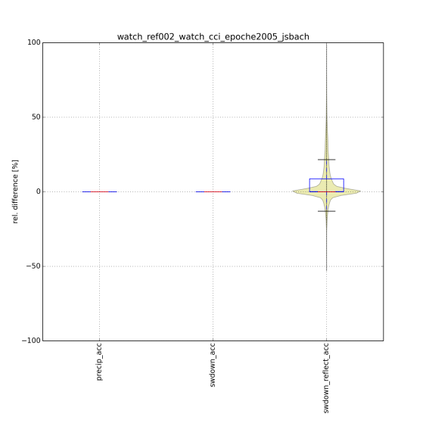
CTRL-CCI
What effect has CCI data compared to CTRL model?

Slide 22
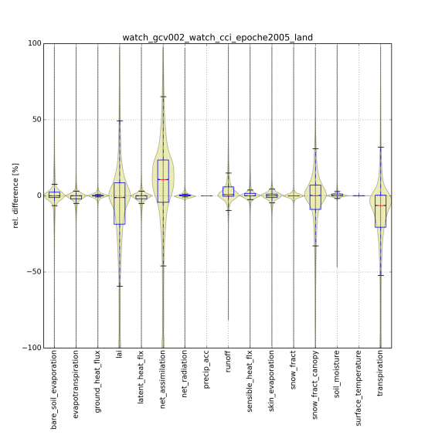
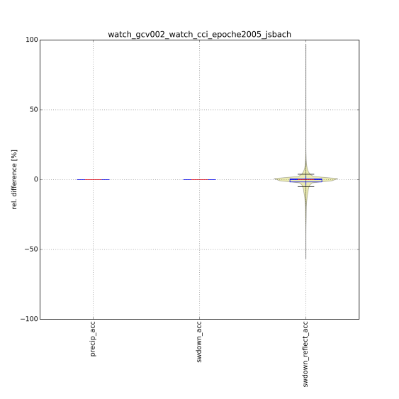
Globcover - CCI
In which aspects does CCI differ from precursor?

Slide 23
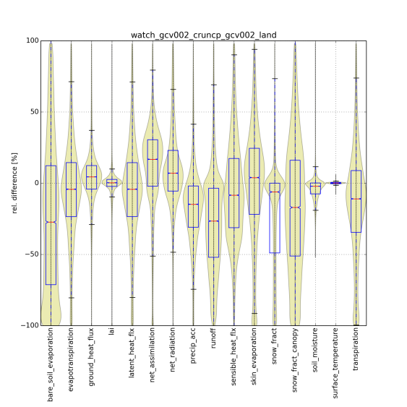
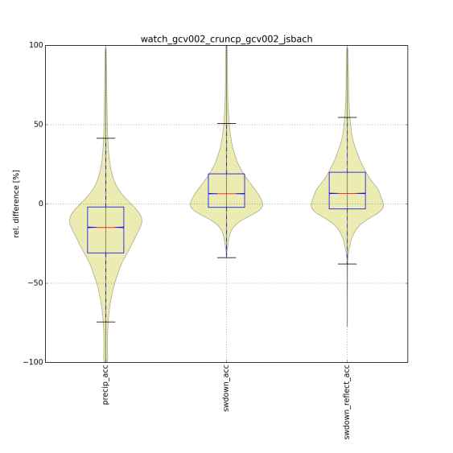
WATCH - CRU
What is the effect of different forcings?

Slide 24

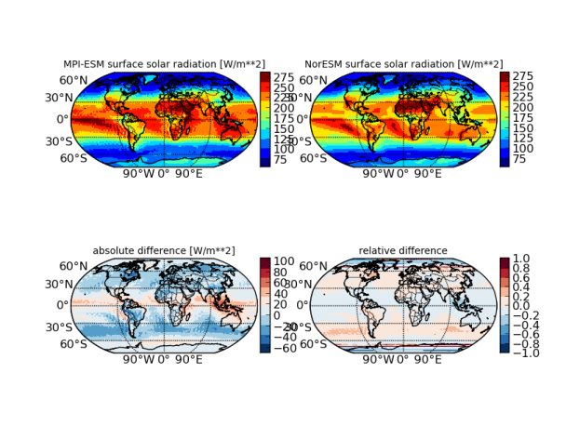
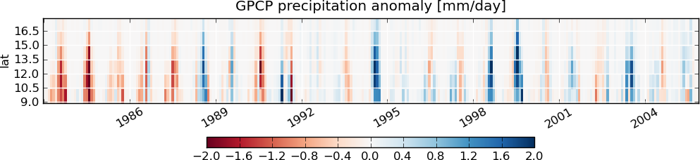
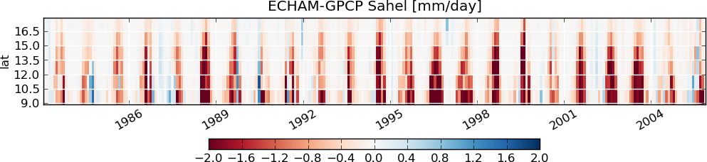
Independent model benchmarking
CMIP5
(ESG)
Observations
Your model
Standard diagnostics
Your
script
ctrl simulation
https://github.com/pygeo/pycmbs
Notes:
pyCMBS provides preprocessing of observational data and model data „on the fly“; implementation using cdo‘s (=efficient and fast)
Preprocessed files are stored in a temporary directory and can be accessed at a second run (if desired), which avoids unnecessary preprocessing overhead.
For different models, one needs basically to implement a READER that knows how to read specific variables. This is however flexible enought that it can be adapted quite easily to new models.

Slide 25


Skill scores

Slide 26
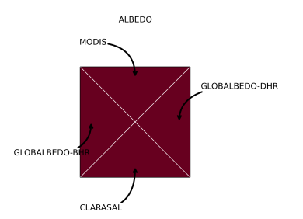
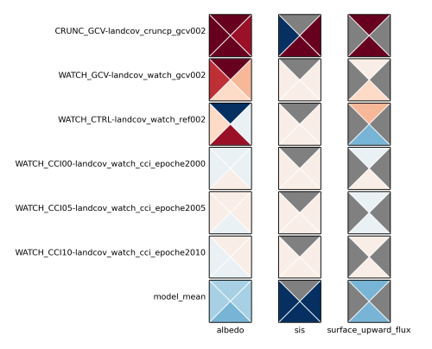
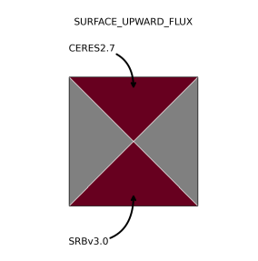
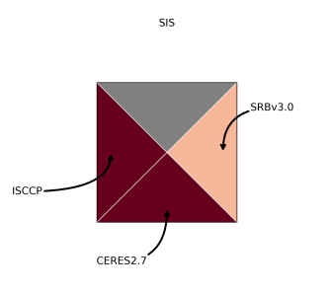

Benchmarking: offline

Slide 27
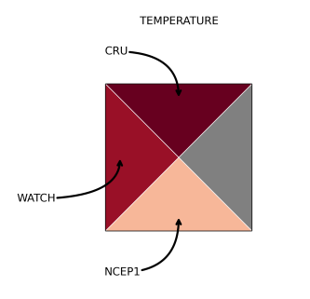
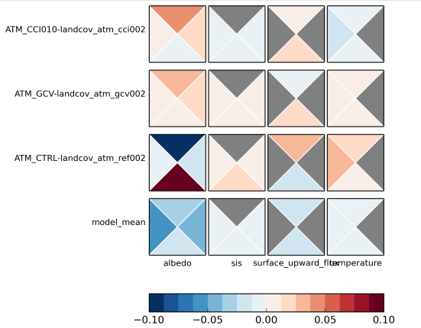
Benchmarking: online
Global 2m temperature simulations slightly better with ESA CCI LC data
Note: small changes only and significance of results still would need to be assessed

Slide 28
Summary
Unique first multidecadal data record; good proxy for prec. dynamics
Documentation of caveats needed; no CDF matching to reference model if possible
Large potential for joint fire and LC data usage for improvement of global fire emission estimates
No suitable CCI fire record available so far.
CCI LC slightly improves global 2m temperature estimates (robustness?) ... however changes small compared to forcing uncertainty
→ high resl. LC for better process understanding (phase 2)

