Slide 1
Fire_CCI from Phase 1 to Phase 2
Itziar Alonso-Canas
Emilio Chuvieco
University of Alcalá

Slide 2
Outline
Each ECV project to describe current and planned applications for their data, and allow for discussion
1. Description of available data including: specification, validation, uncertainty, improvement of current state of the art
2. Current and planned applications of this data, including:
C3S (copernicus climate change services), H2020 research, international initiatives, national programmes
3. Plans for products, delivery and engaging with climate researchers 4. Common issues between ECVs

Slide 3
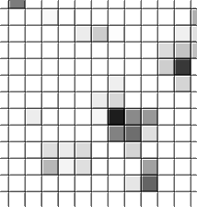
1. Description of available data: specification - products
3 years of MERIS data processed 2006-2008
Pixel product :
Monthly files with date of detection.
Include confidence level and %cloud-free observations.
GeoTiff format
Grid product:
15-day files at 0.5 x 0.5 degree (CGM).
Include standard error and burned land cover.
NetCDF format.

Slide 4
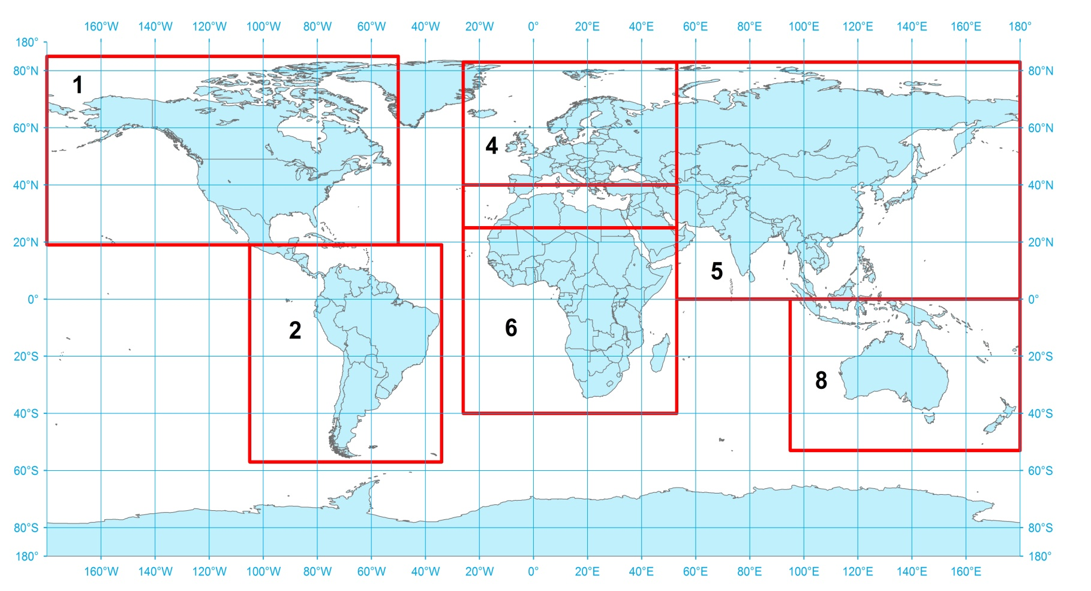
1. Description of available data: specification - products
https://geogra.uah.es/esa/

Slide 5
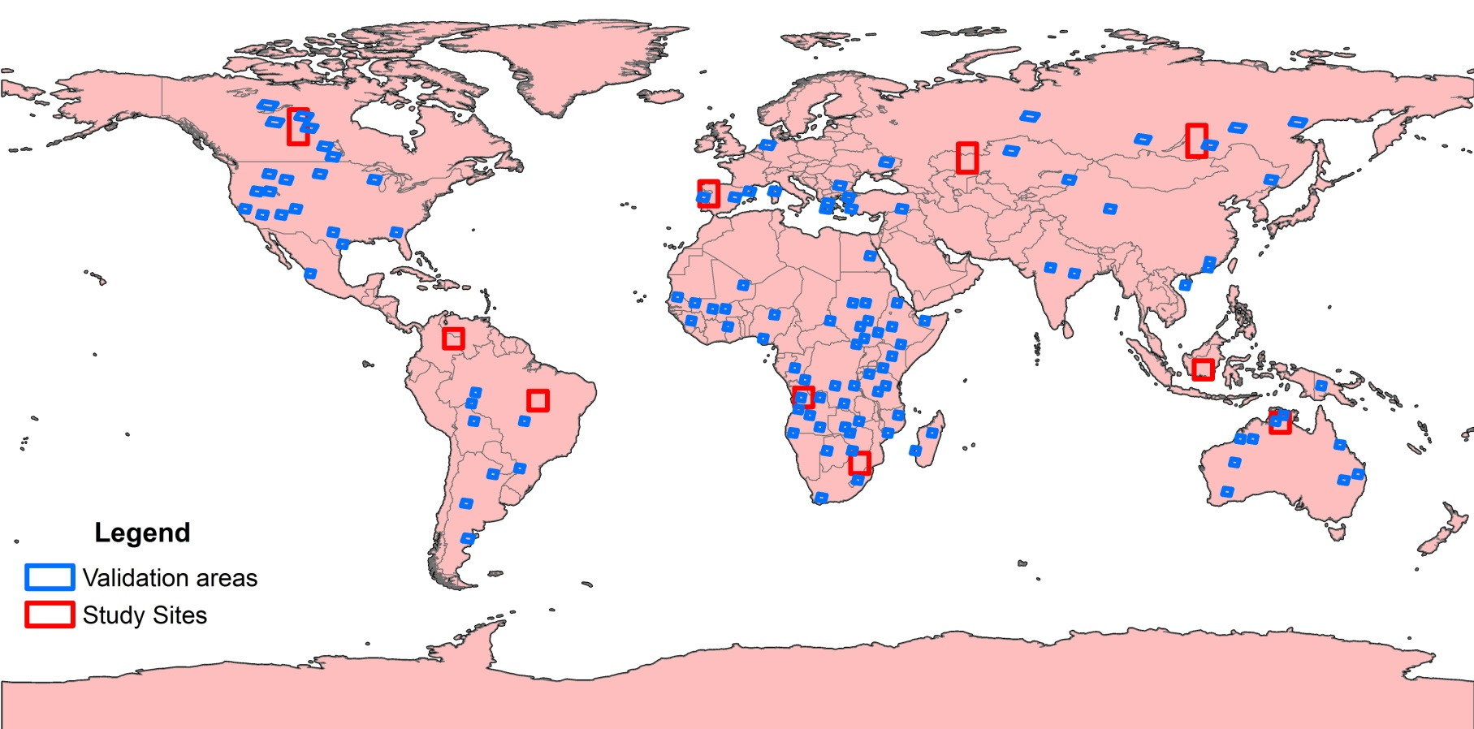
1. Description of available data: Validation
Reference fire perimeters derived from 105 Landsat TM/ETM+ image pairs
Global validation performed for 2008, using probability sampling design, 2005-2009 temporal validation
Validation based on cross tabulated error matrices
Padilla et al, 2015 RSE

Slide 6
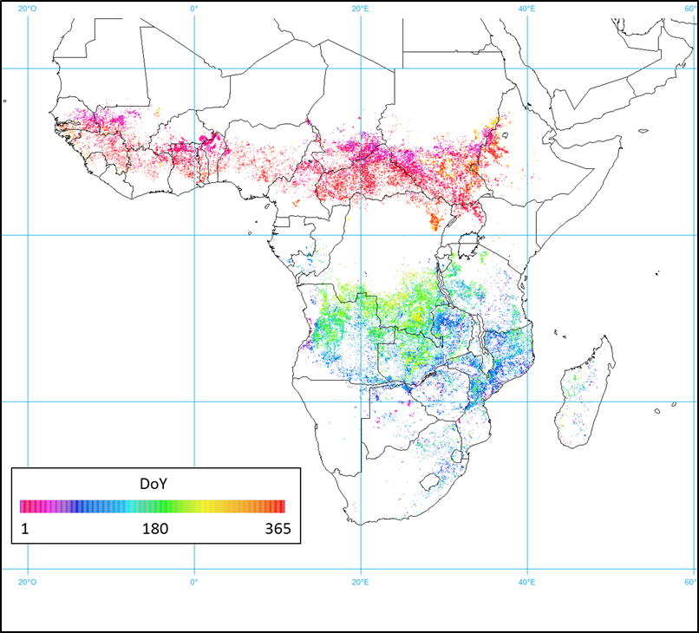
1. Description of available data: Uncertainty
Derived from 23 pairs of Landsat TM/ETM+ images from 2006 to 2008 not used in the validation
Pixel product: estimated in probabilistic terms (% confidence) based on regression analysis using as inputs CL of the classification, number of neighbour burned pixels and LC.
Grid product: similar model, output expressed as a standard error of the total burned area for each grid cell.
Alonso-Canas et al, 2015 RSE

Slide 7
1. Description of available data: Improvement of CS of the art
Adapted to climate modellers needs
Higher spatial resolution (300m vs 500m) than other global BA products
Detection of smaller fires (Randerson et al, 2012)
Accuracy assessment: better balanced than the MODIS BA products (higher commission), less underestimation (relB = -34%, MCD64= 44% and MCD45= 48%). Significantly better than other European BA products (Geoland, GLOBCARBON and L3JRC)
Assessment of its potential at regional and global scale
Notes:
Globally, small fires increased total burned area by approximately by 35%

Slide 8
Global scale
Close agreement with GFED4 in terms of spatial and temporal distribution. Mean annual burned area in the Fire_cci product was 369 Mha yr⁻¹, 6.6 % higher than the estimated 346 Mha yr⁻¹ of GFED4.
Simulations with the ORCHIDEE model forced with the Fire_cci data yield comparable emissions to those of the GFED3 estimation
-> The Fire_cci product is well suited for modelling fire emissions and related downstream studies of climatic effects.
Notes:
expressed as grid area percentage burned

Slide 9
Regional scale
Products have different commission and omission errors depending on the region.
Test if global products could be used to characterise regional fire regimes and fire shape
Promising development of fire patch indices: fire model testing in DGVM
Very useful to describe and better understand fire size and fire shape distributions at regional and global scale -> fire regime characterization and improvement in DGVMs.

Slide 10
Improvements in Phase 2
Process MERIS full time series
Based on this algorithm (VNIR), develop a BA product from MODIS 250 m VNIR channels (current MODIS BA products use 500 m bands)
Generating a small fire database for the African continent (also for other regions depending on data availability). The principal data sources for this work will be Landsat-8/OLI, Sentinel-2/MSI and Sentinel-1 SAR for very cloudy regions
Extending time series (2000 – 2017)
Adapt to S3 OLCI -> better temporal coverage
Uncertainty

Slide 11
2. Current and planned applications of this data:
Download of data from the web->
Planned: + 300 registered users GFED (emissions, deforestation,REDD, Carbon Cycle, DGVM).
Notes:
24 downloads
3 years, this will grow as the time series grows

Slide 12
2. Current and planned applications of this data:
C3S: fire disturbance is one of the ECV’s foreseen in the services
H2020: 2 proposals submitted
MyQube
Multiply
International initiatives:
GOFC-GOLD
USGS ECV: implementation, validation
Notes:
Time series not mature enough

Slide 13
3. Plans for products, delivery and engaging with climate researchers

Slide 14
3. Plans for products, delivery and engaging with climate researchers
CRG , CMUG
Phase 2:
MPIC: IBBI, GEIA , MACC/CAMS, Core-Climax, CMIP6
IRD: GEIA, ACCENT, FireMIP, CMIP6
LSCE: FireMIP, GCP and GCP-RECCAP
VUA: GOFC-GOLD, GFED, FireMIP, GCP and GCP-RECCAP, CMIP6
End users: partner institutions from these activities include ECMWF, UK Metoffice, Juelich, Meteo France, Max Planck Institute for Meteorology, Max Planck Institute for Biogeochemistry, King’s College.
External user group: MODIS team, FAO, INTA, JRC, CSIRO, INPE, natural hazards prevention community -> fire risk assessment

Slide 15
4. Common issues between ECVs
Fire risk assesment:
Soil moisture
LST
Fire emissions:
GHG
Ozone
Aerosol
Deforestation fires: Land cover CCI

Slide 16
4. Common issues between ECVs
Common sensors:
MERIS: LC_cci, Aerosol_cci
S2 data: LC_cci
Common distribution interfaces: LC
Water mask
Cross-ECV checks to identify errors in the products, inconsistencies.
Notes:
Cross check: (e.g. by evaluating if and due to what reason high burned area records coincide with high soil moisture records)

Slide 17
Fire_CCI from Phase 1 to Phase 2
Itziar Alonso-Canas
Emilio Chuvieco
University of Alcalá

