Slide 1

Sea Ice CCI project Phase 2
2015-2018
CMUG meeting 14-16 March 2016

Slide 2
Status of the sea ice ECVs
Sea ice concentration: Arctic and Antarctic, daily, 25 km grid
1979-2015: SMMR, SSM/I, SSMI
2002-2011: AMSR-E
Sea ice thickness: monthly, October – March, 100 km grid
2003-2012: ENVISAT
1993-2003: ERS 1/2
2010 – present: Cryosat-2
Sea ice drift: algorithm intercomparison and product specifications for a new sea ice ECV

Slide 3
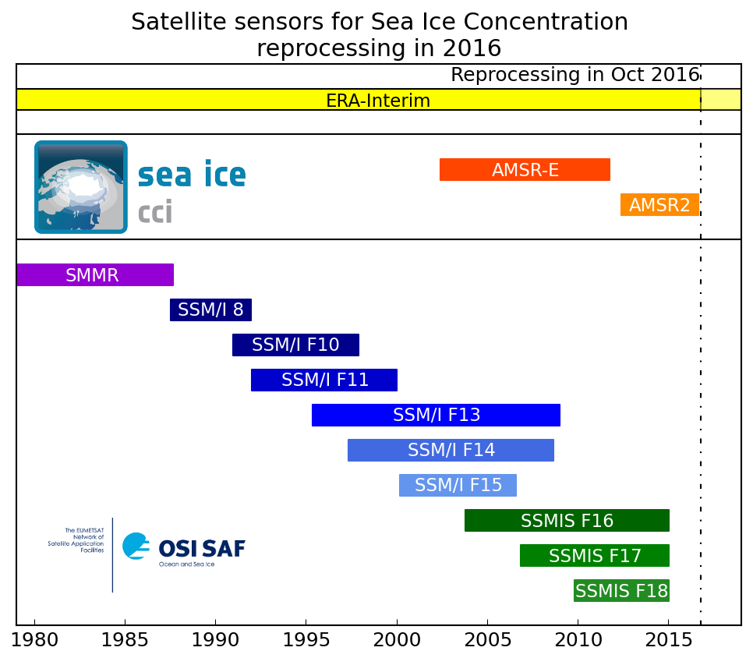
Sea ice concentration
improved algorithm and reprocessing in 2016
Joint operational production between CCI and OSI SAF

Slide 4
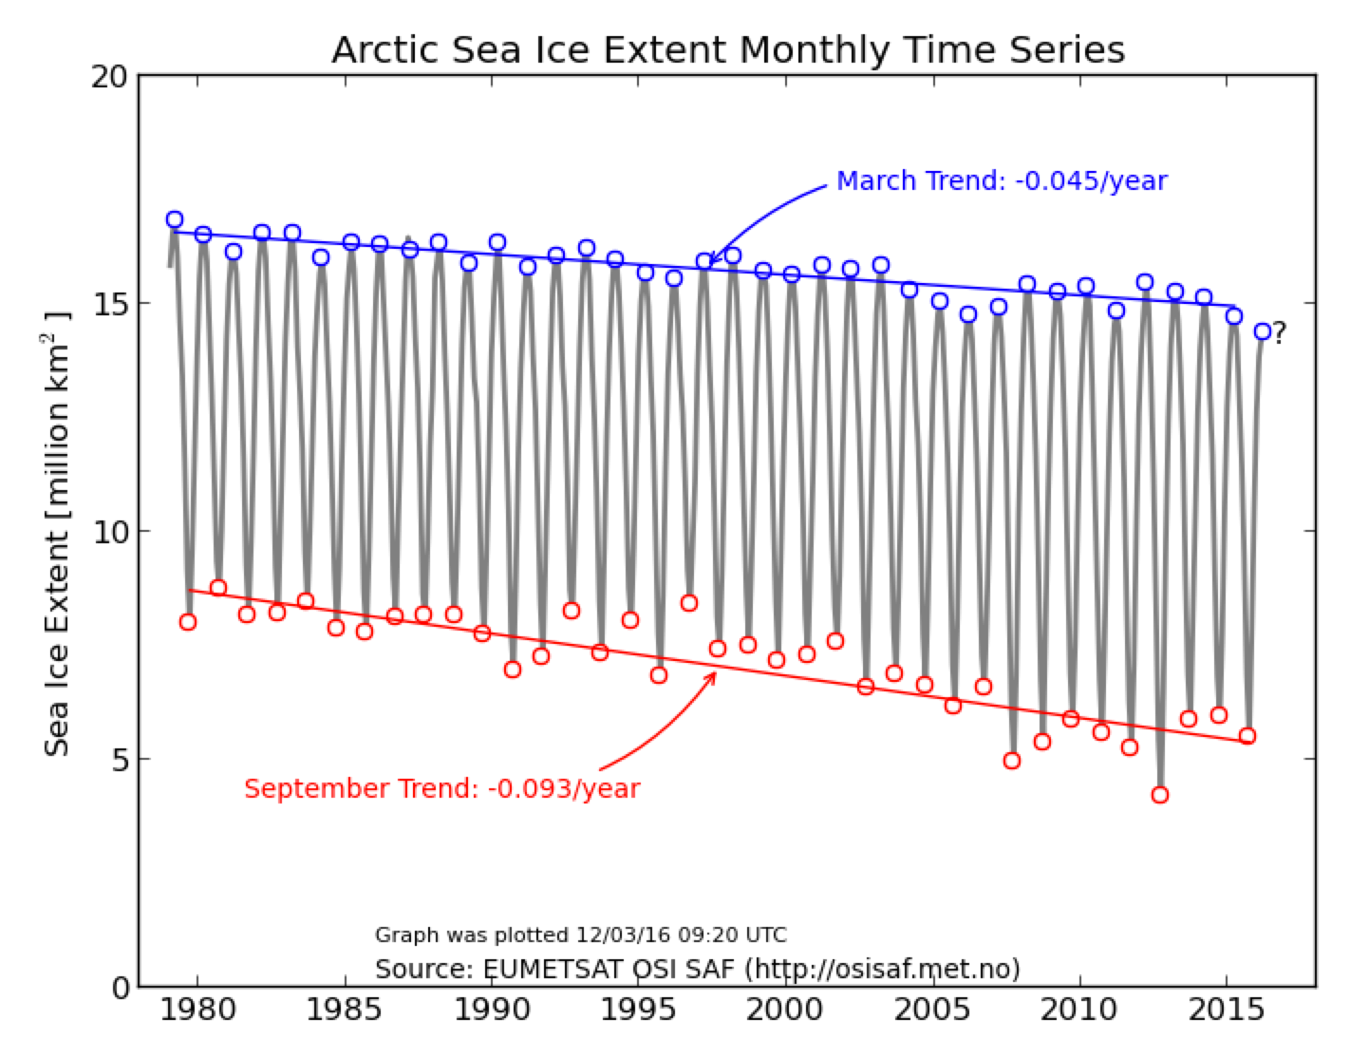
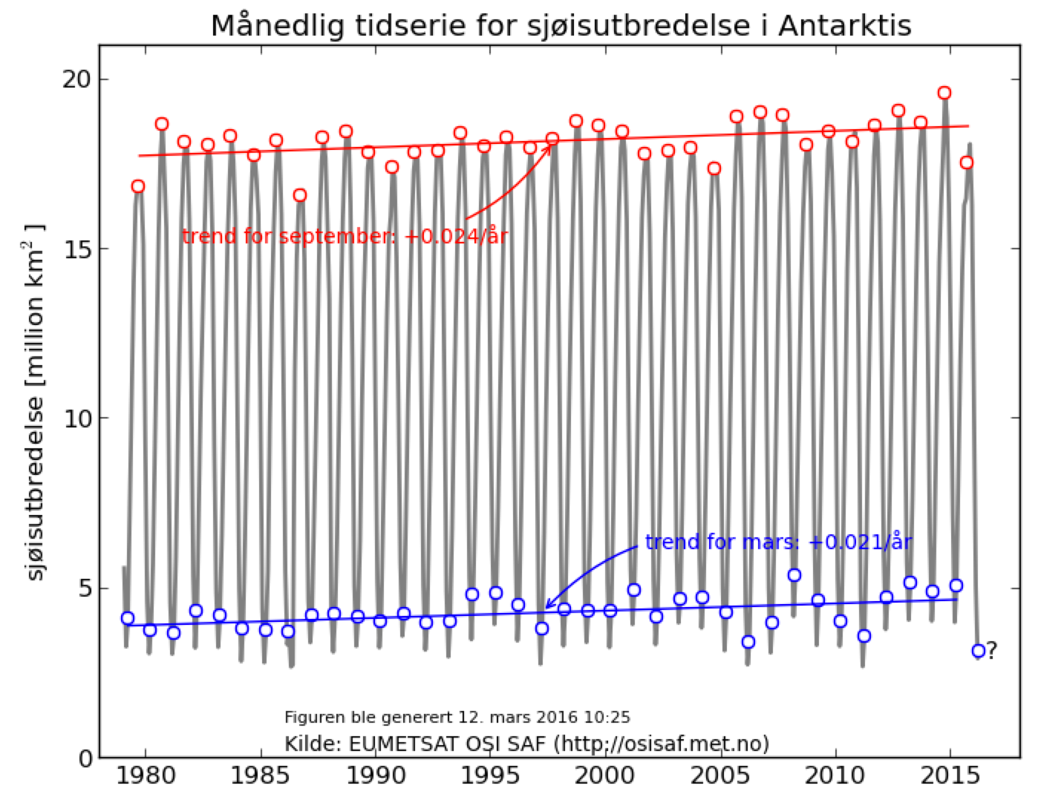
Monthly sea ice extent 1979 - present
Arctic
Antarctic
http://osisaf.met.no

Slide 5

Algorithm improvement:
From dynamic tie-points to dynamic algorithms
In OSISAF and SICCI1 we used a mix of ”static” algorithms with dynamic tie-points. Comiso Freq (19v,37v) and Bristol (19v,37v,37h).
Investigating ”dynamic Bristol” led us to design a new class of SIC algorithms: dynamic algorithms.
Dynamic algorithms self-optimize against the training data to zero bias and minimize uncertainty.
Basic principle: we view Tb triplets on a 2D plane that contains the ice line. The best projection plane gives the best algorithm.
Two algorithms: SICCI2LF uses (19v,37v,37h), and SICCI2HF uses (19v,n90v,n90h).

Slide 6
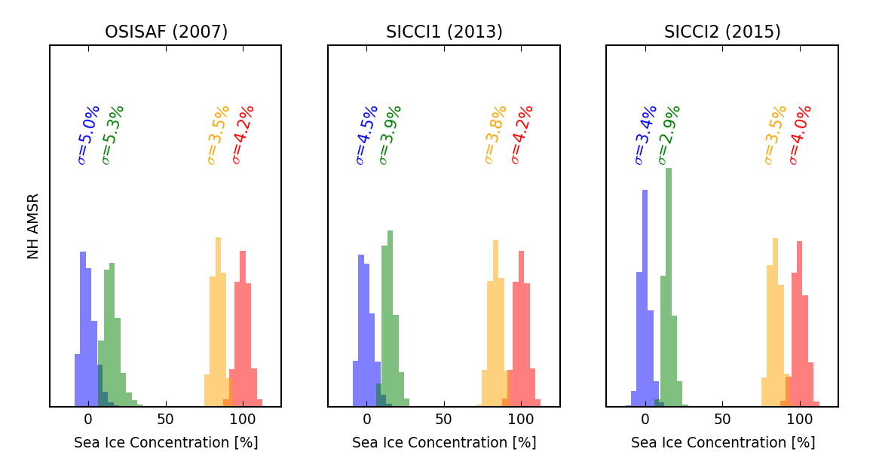
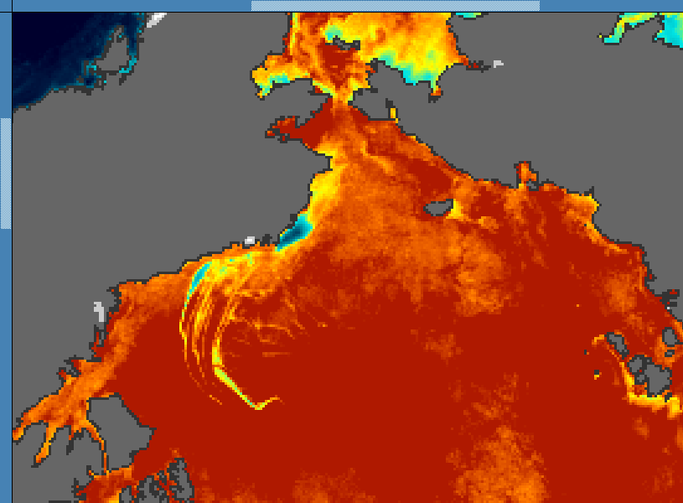
Reduced uncertainty of SIC algorithms
Beaufort Sea and Central Arctic SIC from SICCI2 HF algorithm Feb 26th 2013 (AMSR2). 12.5km EASE2.
0 15 85 100%
NASATeam
Ice conc | OSISAF σ | SICCI1 σ | SICCI2 LF σ
0% | 5.0 | 4.5 | 3.4
15 % | 5.3 | 3.9 | 2.9
85 % | 3.5 | 3.8 | 3.5
100 % | 4.2 | 4.2 | 4.0
SICCI2LF
SICCI2HF

Slide 7
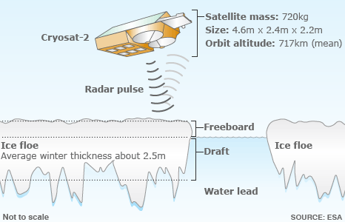
Sea ice freeboard from radar altimeters

Slide 8
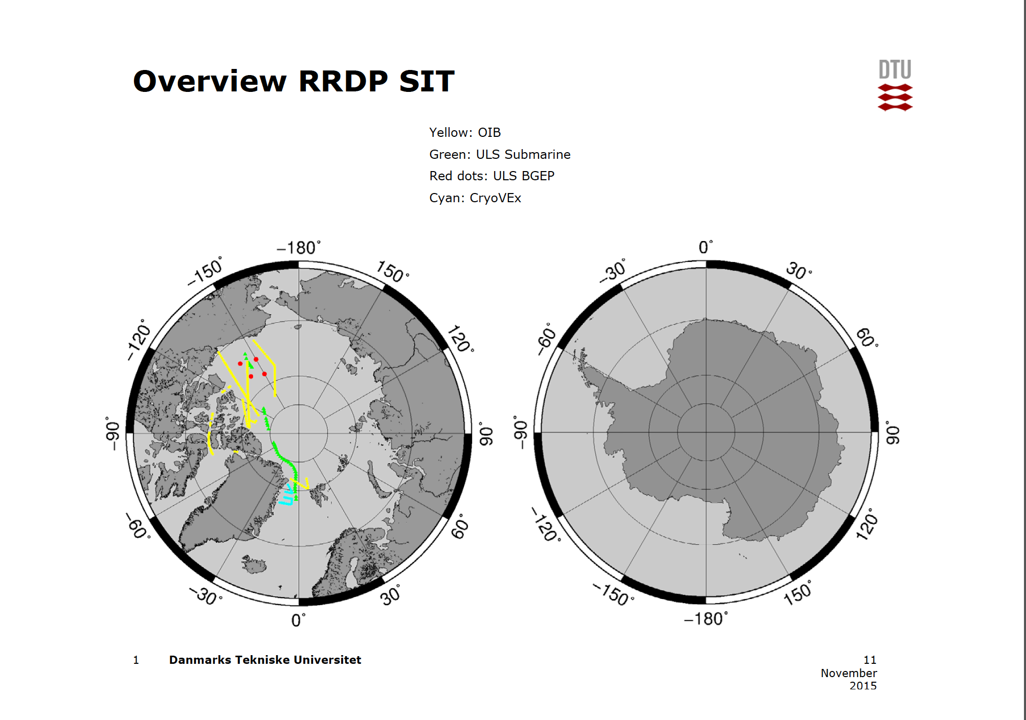
Extending Round Robin database

Slide 9
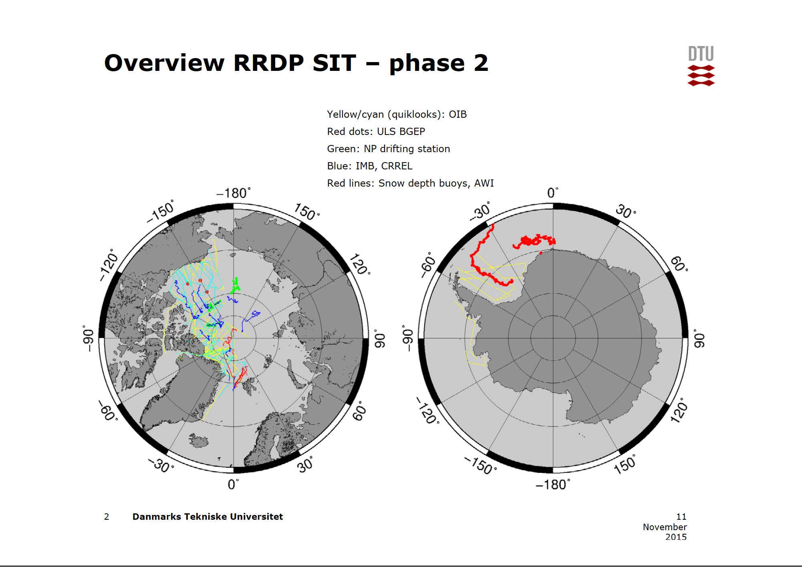
Extending Round Robin database

Slide 10
First version from Phase 1
ENVISAT ice thickness 2002-2012
November 2003 March 2004
Notes:
10

Slide 11
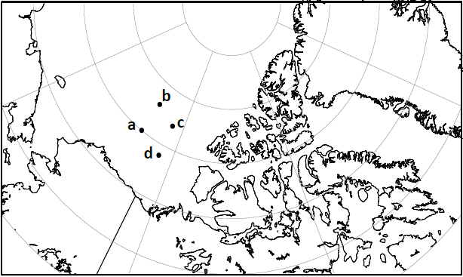
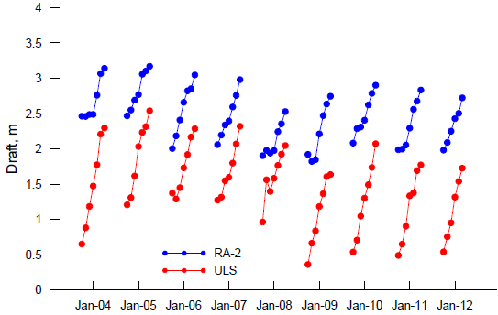
Validation of Sea Ice Thickness : Comparison to moored ULS data
  BGEP mooring ULS draft data
  Average data from 2 to 4 ULS for period 2003-2012
  Conversion of SICCI freeboard to draft using Warren et al. snow depth
  MY density: 882 kg/m3
  FY density: 916 kg/m3
  Positive bias of 0.5 m to 1.5 m
  Depends on choice of snow depth & ice density
Notes:
11

Slide 12
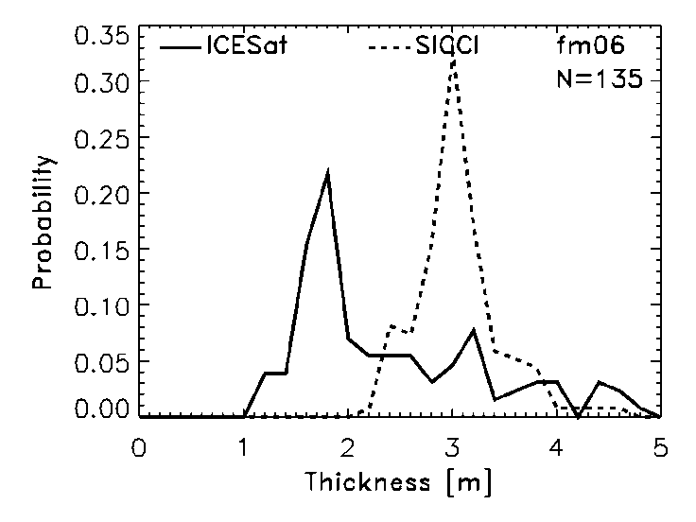
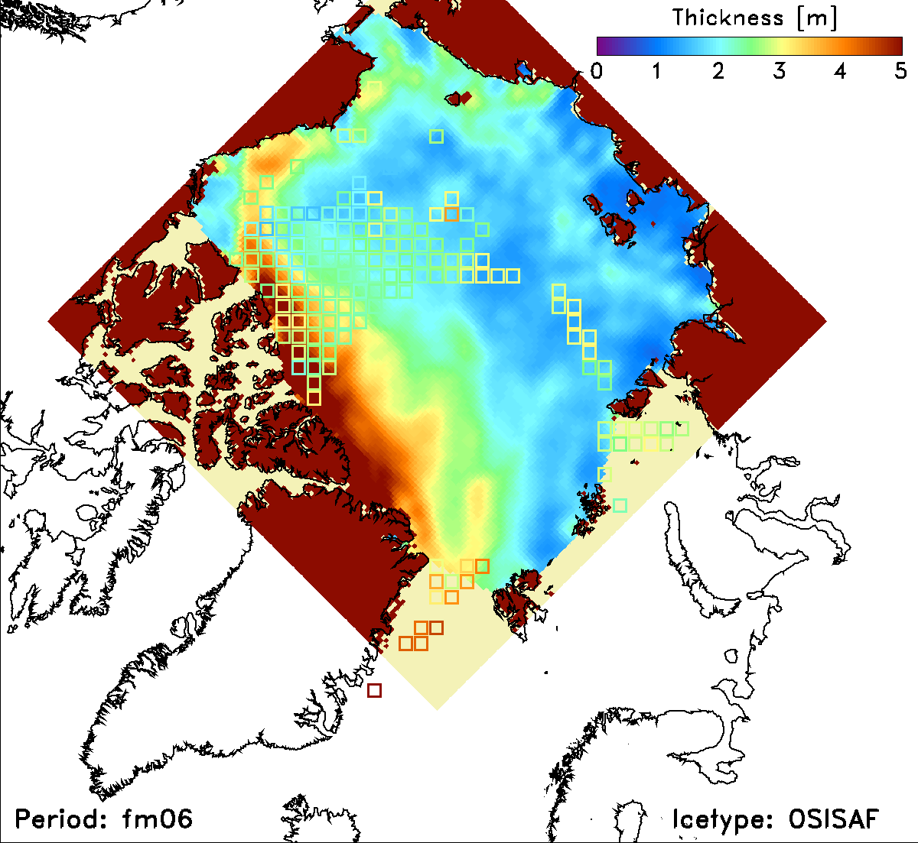
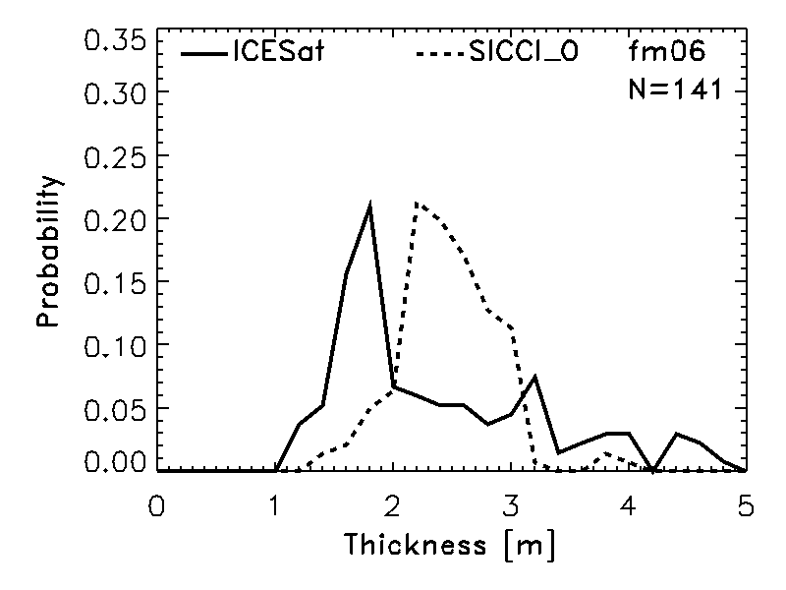
Validation of Sea Ice Thickness from Envisat versus IceSat thickness
version fv 0.09 and fv0.11: Maps (n > 100)
fv0.09
fv0.11 OSISAF
Difference of mean SIT: 0.52 m → 0.11 m (IFR); 0.07 m (OSI)
Difference of median SIT: 0.87 m → 0.24 m (IFR); 0.33 m (OSI)
fv0.11 uses separation of MYI and FYI with different ice density
Notes:
12

Slide 13
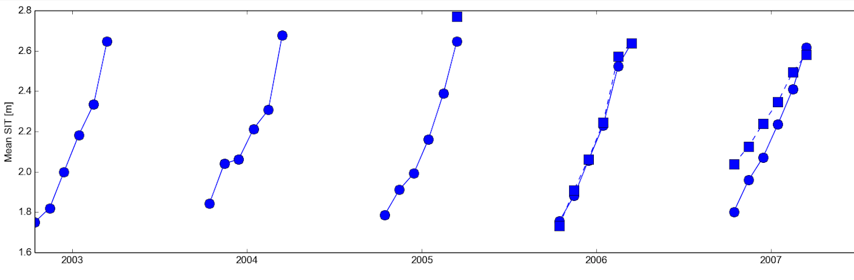

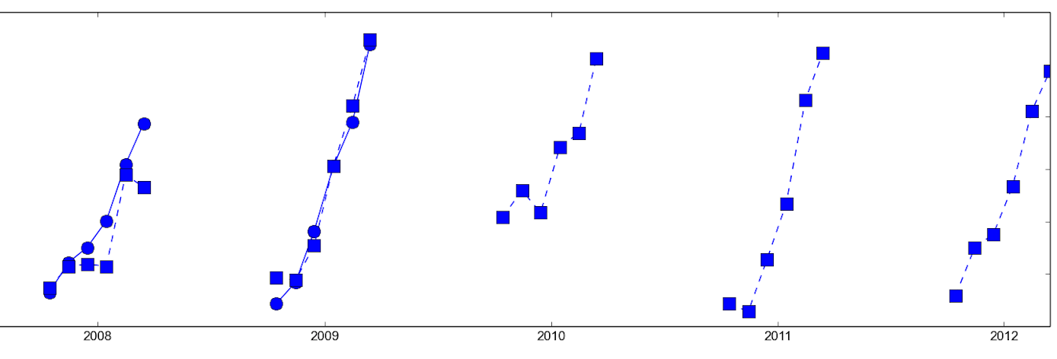
Sea Ice Thickness: monthly mean retrievals from ENVISAT (October – March)
2003
2005
2007
2008
2010
2012

Slide 14
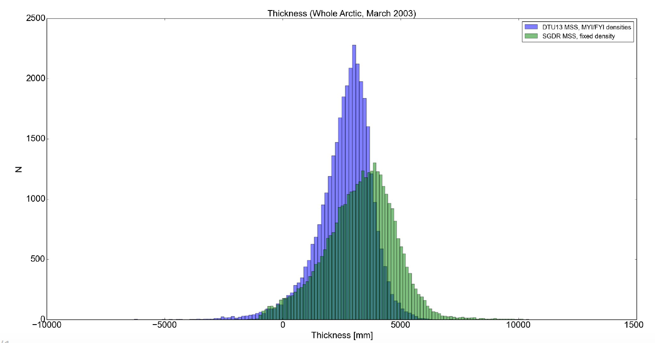
Improved Envisat thickness retrieval
from fv 0.09 to fv0.11: Maps where
DTU13 MSS and MY/FY discrimination is used

Slide 15
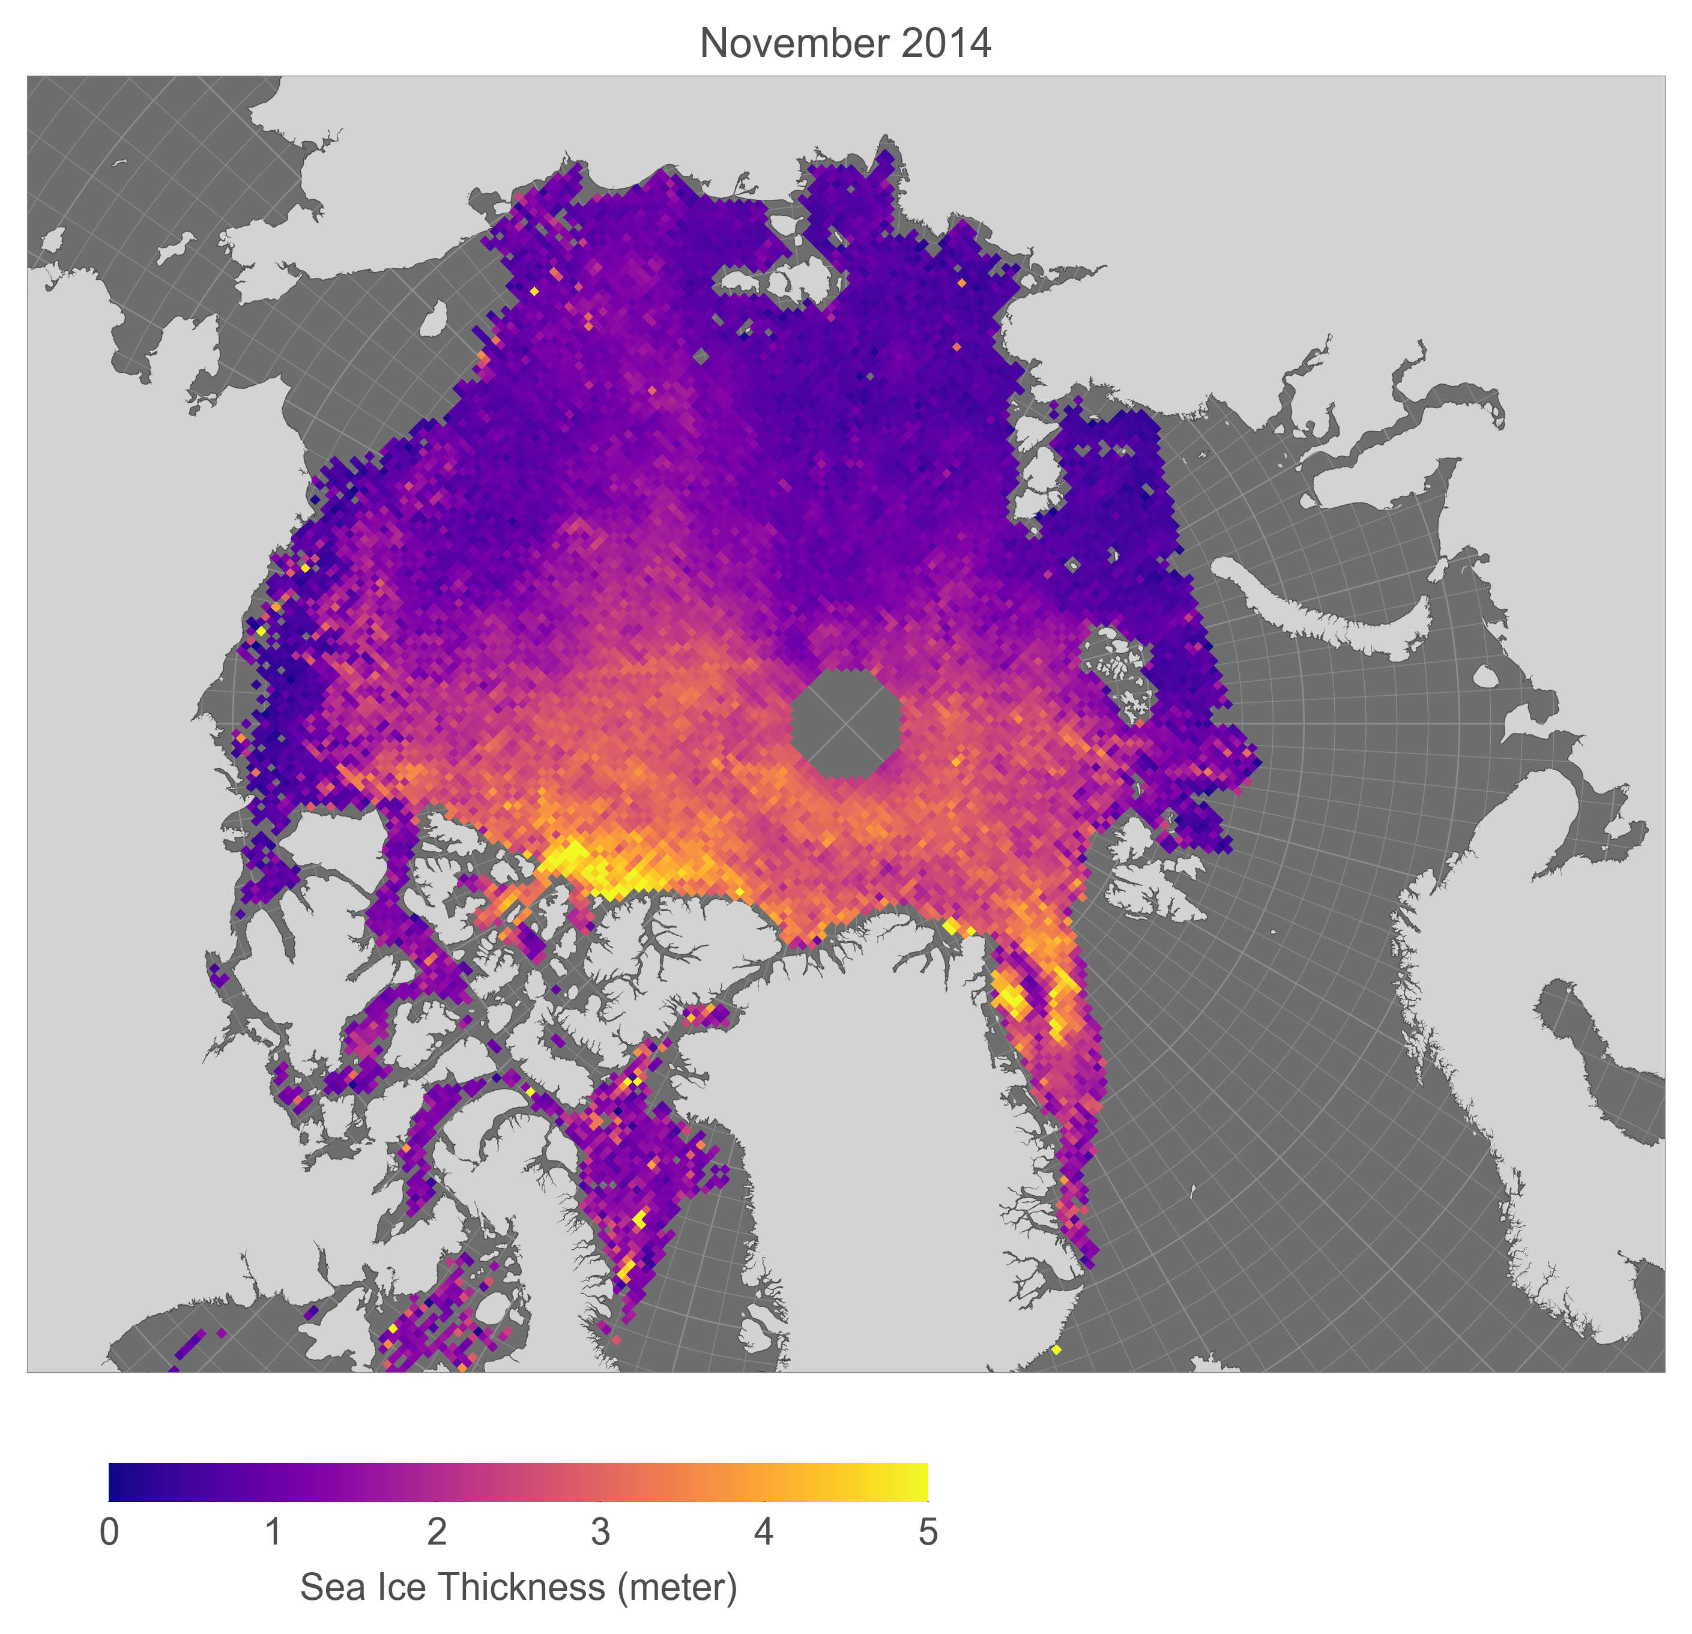
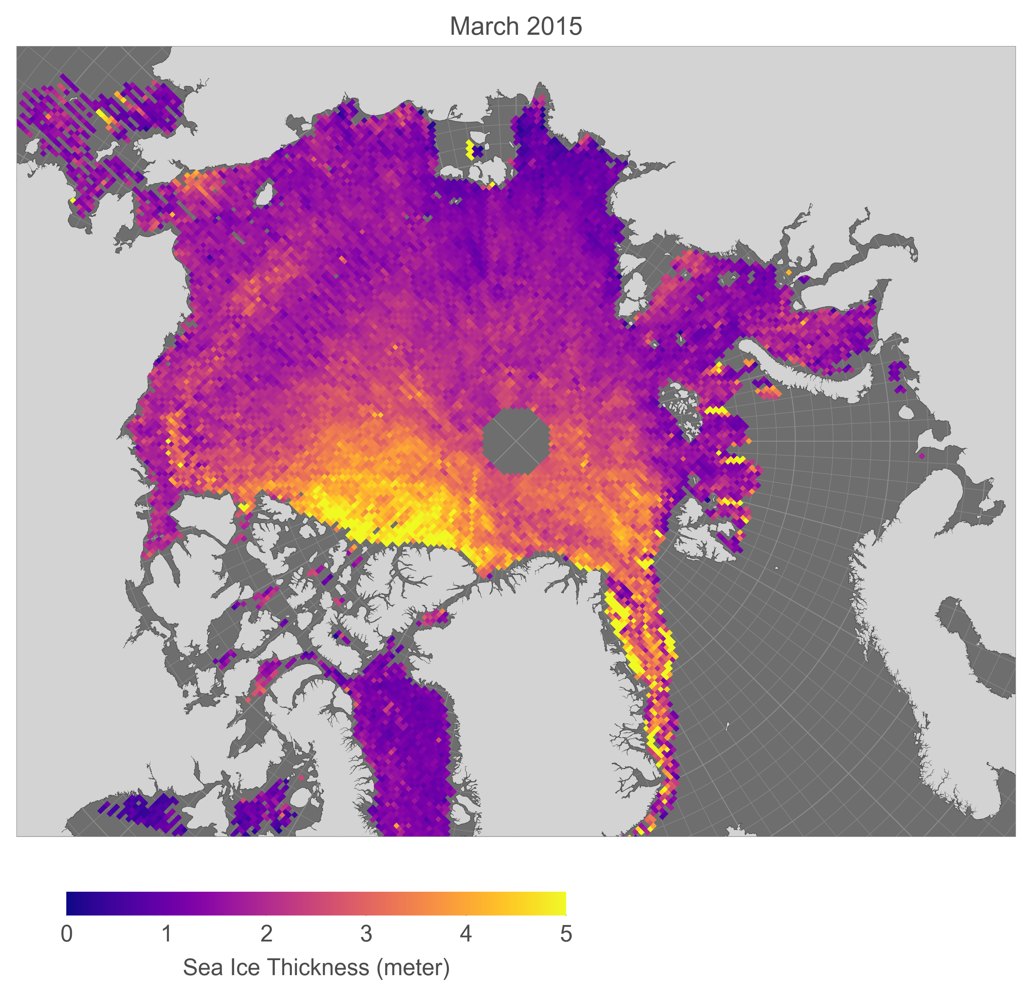
Ice thickness in the Arctic from CryoSat

Slide 16
Threshold First Maximum Retracker Algorithm (TFMRA)
Ice floes
Leads
(Ricker et al., 2014)

Slide 17
Computation of freeboard

Slide 18
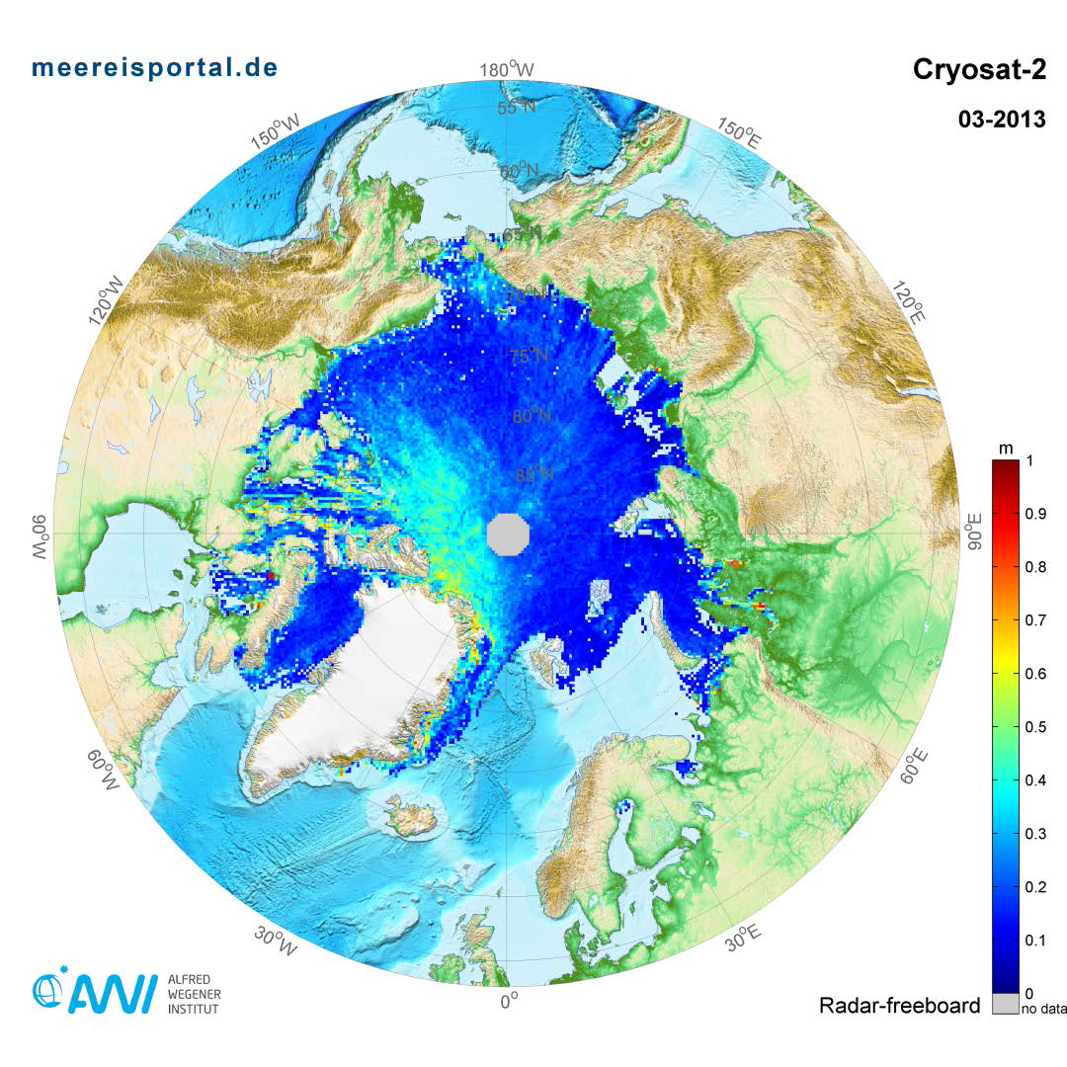
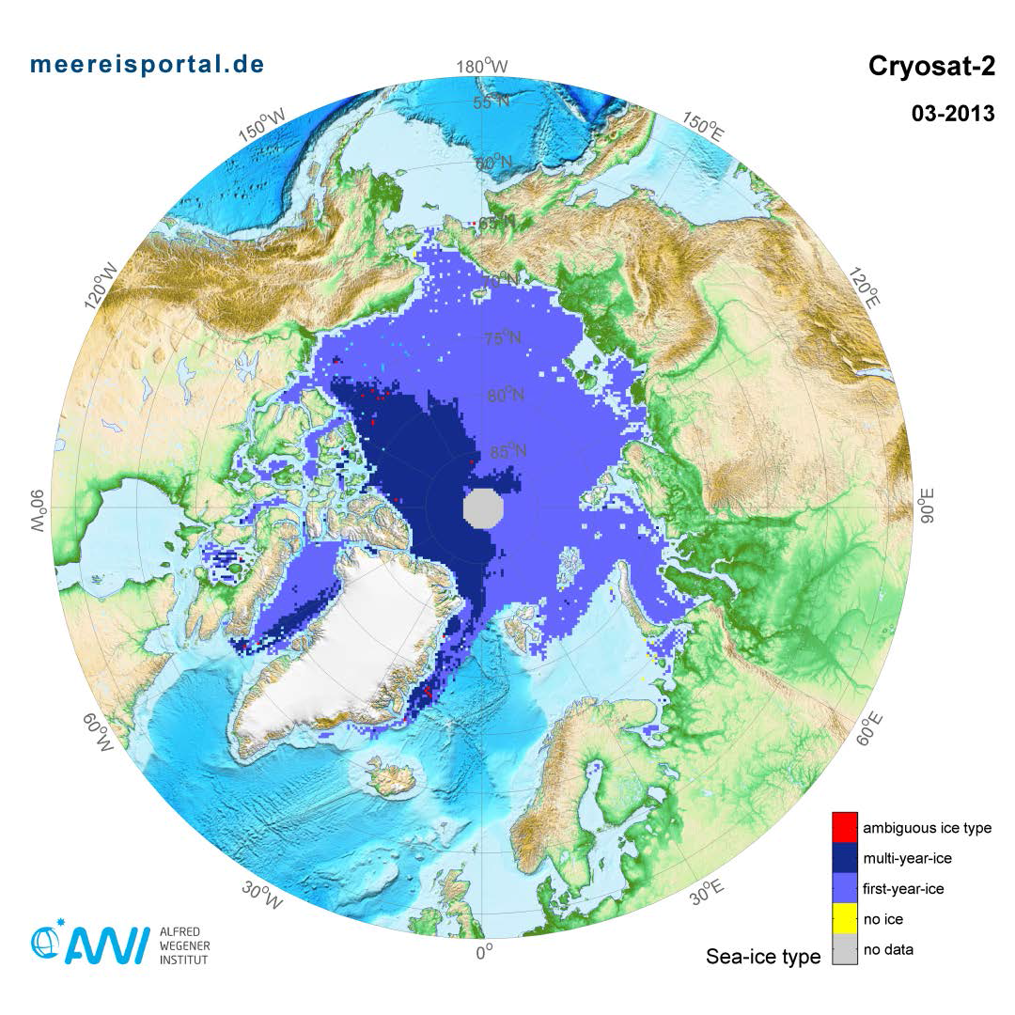
CryoSat freeboard and MY/FY classification
Direct freeboard retrieval using mean SSH, Range Retracking and lead detection
Multiyear – Firstyear classification from OSI-SAF maps

Slide 19
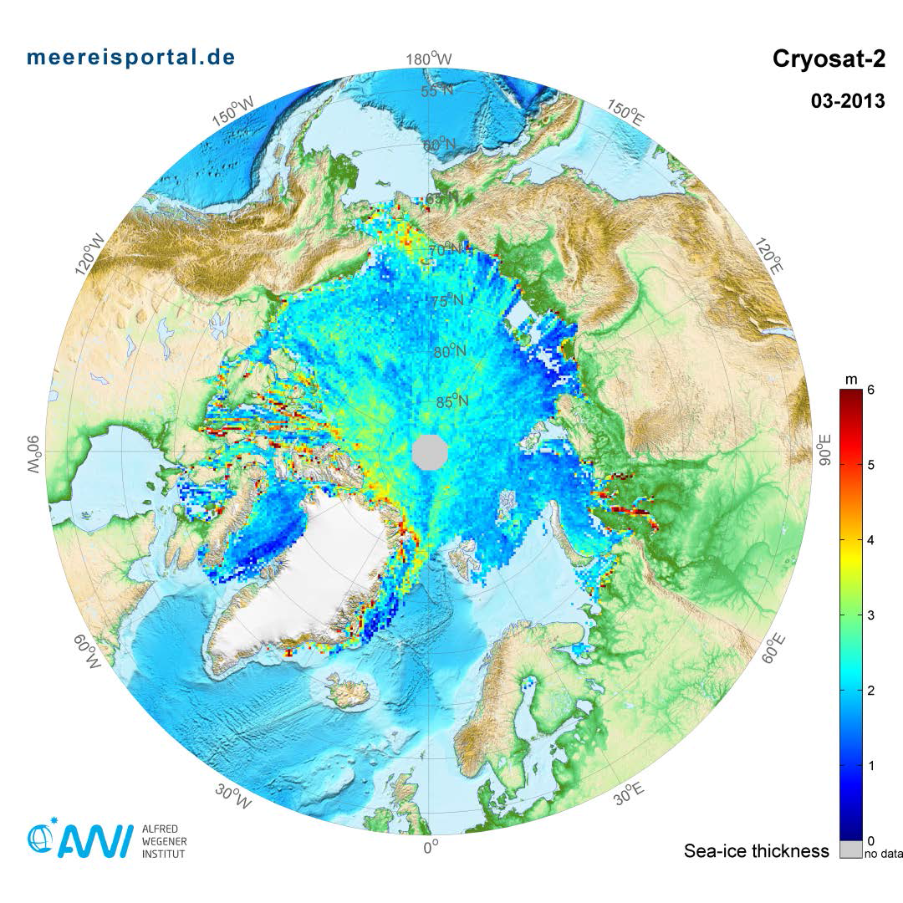
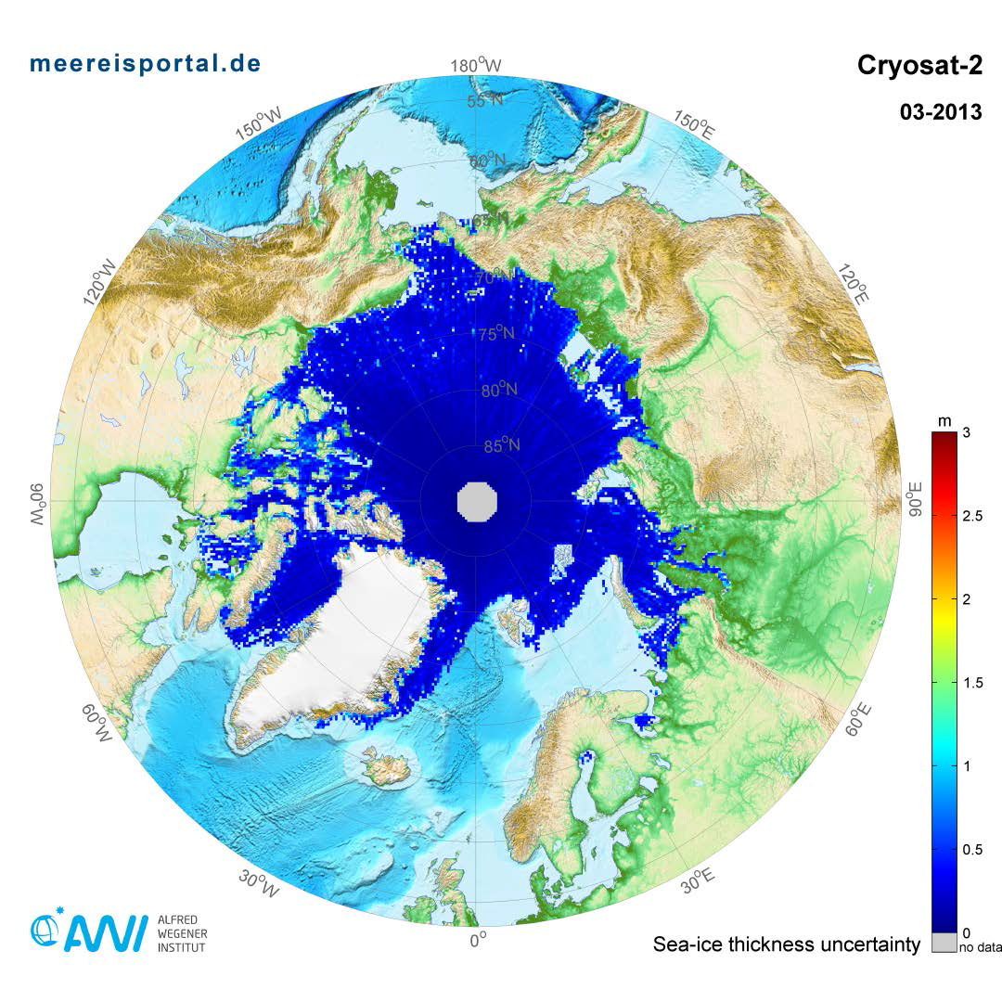
CryoSat ice thickness with uncertainty
Uncertainty
Range: 0.5 m – 1 m
Higher in Archipelago / Ice Edge
Thickness: Thick ice in FYI regions
Artefacts from ice classification

Slide 20
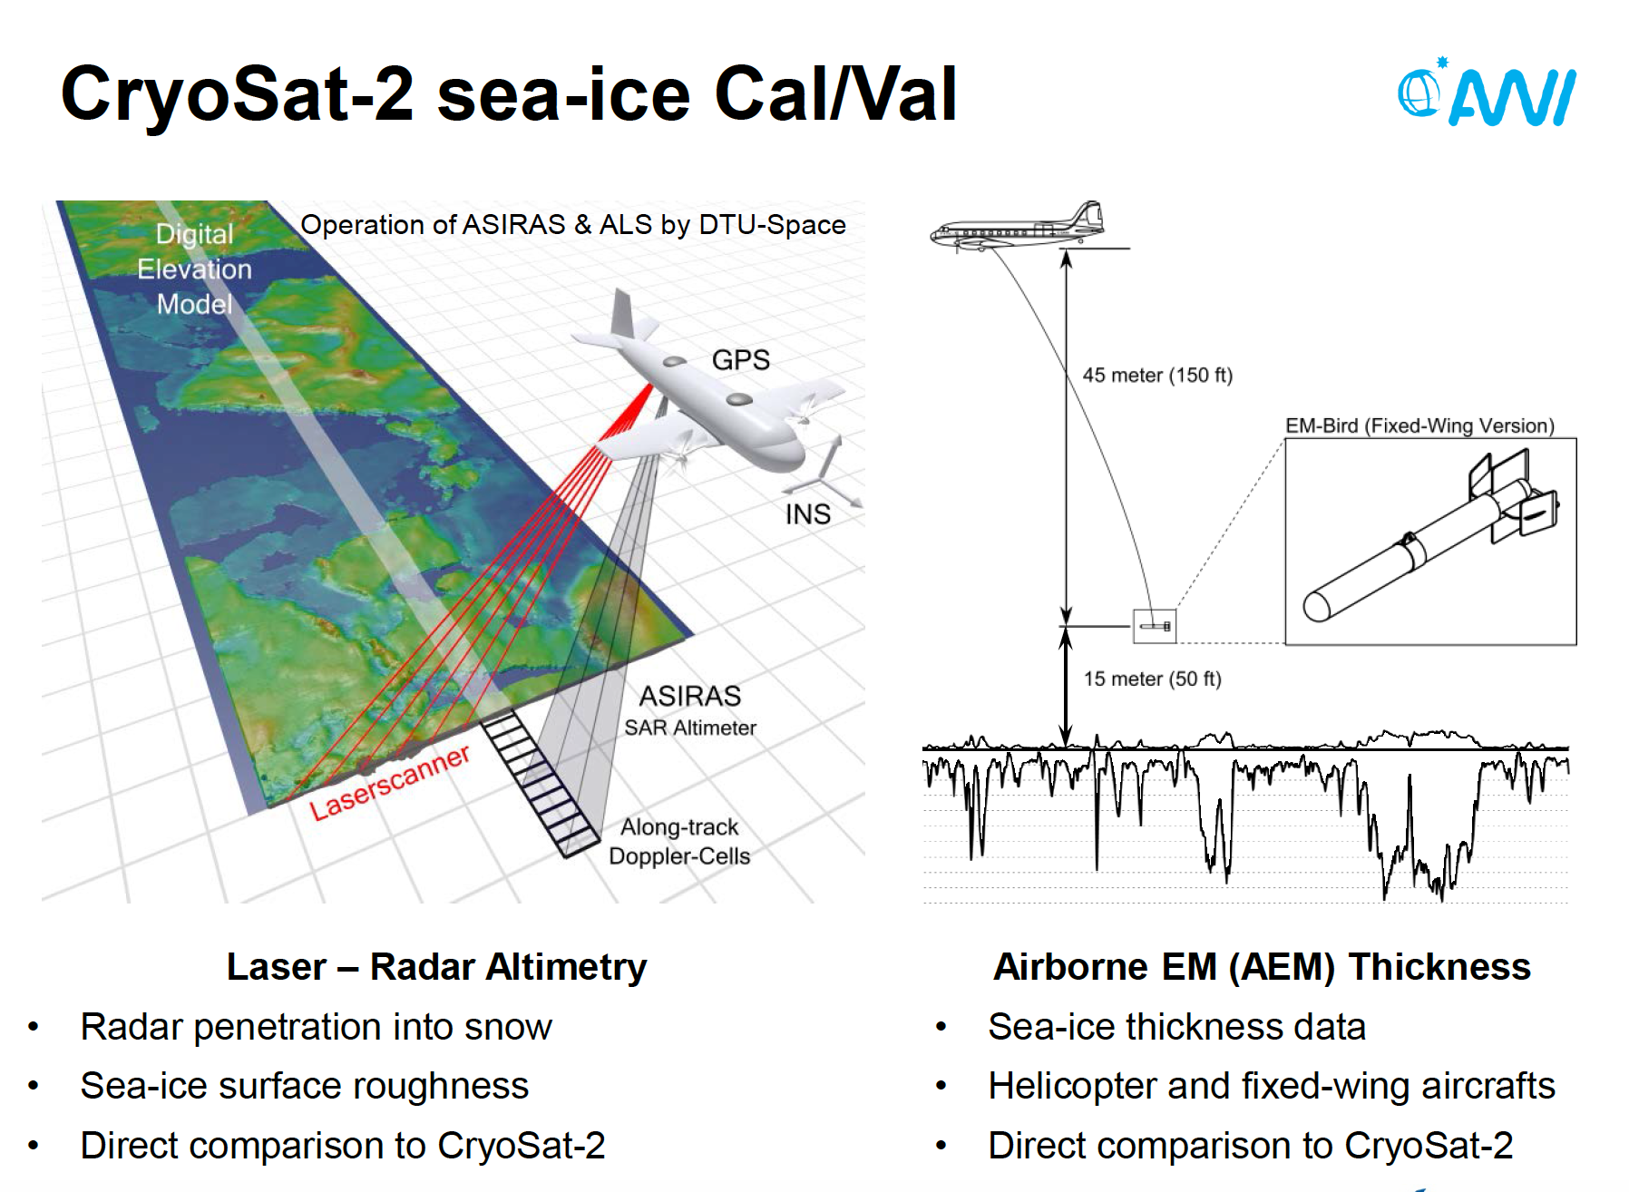

Slide 21
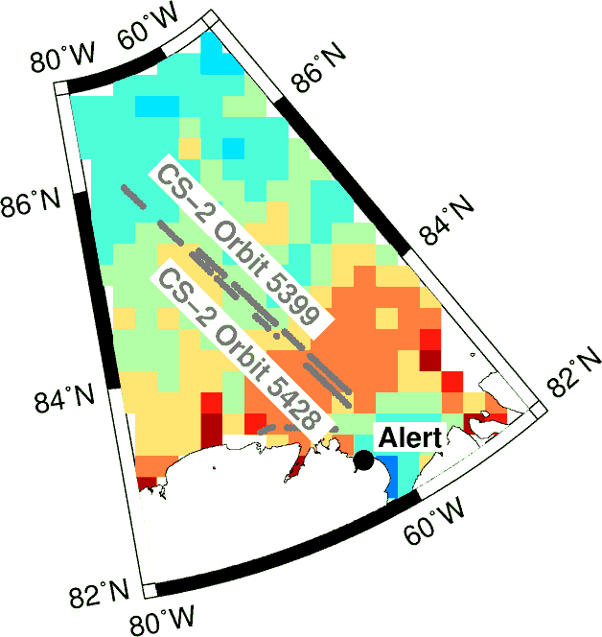
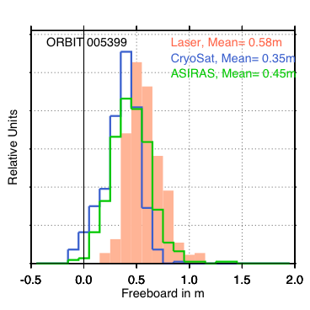
CryoSat freeboard compared to co-located
airborne data
Airborne (laser & radar) and CryoSat-2 freeboard
Coincident Data Acquisition (CryoVEx 2011)
Distribution of airborne radar and CryoSat-2 freeboard comparable
Difference (22 cm) to laser freeboard smaller than expected snow depth (even for dry & cold snow)

Slide 22
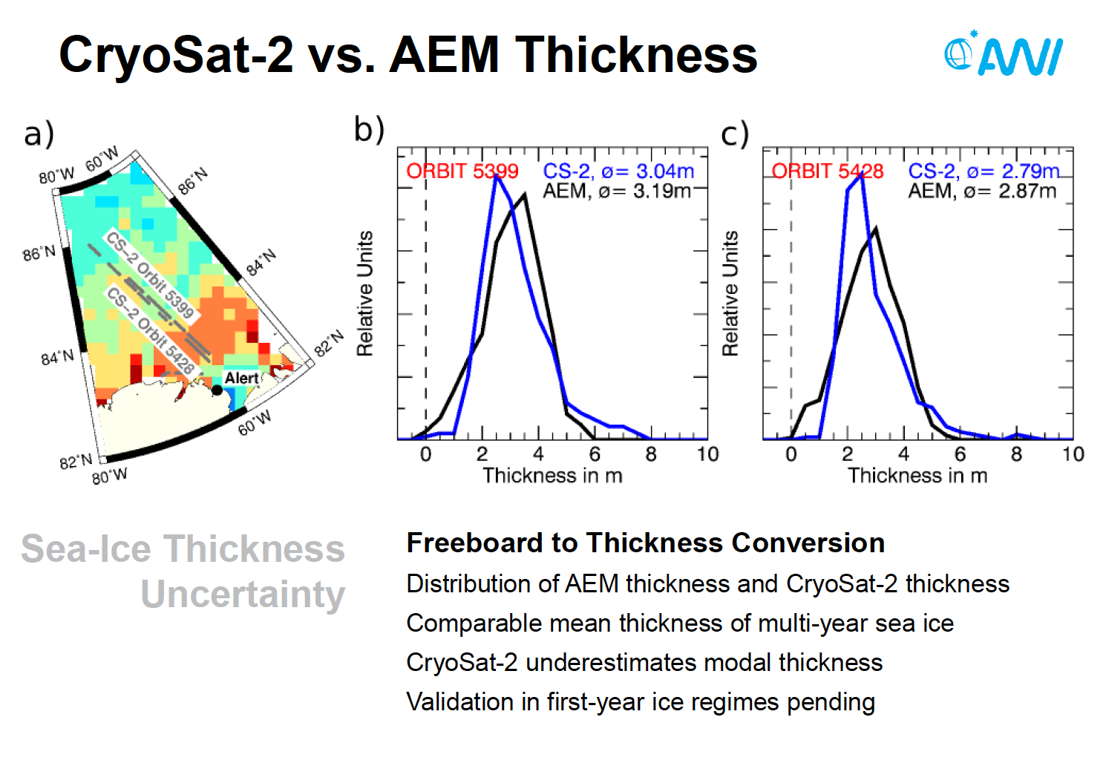

Slide 23
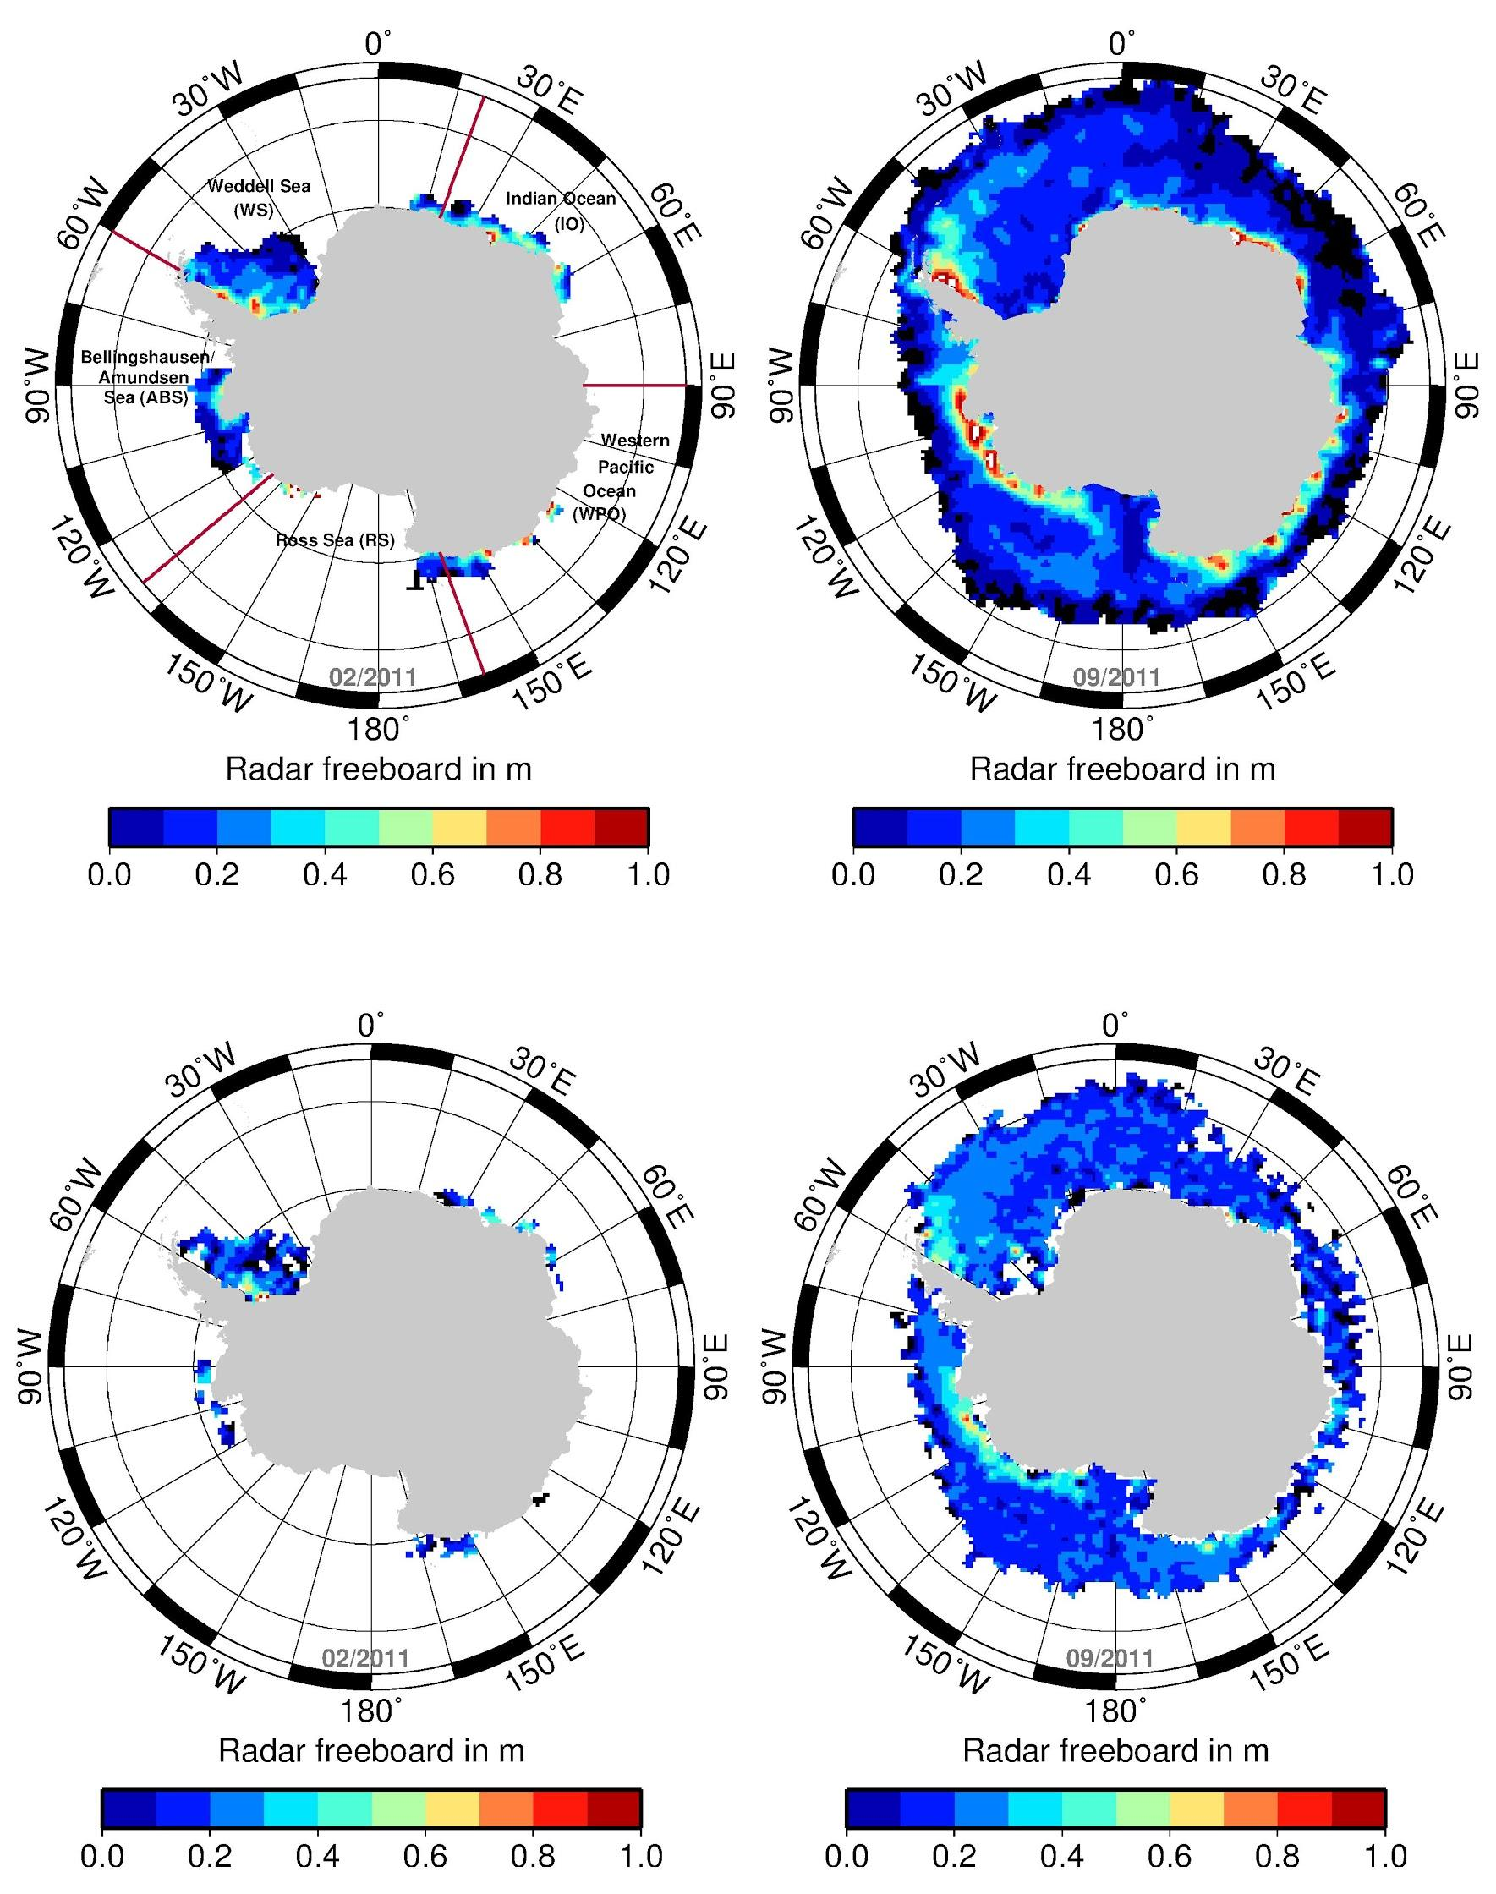
Freeboard distribution in Antarctica
Highest freeboard in regions with perennial sea ice in both data sets
Envisat freeboard is generally lower in those regions
Both products reveal also negative freeboard
Sea-ice extent in CryoSat-2 product is larger than in Envisat
Notes:
comparison between freeboard from CS (left) and Envisat (right) for summer and winter
In summer only few regions remain ice covered and hold ice with partly high freeboard
Those regions show also the highest fb during winter while the rest has considerably lower fb
Envisat tends to be lower in these regions
Also found: SIE different although same SIC product -> different filter processes in the algorithms but also different sensor characteristics -> might be that ENVISAT fails to see smaller floes in MIZ
For further comparisons, only grid cells occurring in both data sets are used

Slide 24
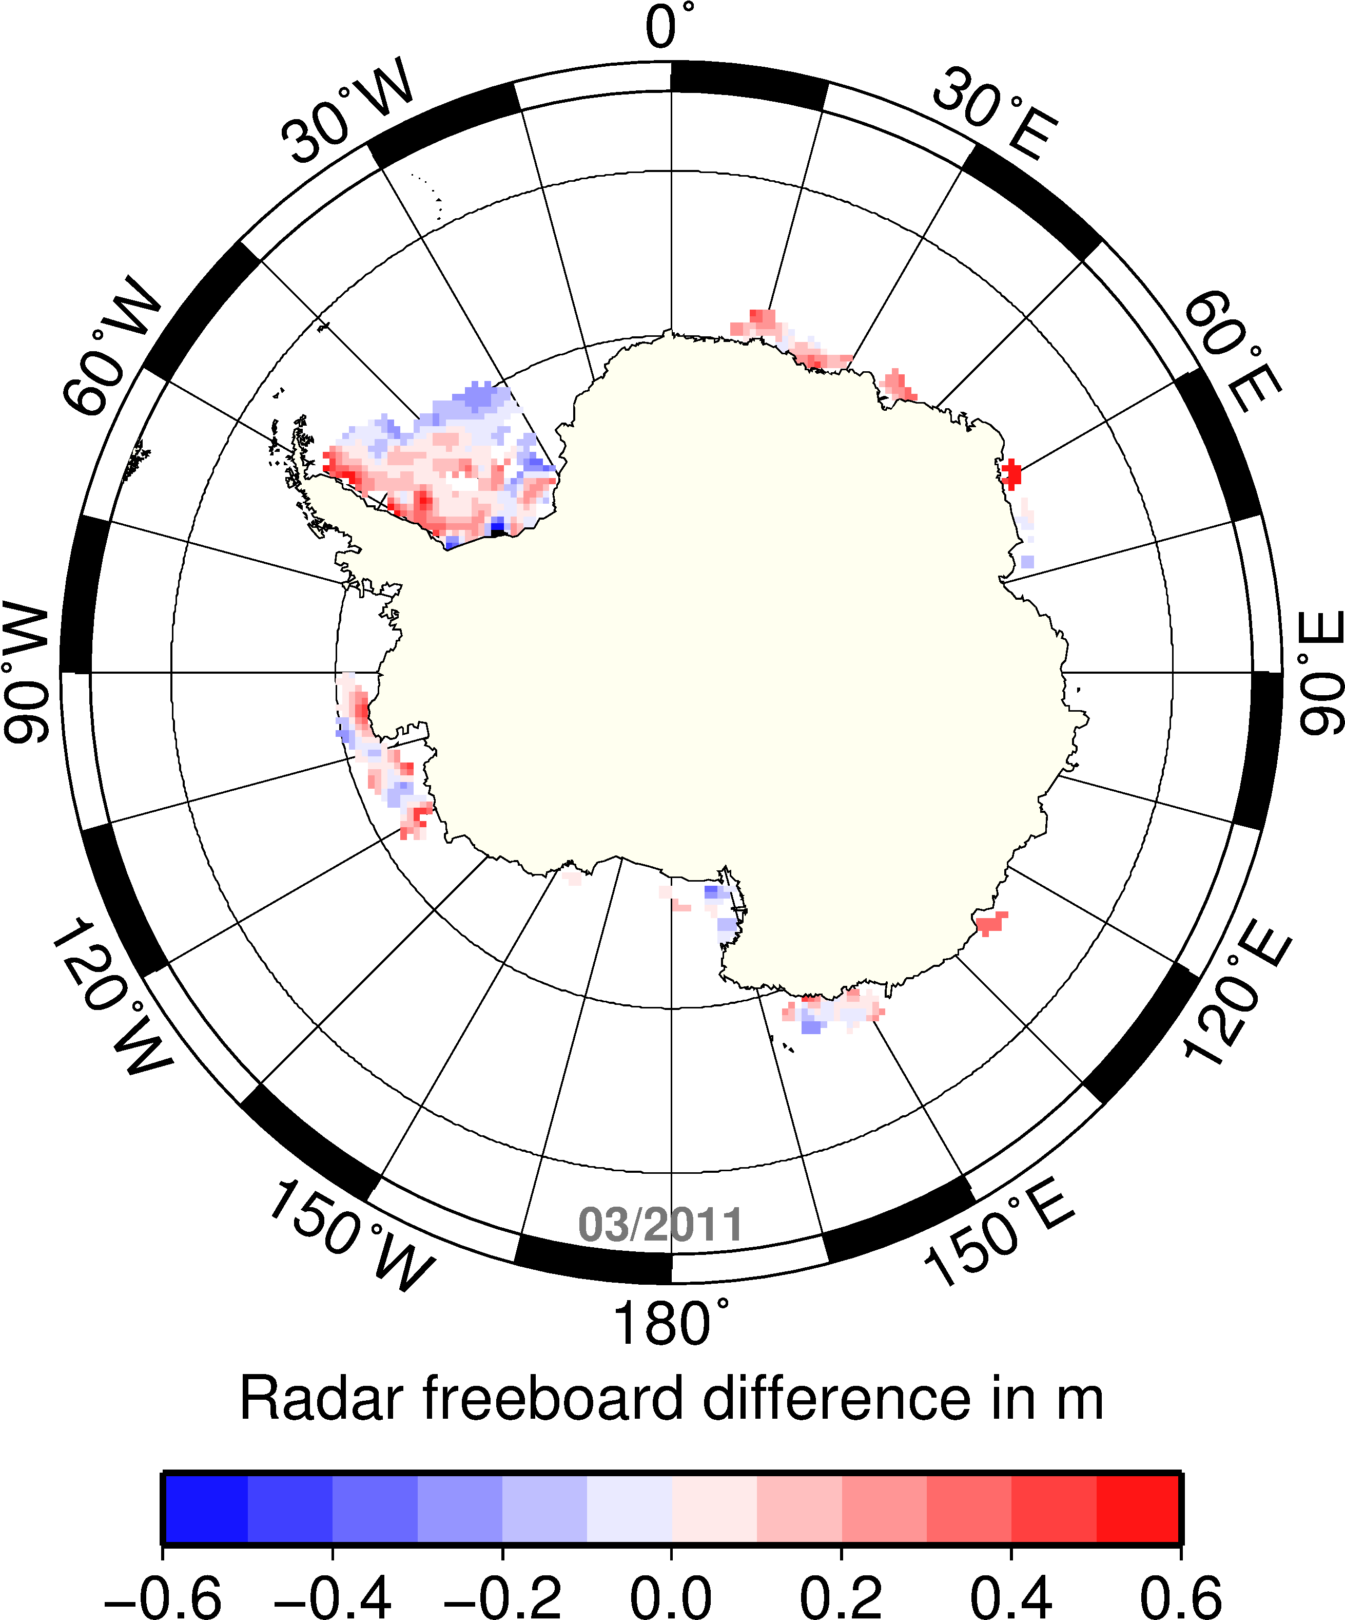
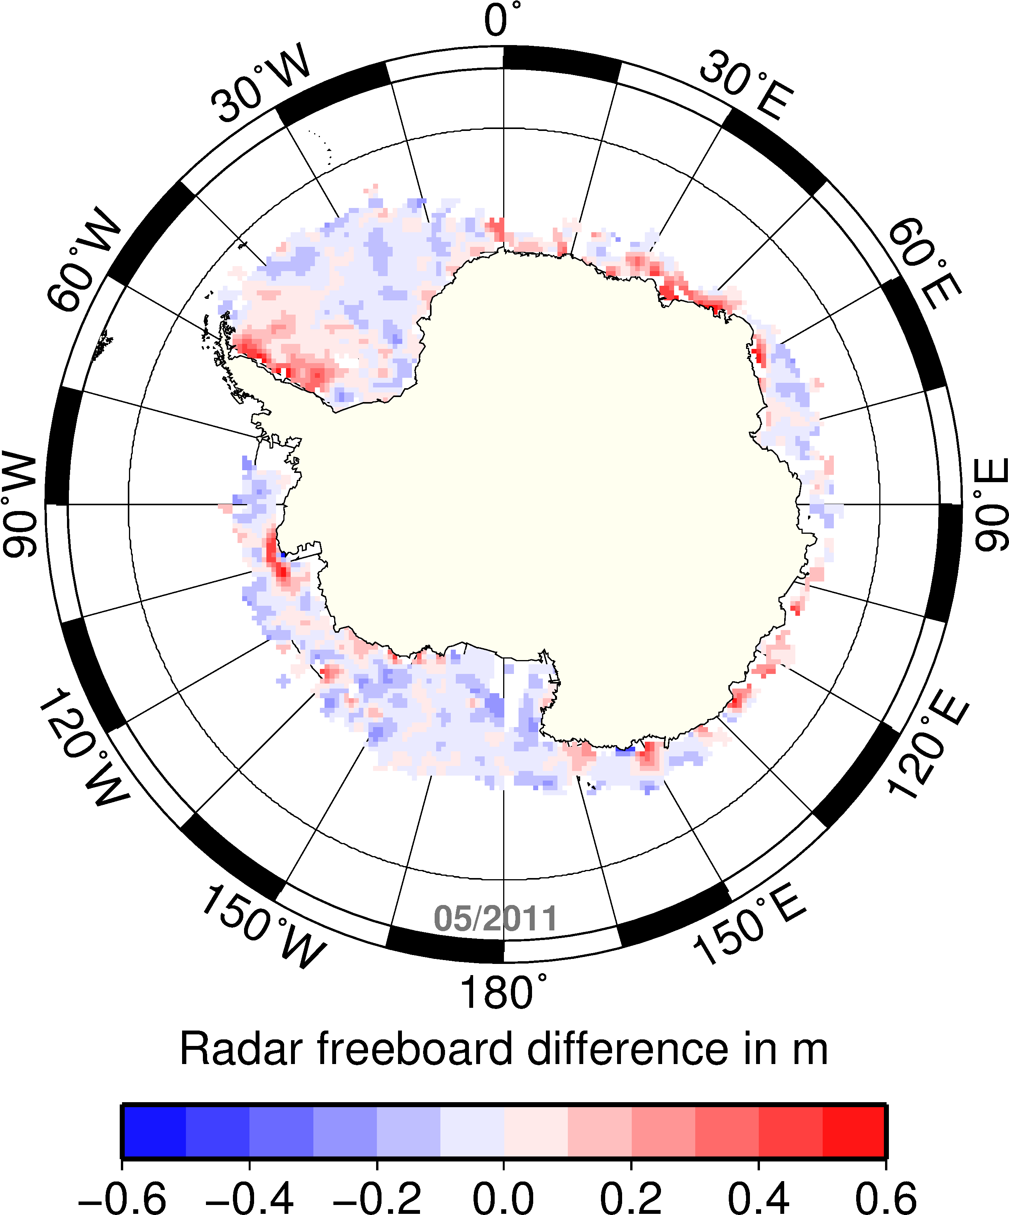
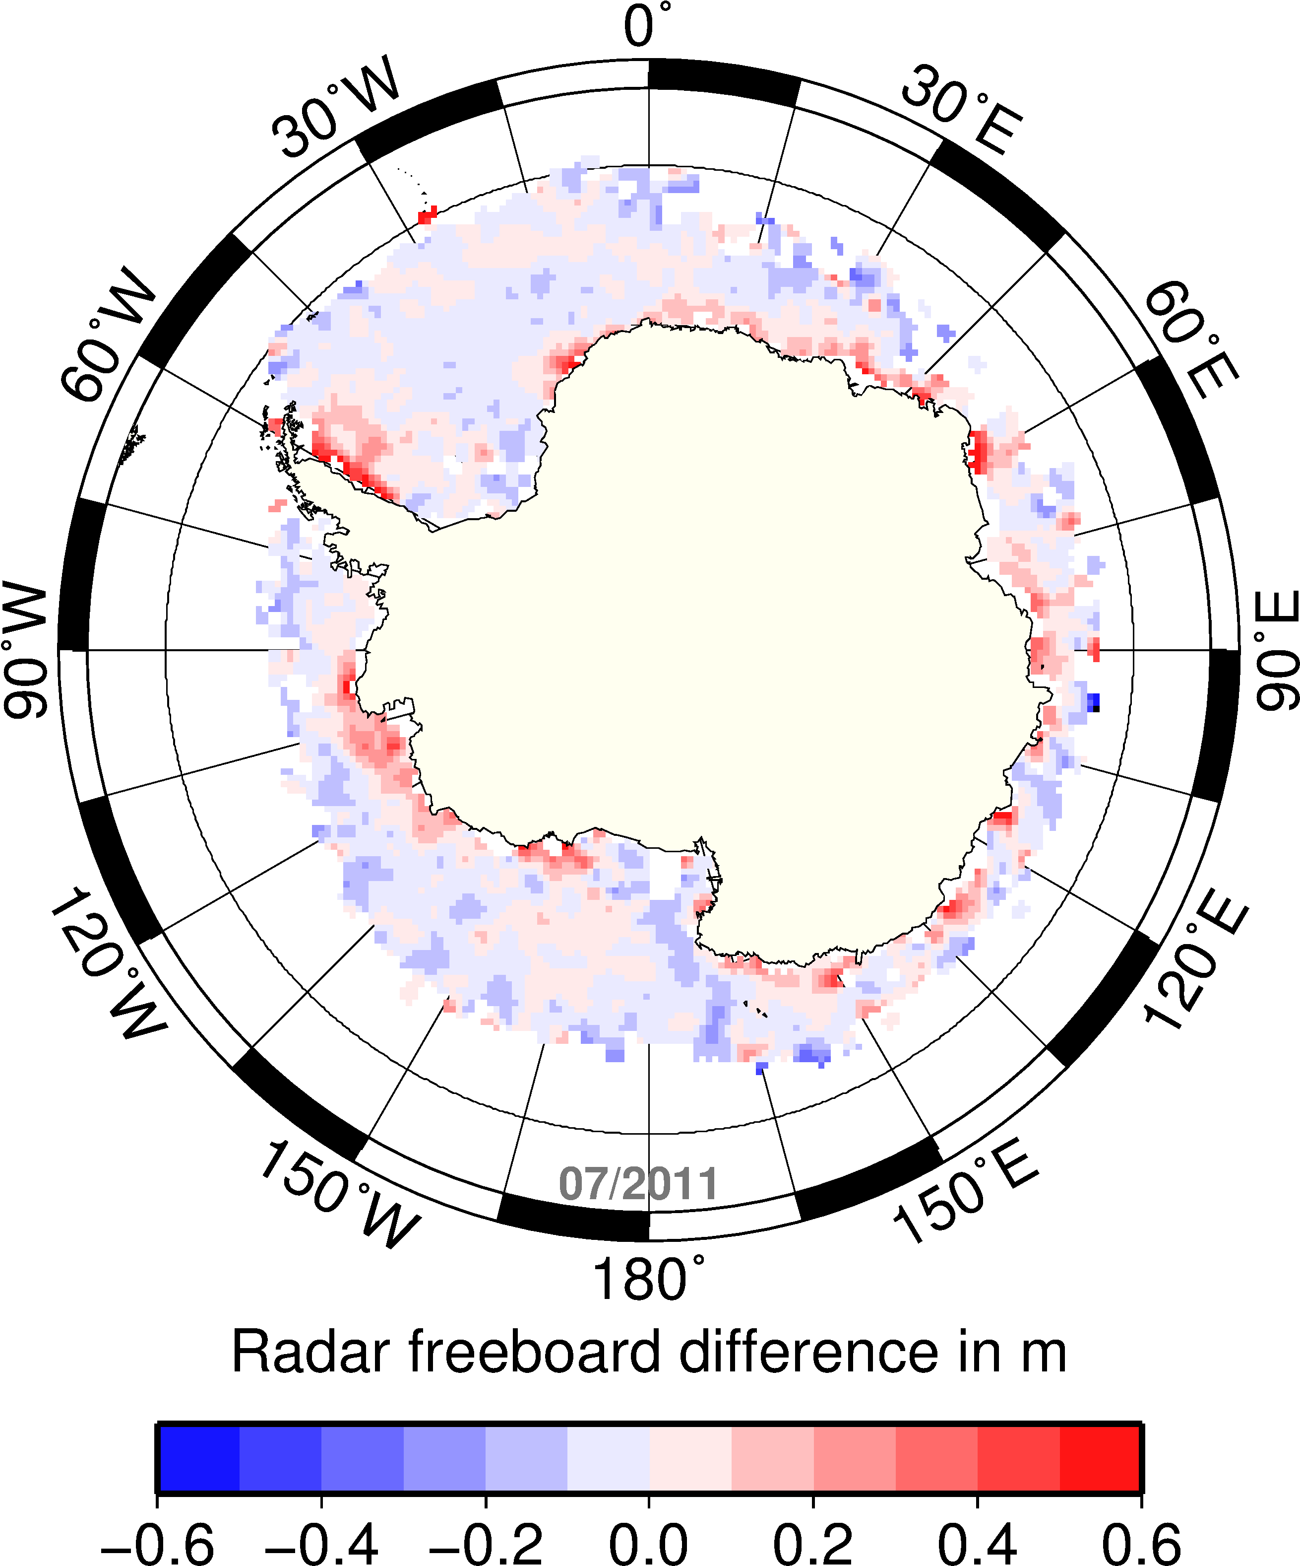

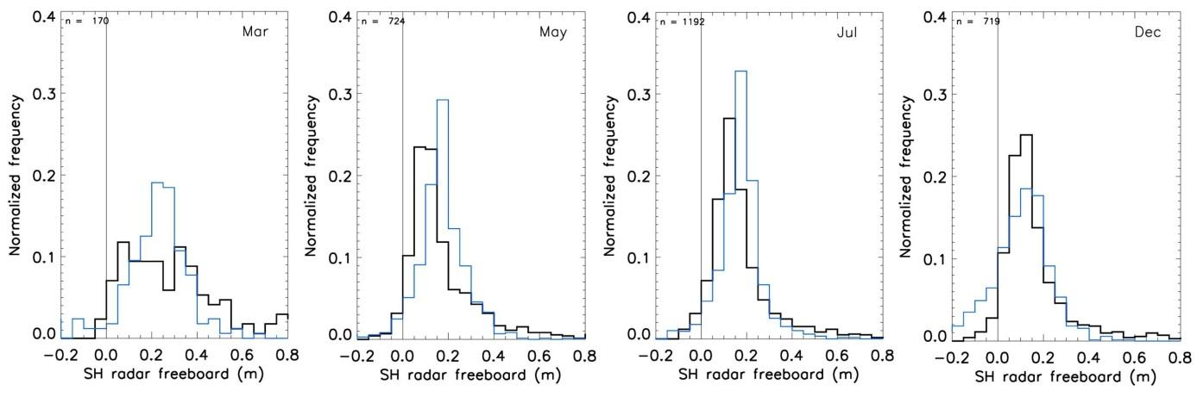
Freeboard differences (CS2-RA)
Red: CS2 is larger
March
May
July
Dec
Similar distribution over growth season
Envisat modal freeboard slightly shifted to higher values but less strong represented at the thick end of the distribution
More negative freeboard within the pack-ice zone in Envisat data over summer
Envisat
CryoSat-2
Notes:
The general Antarctic-wide distribution looks quite similar over winter months, in fact, only fall has strong differences
Envisat shows the shift of modal fb to higher values
Thick end of distribution is less strong represented (discussed before)
Thin end as well

Slide 25
Next steps
Process all of Envisat RA-2 data with DTU13 into freeboards
Process the Envisat RA-2 freeboards into thickness as soon as MYI/FYI product is ready with improved snow climtology
Develop the ERS-2 processor and process REAPER
CryoSat-2 processor work in good progress.
Continue validation with extended Round Robin data
Merge ENVISAT, ERS and CryoSat processors into one – prepare for Sentinel-3

