Slide 1









Cloud_cci
R. Hollmann¹, C. Poulsen², U. Willen³, C. Stubenrauch⁴, M. Stengel¹, and the Cloud CCI consortium
¹Deutscher Wetterdienst, ² RAL Space, ³SMHI, ⁴LMD

Slide 2
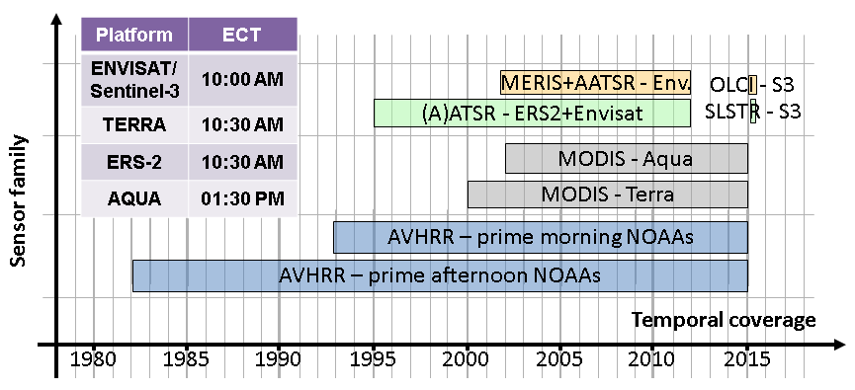
Cloud_cci: Available data phase 2
Two multi-decadal global data sets for the GCOS cloud property ECVs including uncertainty estimates.
  multi-decadal multi-instrument product from (A)ATSR – AVHRR – MODIS (1982-2012 (2014)
  decadal product that uses complimentary information from AATSR and MERIS on-board of ENVISAT (2002-2012)
Processing has started, first data available May 2016

Slide 3
Cloud_cci: Available data FAME-C
  FAME-C
  decadal product that uses complimentary information from AATSR and MERIS on-board of ENVISAT (2002-2012)
  Daytime orbits
  Swath width ~ 500 km
  Pixels of ~1 km

Slide 4
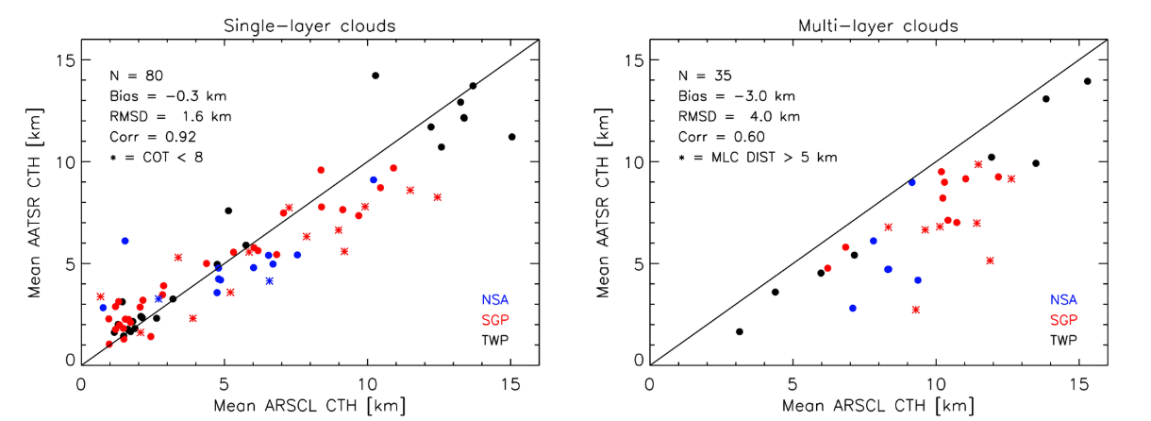
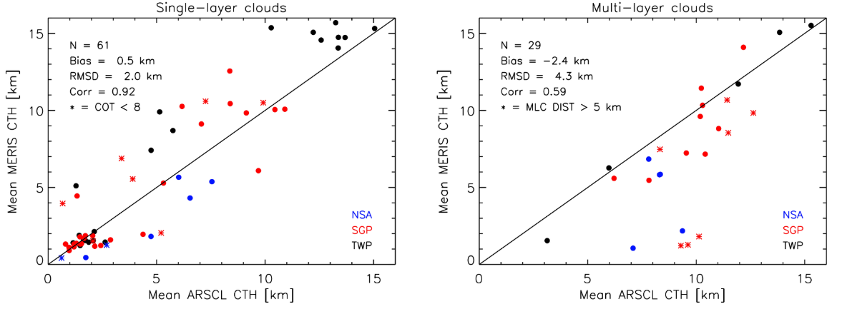
Evaluation: FAME-C
Cloud Top Heights
Comparison to ground-based radar and lidar observations:
At 3 ARM sites covering various cloudy regimes: NSA, SGP, TWP
Cloud boundary product ARSCL (Clothiaux et al., 2000)
On a level-2 basis, 2007-2009
Single- and multi-layer clouds
Main conclusions:
AATSR better for higher clouds
MERIS better for lower clouds
Better results for single-layer clouds than multi-layer clouds

Slide 5
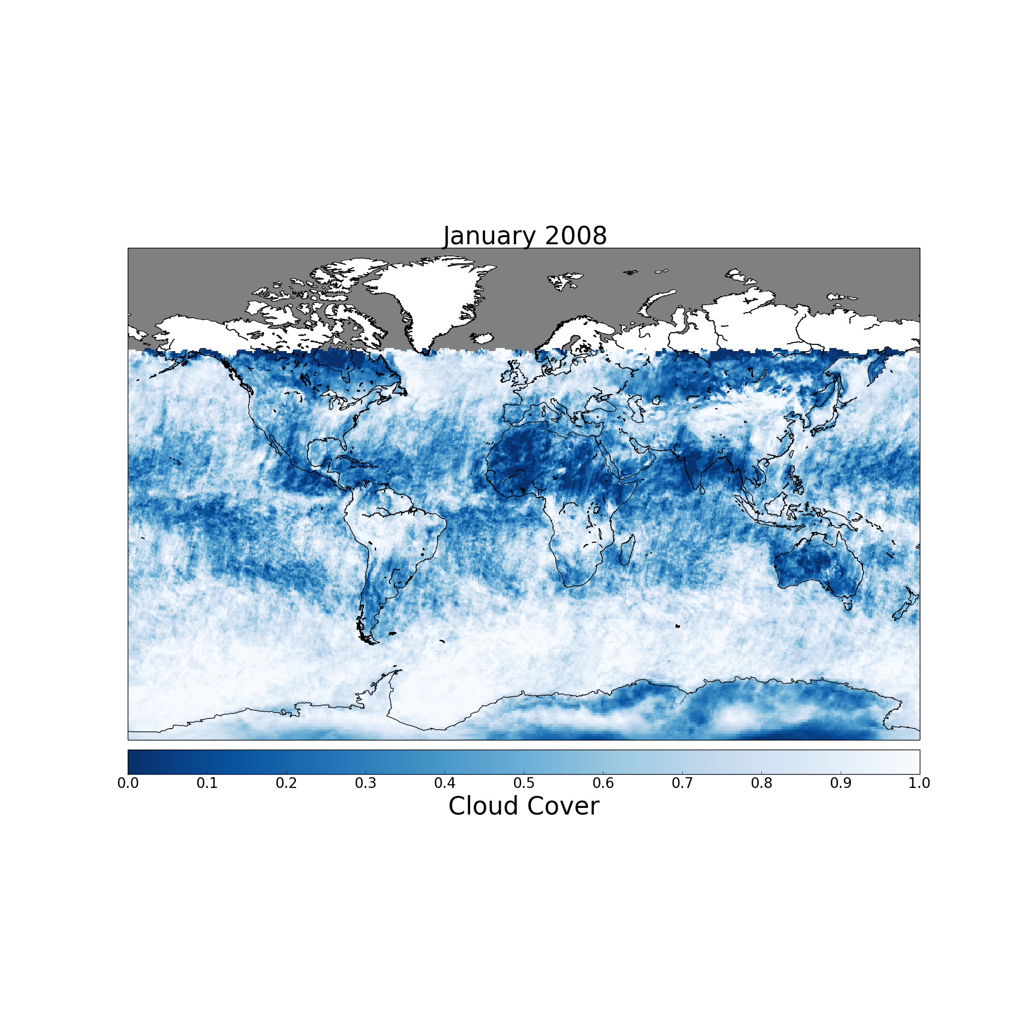
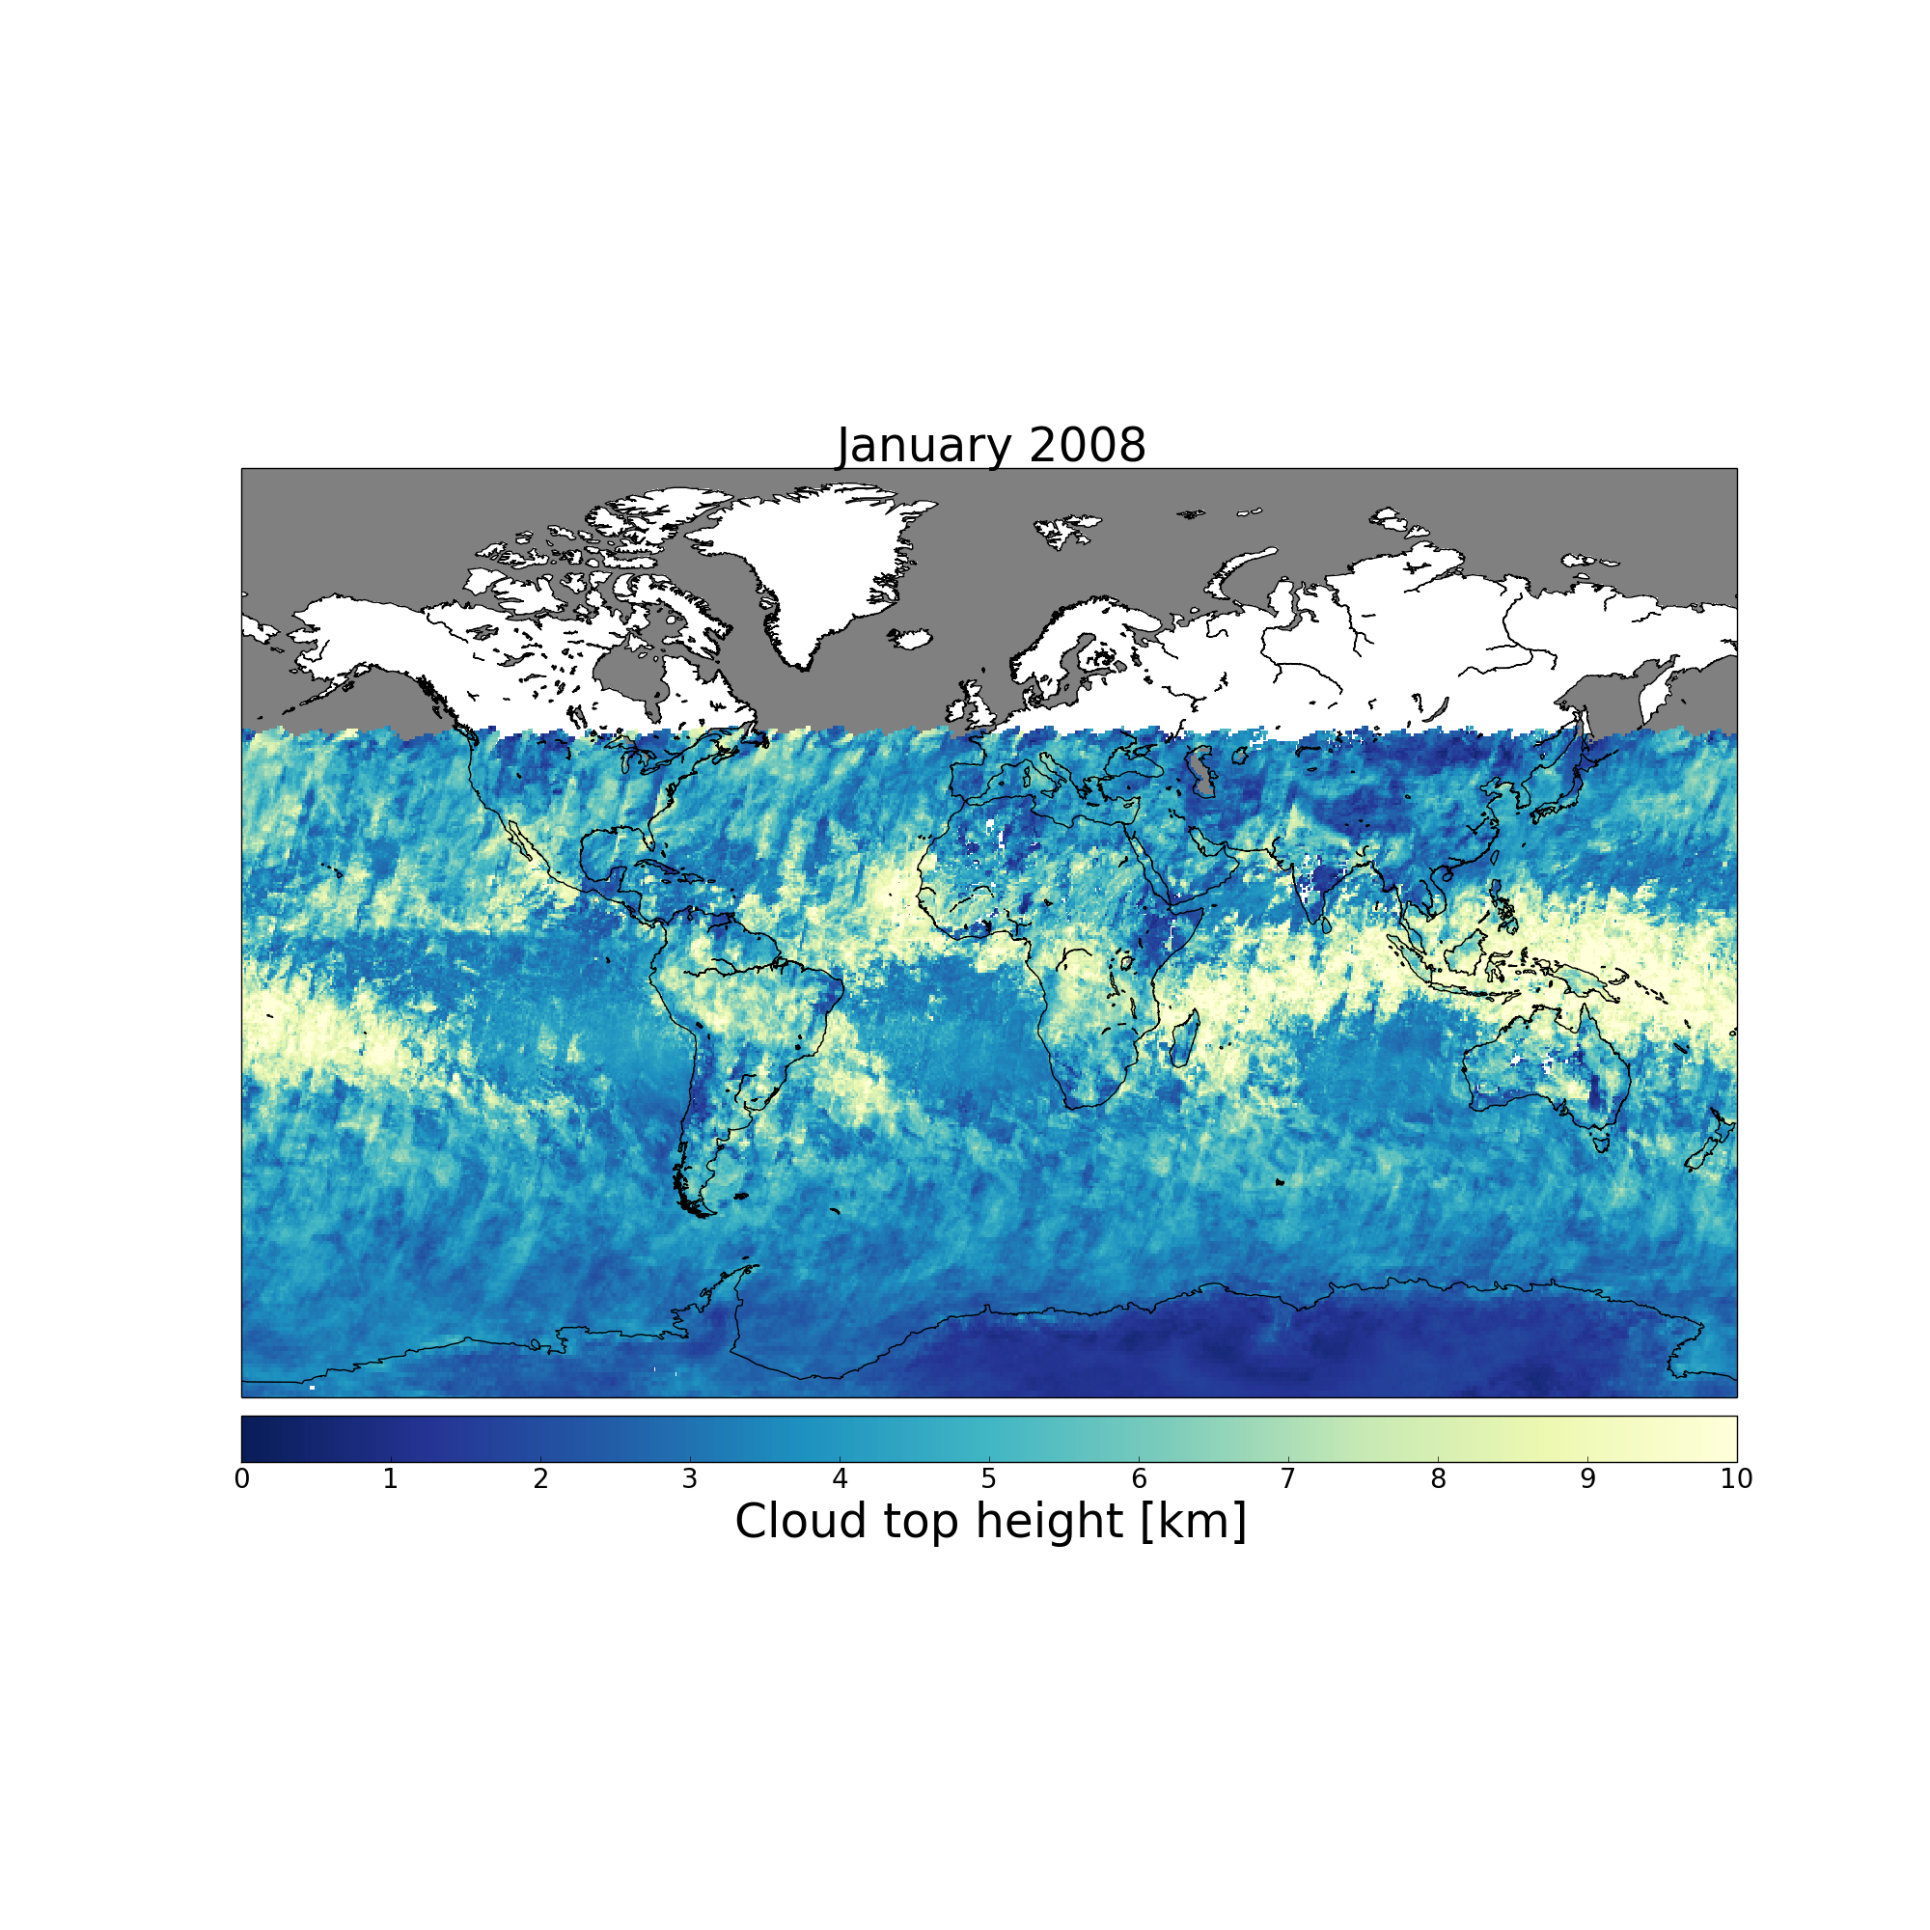
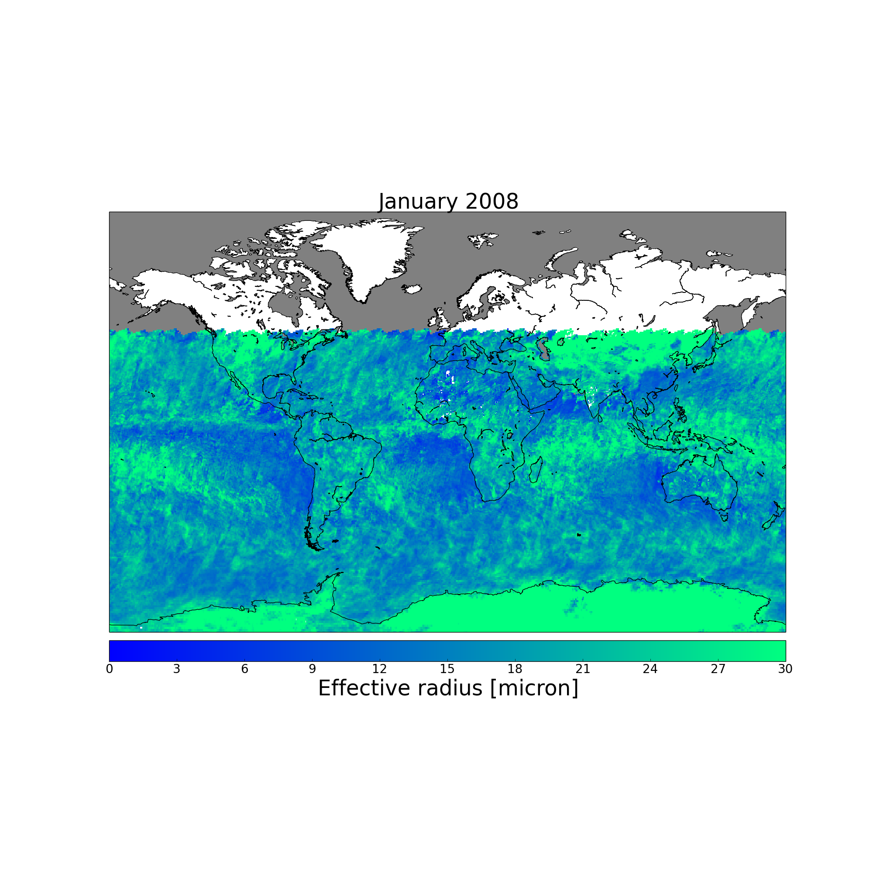
Level-3 products: FAME-C
examples
Level-3 products for:
Cloud cover
Cloud top height/temperature/pressure
Ice water path, liquid water path
Cloud phase
Effective radius
Optical thickness
Cloud Albedo VIS and NIR

Slide 6
Cloud_cci: Available data CC4CL
  FAME-C
  decadal product that uses complimentary information from AATSR and MERIS on-board of ENVISAT (2002-2012)
  CC4CL
  multi-decadal multi-instrument product from (A)ATSR – AVHRR – MODIS (1982-2012 (2014)

Slide 7
Cloud_cci: CC4CL OE Framework
L1c AVHRR, MODIS, A(A)TSR + auxiliary data
Pre-processing
Retrieved products
Derived products
L2toL3
c_{f}
τ_{c}
h_{c}
L3U
phase_{c}
r_{eff}
T_{c}
L3C
p_{c}
LWP, IWP
L3S
T_{surf}
ρ_{DHR}^{1,2}
Community Optimal Estimation Cloud Retrieval for Climate = CC4CL

Slide 8
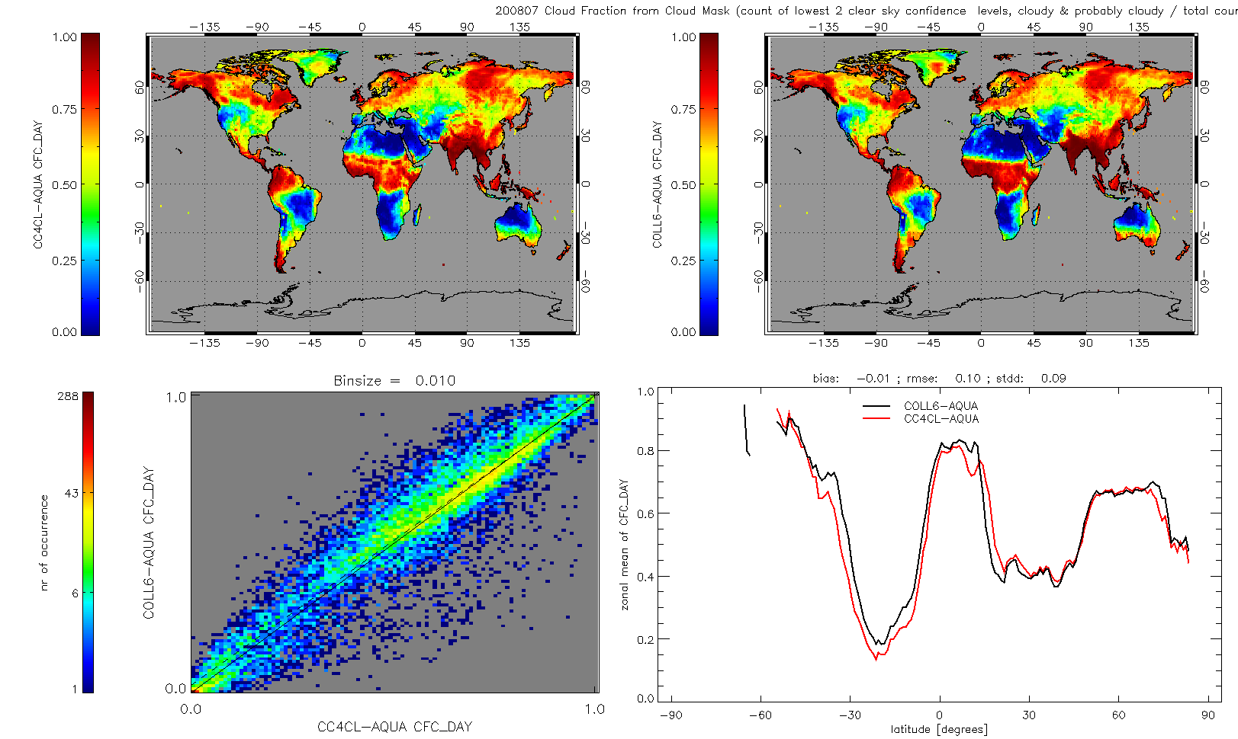
Cloud fraction day land (07/2008)

Slide 9
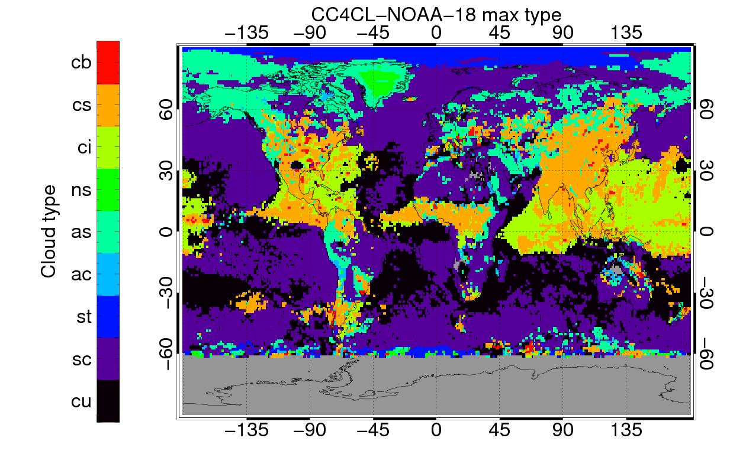
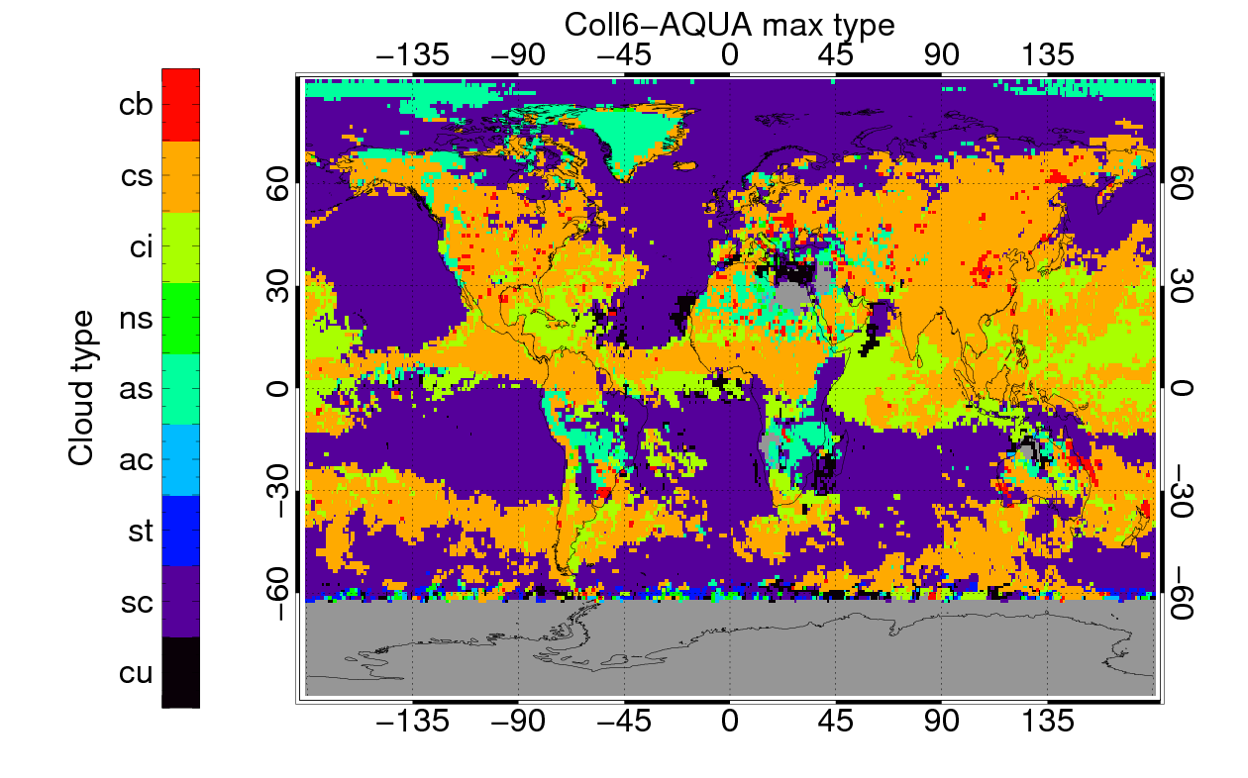
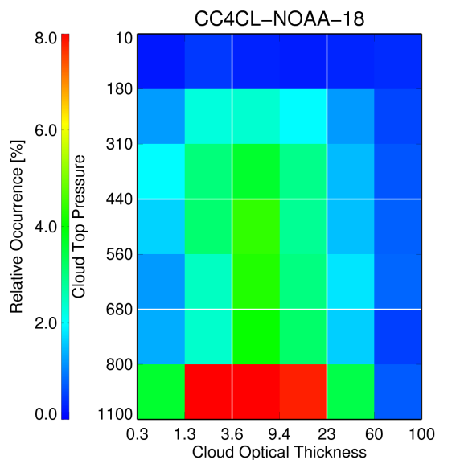
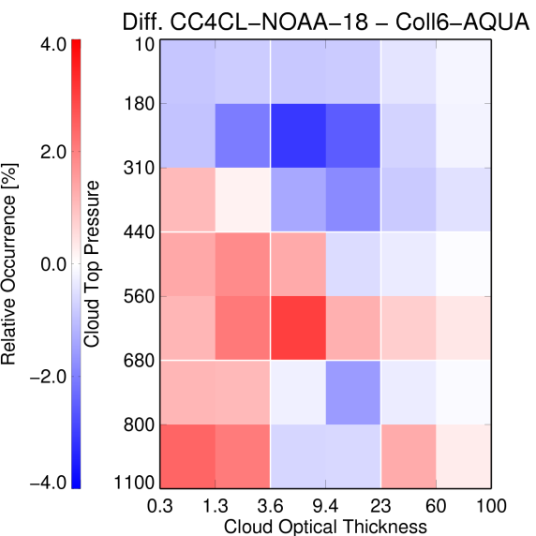
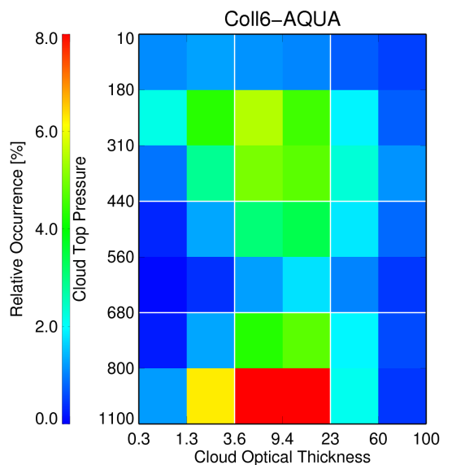
Joint Cloud Property Histograms for July 2008
ci
cs
cb
ac
as
ns
cu
sc
st
Notes:
JCP histograms for daytime retrievals due to the fact that COT is derived using VIS channels! Left figures show the dominating cloud type per grid cell (0.5 grid) in january and june 2008 for AVHRR NOAA18; Right figures show the relative occurrence of the cloud types w.r.t. ISCCP COT-CTP classification.
Based on 2D histogram analysis: Im mittel haben wir signifikant weniger hohe Wolken (-17%). Vor allem weniger cirrus stratus (-10%) dann cirrus (-5%) und erst dann deep convectice (-2%). (das sah bei collection 5 noch anders aus , beide gemeinsam haben mehr cirrustratus)
;high clouds HIGH/all Ratio CC4CL-NOAA-18 : 27.89%
HIGH/all Ratio Coll6-AQUA : 44.93%
;cirrus CI/all Ratio CC4CL-NOAA-18 : 11.07%
CI/all Ratio Coll6-AQUA : 16.47%
; cirrus-stratus CS/all Ratio CC4CL-NOAA-18 : 11.60%
CS/all Ratio Coll6-AQUA : 21.49%
; deep convective clouds CB/all Ratio CC4CL-NOAA-18 : 5.22%
CB/all Ratio Coll6-AQUA : 6.96%
Wir haben dafür mehr mittelhohe wolken (+9%)
; middle high clouds MID/all Ratio CC4CL-NOAA-18 : 22.44%
MID/all Ratio Coll6-AQUA : 13.64%
Auch mehr niedrige (+8%)
; low clouds LOW/all Ratio CC4CL-NOAA-18 : 49.67%
LOW/all Ratio Coll6-AQUA : 41.44%

Slide 10
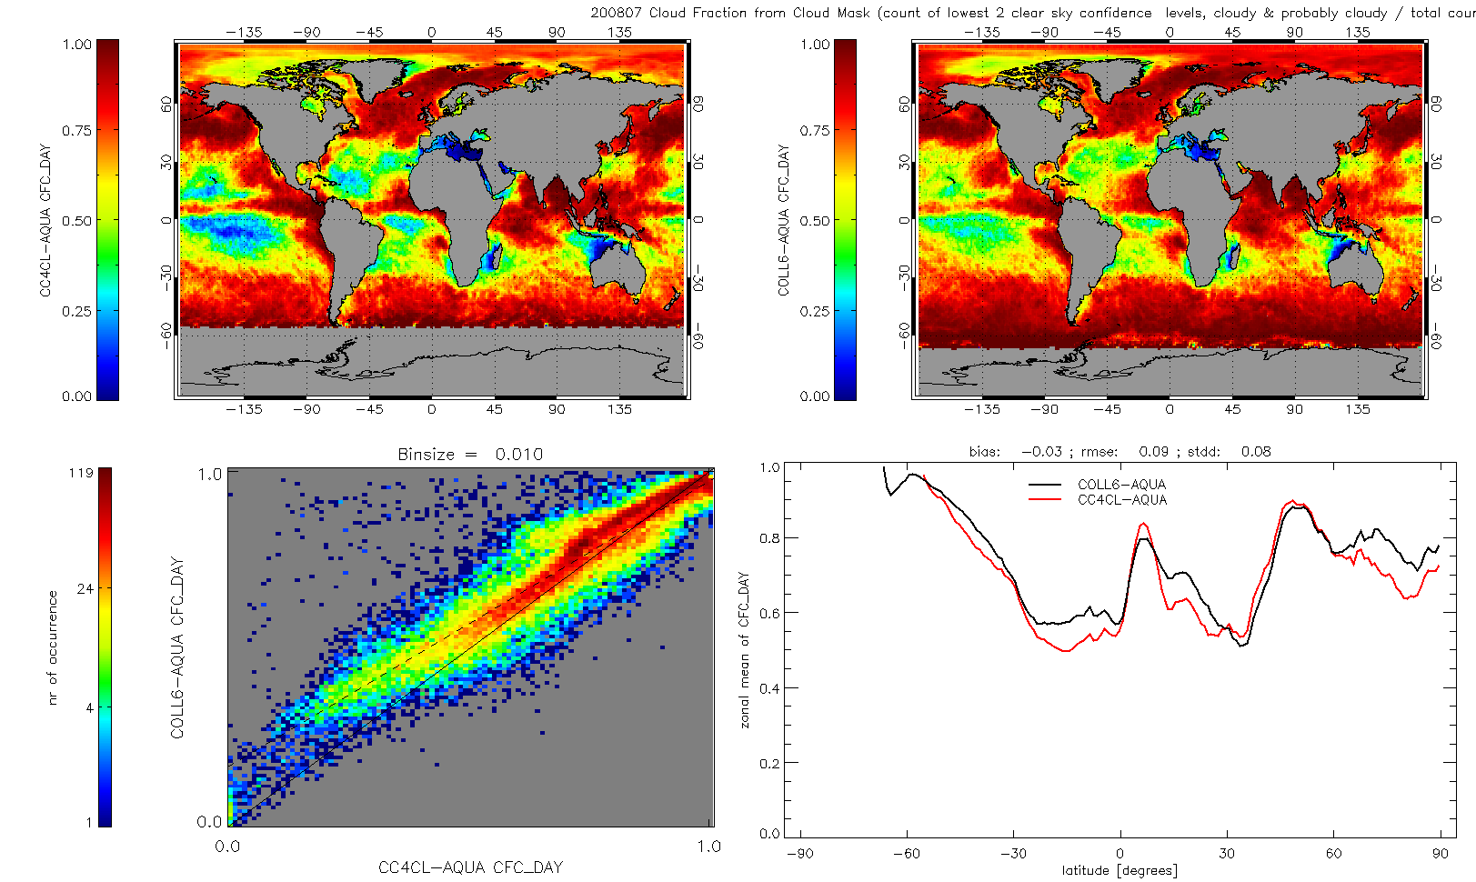
Cloud fraction day ocean (07/2008)

Slide 11
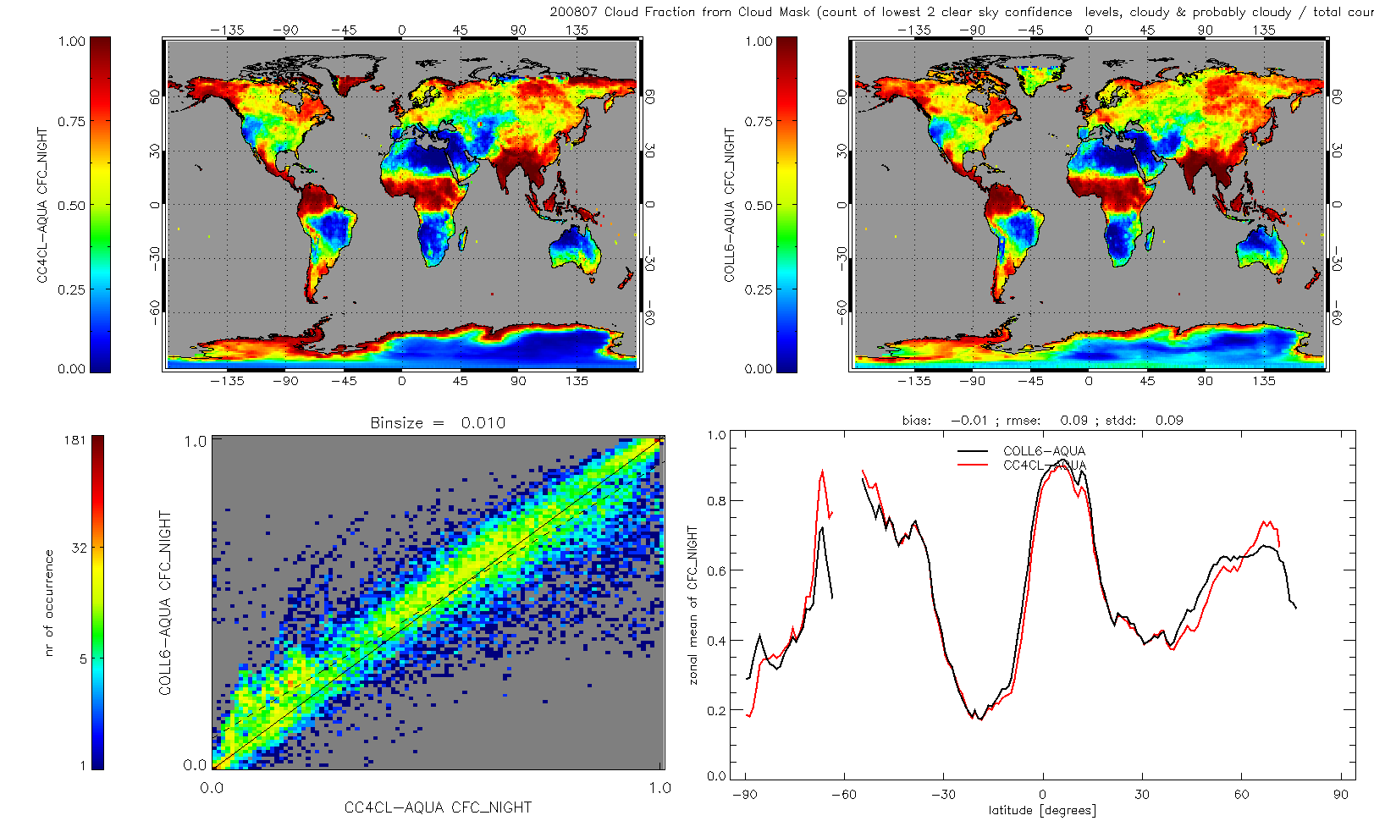
Cloud fraction night land (07/2008)

Slide 12
Cloud_cci: cross-cutting themes
cloud & Aerosol interactions
SST joint radiance Level 1 data set for AVHRR GAC data.
Clouds feedback sea-ice, SST?
Clouds - soil-moisture - precip

Slide 13



Thank you for your attention

