Slide 1
Assimilating ocean colour and other marine ECVs
David Ford
CCI-CMUG 6th Integration Meeting, 15th March 2016

Slide 2
Contents
Ocean colour assimilation
Ocean colour V1 and V2 compared
Integrated assessment of marine ECVs

Slide 3
Ocean colour assimilation

Slide 4
Experiments
Assimilate chlorophyll into FOAM-HadOCC
Global reanalysis for Sept 1997 – July 2012
Compare:
Control run
Assimilation of OC-CCI V1 chlorophyll
Assimilation of GlobColour chlorophyll
Assess:
Impact of assimilation on biology and carbon cycle
Differences between OC-CCI and GlobColour runs
Seasonal and inter-annual variability

Slide 5
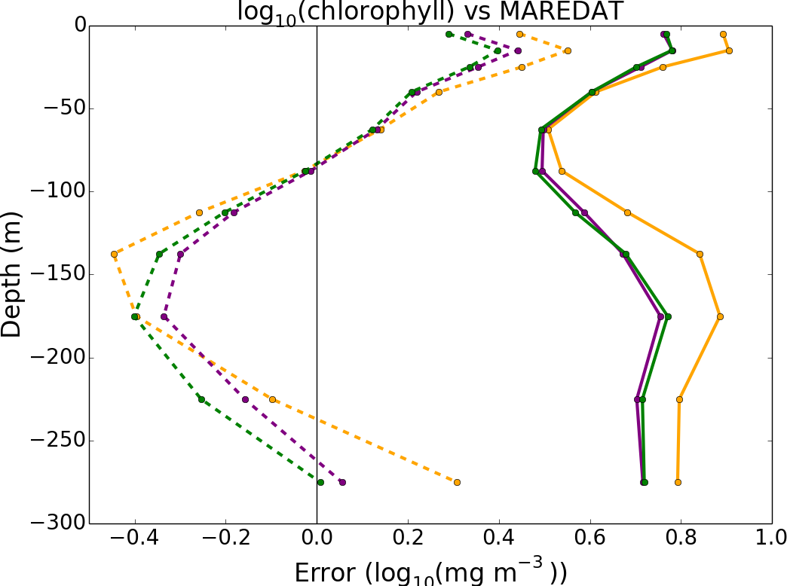
Error vs in situ chlorophyll profiles
Control
OC-CCI
GlobColour
RMSE
Bias

Slide 6
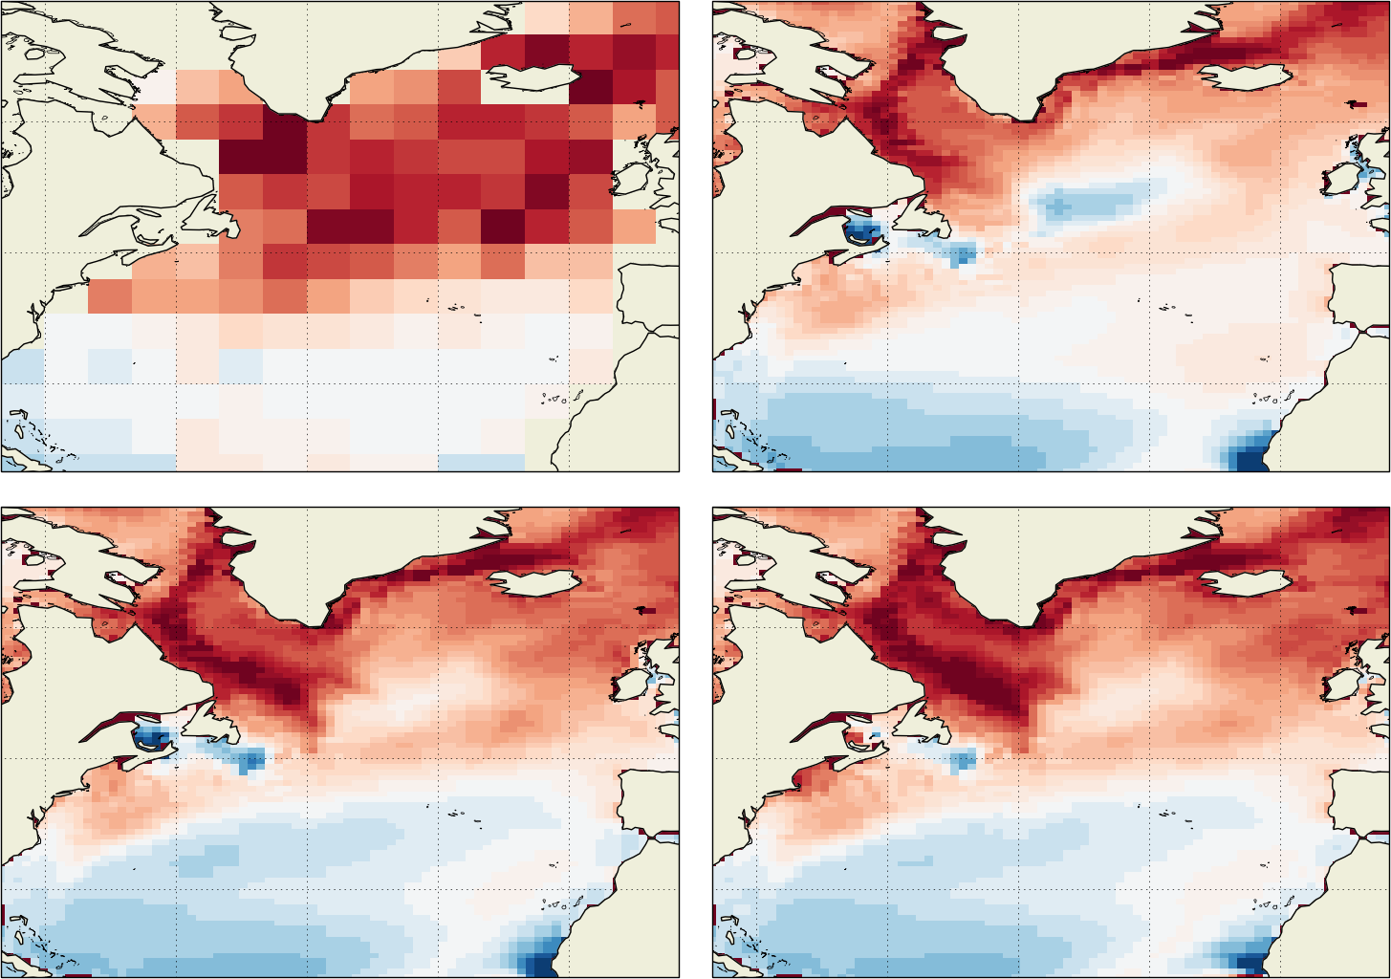
Air-sea CO₂ flux – June (1998-2012 mean) (version appeared in Gehlen et al., 2015, J. Oper. Oceanog.)
Climatology
Control run
4 molC/m²/yr
2
Into
ocean
0 ----------
Out of
ocean
-2
GlobColour assim
OC-CCI assim

Slide 7
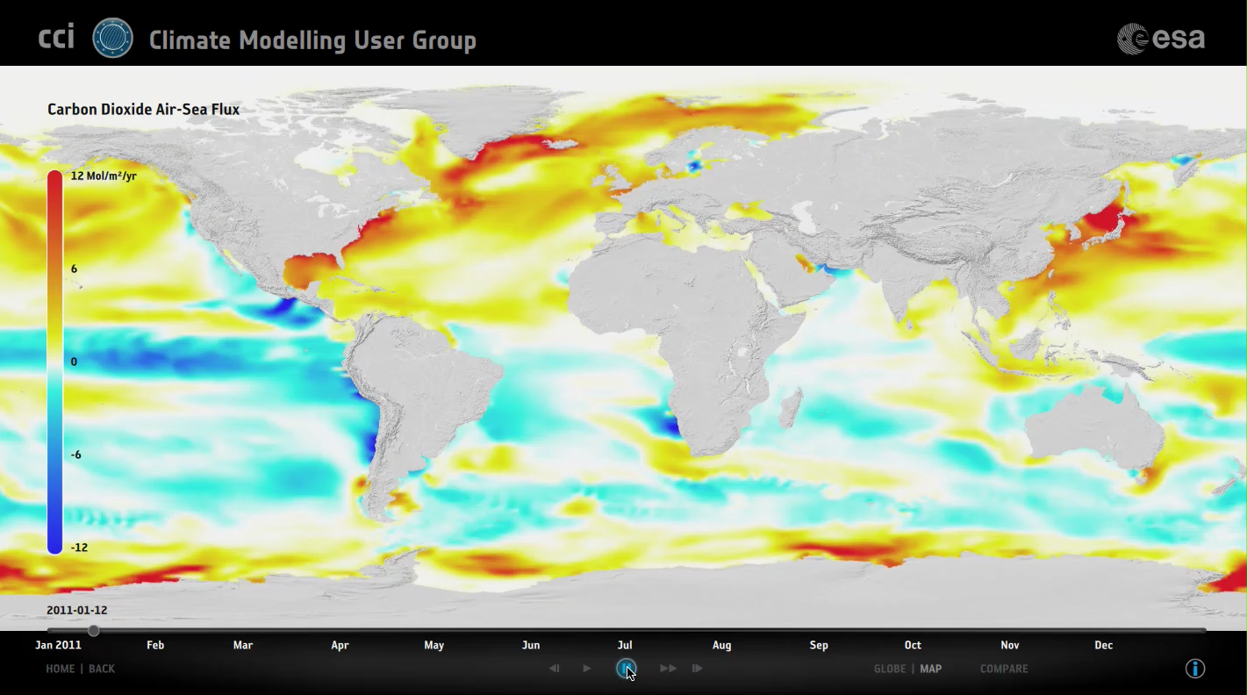
Planetary Visions animation

Slide 8
Summary
Assimilation improves model results
Reanalyses capture real-world variability
OC-CCI and GlobColour both fit for purpose
Some improved coverage and stability with OC-CCI
Paper to be submitted shortly

Slide 9
Ocean colour V1 and V2 compared

Slide 10
V2 products
Product user guide improved, especially regarding uncertainties
Change of variable names (for the better), but otherwise easy to start using
V1 metadata error corrected, no new errors found
Short test run to compare with V1 (January 2011, 1/4°)

Slide 11
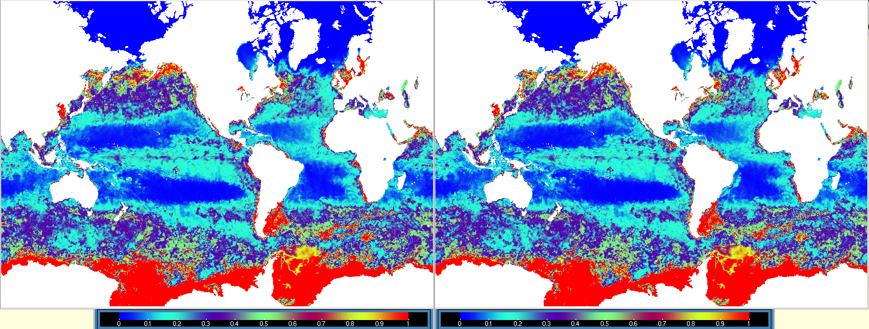
Surface chlorophyll January 31st 2011
Assimilating v1
Assimilating v2

Slide 12
Integrated assessment of marine ECVs

Slide 13
Outline of work
Assess cross-consistency of marine ECVs (ocean colour, SST, sea level, sea ice conc.)
Assimilation experiments with FOAM-HadOCC
Assess now using current product versions
OC: V2
SST: V1.1
SL: V1.1
SIC: OSI SAF
Repeat (in part) at end of Phase 2 using final Phase 2 releases

Slide 14
Experiments
Statistical assessment of observations
Model runs assimilating ECVs individually and in combination
1° : 1998-2013
¼ °: 2008-2011

Slide 15
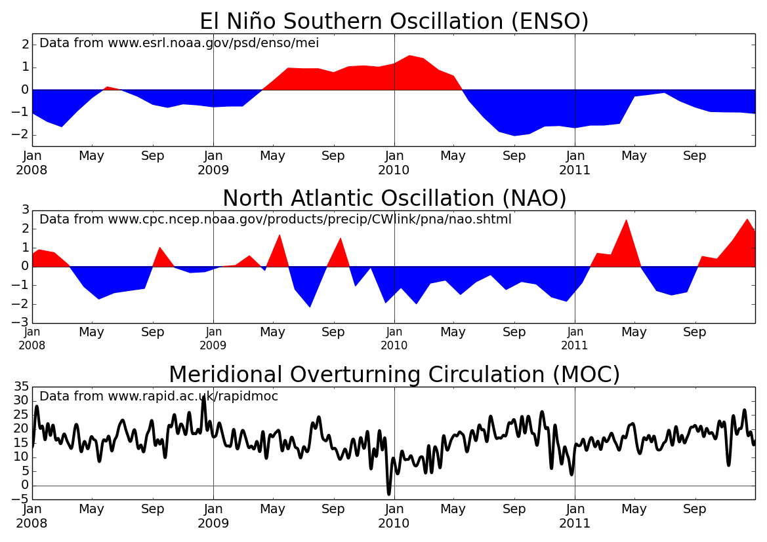

Slide 16
Experiments
Statistical assessment of observations
Model runs assimilating ECVs individually and in combination
1° : 1998-2013
¼ °: 2008-2011
Model runs currently in progress - results next time!

Slide 17
Things to assess
Frontal positions in different fields
Eddy structures in different fields
Sea ice edge in different fields
Seasonal progression of different fields
Inter-annual variability in different fields and relationship to ENSO, NAO, MOC etc
Error in assimilated and non-assimilated fields
Impact of SST assimilation on OC increments
Response of carbon cycle to assimilation
Uncertainty of observations
Anything else that might be of interest?

Slide 18
Questions and answers

