Slide 1
WP3.7 Lake effects on local temperature
Kick-off meeting, ECSAT, Harwell, UK, 1 October 2018

Slide 2
Objectives
Aim of the experiment:
To assess the influence of lakes on the temperatures of surrounding land areas.
Scientific questions addressed:
What effect does lake temperature (or other parameters) have on the surrounding Land Surface Temperature (LST)?
Can estimates of LST and its uncertainties be used to evaluate the importance of representing lakes in regional climate model (RCM) simulations?
What are the interactions between lakes and the surrounding land areas?
Notes:
Task 3.7: The effect of lakes on local temperatures
Responsible partners: Met Office [2/3? PM]

Slide 3
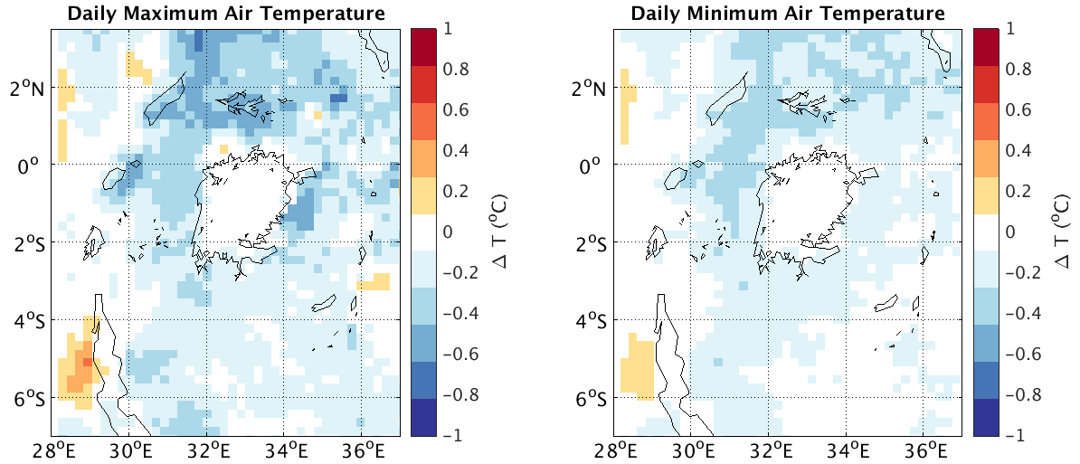
Experiments, analysis and relevance
Run RCM simulations with and without lakes using satellite-era surface water temperature observations for the former for European and African lakes
Assess consistency of observed v. simulated mean, variability, t-series using LST observations
Assess value of lakes in RCMs and LST as reference
Complements LST work in WPs 3.1/4/5. Relevant to CORDEX.
Effect of daily versus monthly resolved lake surface temperatures in a regional modelling experiment around Lake Victoria*
Annual average of daily maximum (left) and minimum (right)
*Results from H2020 project EUSTACE

